Slide 1
Chapter 1: Data and Statistics
Statistics
Applications in Business and Economics
Data Sources
Descriptive Statistics
Statistical Inference
Statistical Analysis Using Microsoft Excel
Analytics
Big Data and Data Mining
Ethical Guidelines for Statistical Practice

Slide 2
What Is Statistics?
The term “statistics” can refer to numerical facts such as averages, medians, percentages, and maximums that help us understand a variety of business and economic situations.
Statistics can also refer to the art and science of collecting, analyzing, presenting, and interpreting data.

Slide 3
Applications in Business and Economics (1 of 2)
Accounting
Public accounting firms use statistical sampling procedures when conducting audits for their clients.
Economics
Economists use statistical information in making forecasts about the future of the economy or some aspect of it.
Finance
Financial advisors use price-earnings ratios and dividend yields to guide their investment advice.

Slide 4
Applications in Business and Economics (2 of 2)
Marketing
Electronic point-of-sale scanners at retail checkout counters are used to collect data for a variety of marketing research applications.
Production
A variety of statistical quality control charts are used to monitor the output of a production process.
Information Systems
A variety of statistical information helps administrators assess the performance of computer networks.

Slide 5
Data and Data Sets
Data are the facts and figures collected, analyzed, and summarized for presentation and interpretation.
All the data collected in a particular study are referred to as the data set for the study.

Slide 6
Elements, Variables, and Observations
Elements are the entities on which data are collected.
A variable is a characteristic of interest for the elements.
The set of measurements obtained for a particular element is called an observation.
A data set with n elements contains n observations.
The total number of data values in a complete data set is the number of elements multiplied by the number of variables.

Slide 7
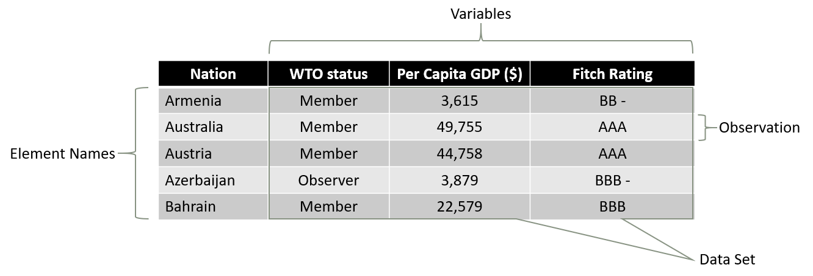
Data, Data Sets, Elements, Variables, and Observations

Slide 8
Scales of Measurement (1 of 10)
Scales of measurement include
Nominal
Ordinal
Interval
Ratio
The scale determines the amount of information contained in the data.
The scale indicates the data summarization and statistical analyses that are most appropriate.

Slide 9
Scales of Measurement (2 of 10)
Nominal
Data are labels or names used to identify an attribute of the element.
A nonnumeric label or numeric code may be used.

Slide 10
Scales of Measurement (3 of 10)
Nominal
Example:
The WTO status category for the nations in the previous example is classified using nonnumerical labels—“member” and “observer.”
Alternatively, a numeric code could be used for the WTO status variable by letting 1 denote a member nation and 2 denote an observer nation.

Slide 11
Scales of Measurement (4 of 10)
Ordinal
The data have the properties of nominal data and the order or rank of the data is meaningful.
A nonnumeric label or numeric code may be used.

Slide 12
Scales of Measurement (5 of 10)
Ordinal
Example:
The nonnumeric rating labels from AAA to F used for Fitch rating. These can be rank ordered from best credit rating AAA to poorest credit rating F.
Numerical code can also be used—Class rank of a student in school.

Slide 13
Scales of Measurement (6 of 10)
Interval
The data have the properties of ordinal data, and the interval between observations is expressed in terms of a fixed unit of measure.
Interval data are always numeric.

Slide 14
Scales of Measurement (7 of 10)
Interval
Example:
Melissa has a SAT score of 1985, while Kevin has a SAT score of 1880. Melissa scored 105 points more than Kevin.

Slide 15
Scales of Measurement (8 of 10)
Ratio
The data have all the properties of interval data, and the ratio of two values is meaningful.
Variables such as distance, height, weight, and time use the ratio scale.
This scale must contain a zero value that indicates that nothing exists for the variable at the zero point.

Slide 16
Scales of Measurement (9 of 10)
Ratio
Example:
Melissa’s college record shows 36 credit hours earned, while Kevin’s record shows 72 credit hours earned. Kevin has twice as many credit hours earned as Melissa.

Slide 17
Categorical and Quantitative Data
Data can be further classified as being categorical or quantitative.
The statistical analysis that is appropriate depends on whether the data for the variable is categorical or quantitative.
In general, there are more alternatives for statistical analysis when the data are quantitative.

Slide 18
Categorical Data
Labels or names used to identify an attribute of each element
Often referred to as qualitative data
Use either the nominal or ordinal scale of measurement
Can be either numeric or nonnumeric
Appropriate statistical analysis is rather limited

Slide 19
Quantitative Data
Quantitative data indicate how many or how much:
discrete, if measuring how many
continuous, if measuring how much
Quantitative data are always numeric.
Ordinary arithmetic operations are meaningful for quantitative data.

Slide 20
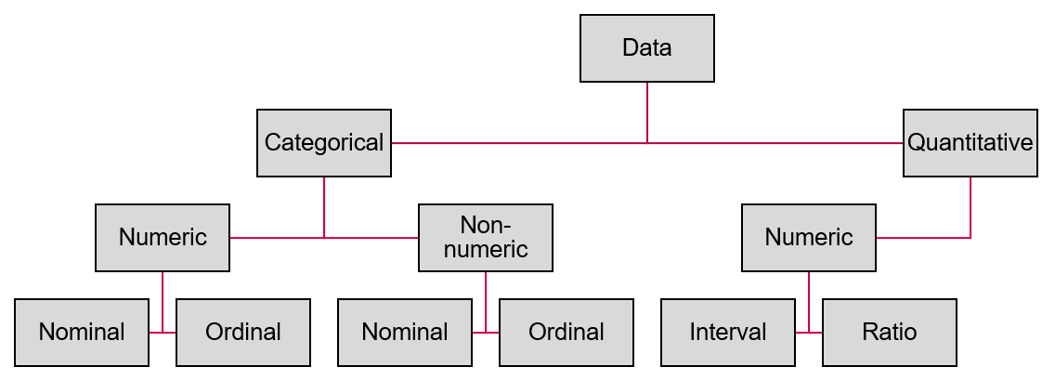
Scales of Measurement (10 of 10)

Slide 21
Cross-Sectional Data
Cross-sectional data are collected at the same or approximately the same point in time.
Example:
Data detailing different variables like status, Per capita GDP, Fitch rating for 60 different WTO nations at the same point in time.

Slide 22
Time Series Data (1 of 2)
Time series data are collected over several time periods.
Example:
U.S average price per gallon of conventional regular gasoline between 2012 and 2018
Graphs of time series help analysts understand:
what happened in the past,
identify any trends over time, and
project future values for the time series.

Slide 23
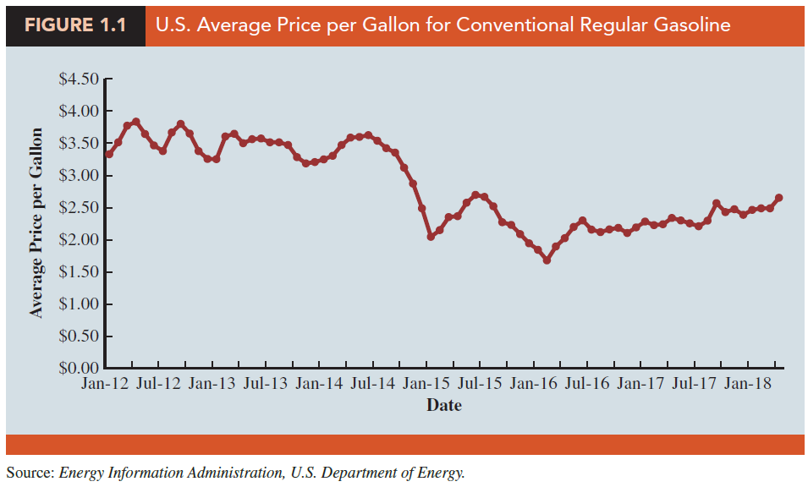
Time Series Data (2 of 2)
Graph of Time Series Data

Slide 24
Data Sources (1 of 5)
Existing Sources
Internal company records—almost any department
Business database services—Dow Jones & Co.
Government agencies—U.S. Department of Labor
Industry associations—U.S. Travel Association
Special-interest organizations—Graduate Management Admission Council (GMAT)
Internet—more and more firms

Slide 25
Data Sources (2 of 5)
Data Available from Internal Company Records
Record | Some of the Data Available
Employee records | Name, address, social security number
Production records | Part number, quantity produced, direct labor cost, material cost
Inventory records | Part number, quantity in stock, reorder level, economic order quantity
Sales records | Product number, sales volume, sales volume by region
Credit records | Customer name, credit limit, accounts receivable balance
Customer profile | Age, gender, income, household size

Slide 26
Data Sources (3 of 5)
Data Available from Selected Government Agencies
Government Agency | Some of the Data Available
Census Bureau | Population data, number of households, household income
Federal Reserve Board | Data on money supply, exchange rates, discount rates
Office of Mgmt. & Budget | Data on revenue, expenditures, debt of federal government
Department of Commerce | Data on business activity, value of shipments, profit by industry
Bureau of Labor Statistics | Customer spending, unemployment rate, hourly earnings, safety record
DATA.GOV | More than 150,000 data sets including agriculture, consumer education, health, and manufacturing data

Slide 27
Data Sources (4 of 5)
Statistical Studies—Observational
In observational studies, no attempt is made to control or influence the variables of interest.
A survey is a good example.
An example of an observational study is researchers observing a randomly selected group of customers that enter a Walmart Supercenter to collect data on variables such as time spent in the store, gender of the customer, and the amount spent.

Slide 28
Data Sources (5 of 5)
Statistical Studies—Experimental
In experimental studies, the variable of interest is first identified. Then one or more variables are identified and controlled so that data can be obtained about how they influence the variable of interest.
The largest experimental study ever conducted is believed to be the 1954 Public Health Service experiment for the Salk polio vaccine. Nearly two million U.S. children (grades 1 through 3) were selected.

Slide 29
Data Acquisition Considerations
Time Requirement
Searching for information can be time consuming.
Information may no longer be useful by the time it is available.
Cost of Acquisition
Organizations often charge for information even when it is not their primary business activity.
Data Errors
Using any data that happen to be available or were acquired with little care can lead to misleading information.

Slide 30
Descriptive Statistics
Most of the statistical information in newspapers, magazines, company reports, and other publications consist of data that are summarized and presented in a form that is easy to understand.
Such summaries of data, which may be tabular, graphical, or numerical, are referred to as descriptive statistics.

Slide 31
Example: Hudson Auto Repair (1 of 2)
The manager of Hudson Auto would like to have a better understanding of the cost of parts used in the engine tune-ups performed in her shop. She examines 50 customer invoices for tune-ups. The costs of parts, rounded to the nearest dollar, are listed on the next slide.

Slide 32
Example: Hudson Auto Repair (2 of 2)
Sample of Parts Cost ($) for 50 Tune-ups
91 | 78 | 93 | 57 | 75 | 52 | 99 | 80 | 97 | 62
71 | 69 | 72 | 89 | 66 | 75 | 79 | 75 | 72 | 76
104 | 74 | 62 | 68 | 97 | 105 | 77 | 65 | 80 | 109
85 | 97 | 88 | 68 | 83 | 68 | 71 | 69 | 67 | 74
62 | 82 | 98 | 101 | 79 | 105 | 79 | 69 | 62 | 73

Slide 33
Tabular Summary: Frequency and Percent Frequency
Parts Cost ($) | Frequency | Percent Frequency
50 to 59 | 2 | 4%
60 to 69 | 13 | 26%
70 to 79 | 16 | 32%
80 to 89 | 7 | 14%
90 to 99 | 7 | 14%
100 to 109 | 5 | 10%
TOTAL | 50 | 100%

Slide 34
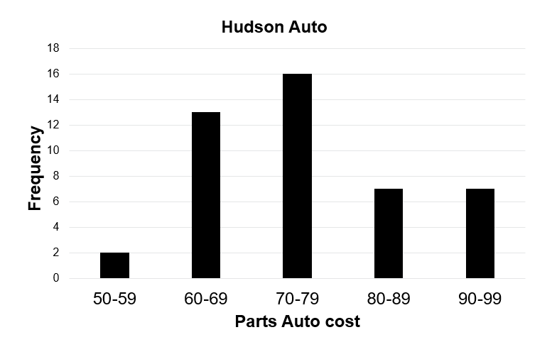
Graphical Summary: Bar Chart
Example: Hudson Auto

Slide 35
Numerical Descriptive Statistics
The most common numerical descriptive statistic is the mean (or average).
The mean demonstrates a measure of the central tendency, or central location, of the data for a variable.
Hudson’s mean cost of parts, based on the 50 tune-ups studied, is $79 (found by summing up the 50 cost values and then dividing by 50).

Slide 36
Statistical Inference
Population: The set of all elements of interest in a particular study.
Sample: A subset of the population.
Statistical inference: The process of using data obtained from a sample to make estimates and test hypotheses about the characteristics of a population.
Census: Collecting data for the entire population.
Sample survey: Collecting data for a sample.

Slide 37
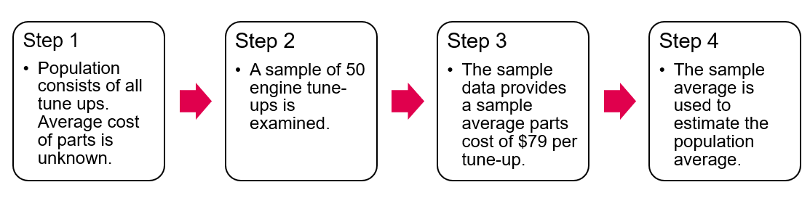
Process of Statistical Inference
Example: Hudson Auto

Slide 38
Analytics
Scientific process of transforming data into insight for making better decisions.
Descriptive analysis—Analytical techniques that describe what happened in the past.
Predictive analysis
Analytical techniques that use models constructed from past data to predict future.
Helps assess the impact the impact of one variable on another
Prescriptive analysis—Analytical techniques that yield a best course of action to take.

Slide 39
Big Data and Data Warehousing
Organizations obtain large amounts of data on a daily basis by means of magnetic card readers, bar code scanners, point-of-sale terminals, and touchscreen monitors. Large and complex data sets are known as big data.
Walmart captures data on 20 to 30 million transactions per day.
Visa processes 6,800 payment transactions per second.
Capturing, storing, and maintaining the data, referred to as data warehousing, is a significant undertaking.

Slide 40
Data Mining
Analysis of the data in the warehouse might aid in decisions that will lead to new strategies and higher profits for the organization.
Using a combination of procedures from statistics, mathematics, and computer science, analysts “mine the data” to convert it into useful information.
The most effective data mining systems use automated procedures to extract information from the data prompted by only general or even vague queries by the user.

Slide 41
Data Mining Applications
The major applications of data mining have been made by companies with a strong consumer focus such as retail, financial, and communication firms.
Data mining is used to identify related products that customers who have already purchased a specific product are also likely to purchase (and then pop-ups are used to draw attention to those related products).
As another example, data mining is used to identify customers who should receive special discount offers based on their past purchasing volumes.

Slide 42
Data Mining Requirements
Statistical methodology such as multiple regression, logistic regression, and correlation are heavily used.
Also needed are computer science technologies involving artificial intelligence and machine learning.
A significant investment in time and money is required as well.

Slide 43
Data Mining Model Reliability
Finding a statistical model that works well for a particular sample of data does not necessarily mean that it can be reliably applied to other data.
With the enormous amount of data available, the data set can be partitioned into a training set (for model development) and a test set (for validating the model).
There is, however, a danger of over fitting the model to the point that misleading associations and conclusions appear to exist.
Careful interpretation of results and extensive testing is important.

Slide 44
Ethical Guidelines for Statistical Practice (1 of 2)
In a statistical study, unethical behavior can take a variety of forms including:
Improper sampling
Inappropriate analysis of the data
Development of misleading graphs
Use of inappropriate summary statistics
Biased interpretation of the statistical results
You should strive to be fair, thorough, objective, and neutral as you collect, analyze, and present data.
As a consumer of statistics, you should also be aware of the possibility of unethical behavior by others.

Slide 45
Ethical Guidelines for Statistical Practice (2 of 2)
The American Statistical Association developed the report “Ethical Guidelines for Statistical Practice.”
It contains 52 guidelines organized into 8 topic areas:
Professional integrity and Accountability
Integrity of Data and Methods
Responsibilities to Science/Public/Funder/Client
Responsibilities to Research Subjects
Responsibilities to Research Team Colleagues
Responsibilities to Other Statisticians or Statistics Practitioners
Responsibilities Regarding Allegations of Misconduct
Responsibilities of Employers Including Organizations, Individuals, Attorneys, or Other Clients Employing Statistical Practitioners

Slide 46
Chapter 2, Part A Descriptive Statistics: Tabular and Graphical Displays
Summarizing Data for a Categorical Variable
Categorical data use labels or names to identify categories of like items.
Summarizing Data for a Quantitative Variable
Quantitative data are numerical values that indicate how much or how many.

Slide 47
Summarizing Data for a Categorical Variable
Frequency Distribution
Relative Frequency Distribution
Percent Frequency Distribution
Bar Chart
Pie Chart

Slide 48
Frequency Distribution (2 of 3)
Example
Soft drink purchasers were asked to select one among the five popular soft drinks: Coca-Cola, Diet Coke, Dr. Pepper, Pepsi, and Sprite.
Soft drinks selected by a sample of 20 purchasers are:
Coca-Cola | Pepsi | Dr. Pepper
Diet Coke | Dr. Pepper | Dr. Pepper
Dr. Pepper | Pepsi | Pepsi
Pepsi | Coca-Cola | Diet Coke
Pepsi | Diet Coke | Dr. Pepper
Pepsi | Pepsi | Sprite
Pepsi | Pepsi

Slide 49
Frequency Distribution (3 of 3)
Example
Rating | Frequency
Coca-Cola | 2
Diet Coke | 3
Dr. Pepper | 5
Pepsi | 9
Sprite | 1
Total | 20

Slide 50
Relative Frequency Distribution
The relative frequency of a class is the fraction or proportion of the total number of data items belonging to a class.
A relative frequency distribution is a tabular summary of a set of data showing the relative frequency for each class.

Slide 51
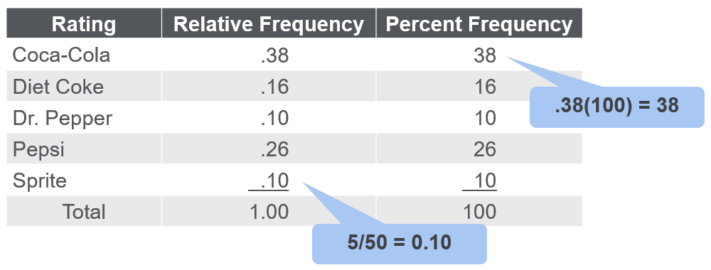
Relative Frequency and Percent Frequency Distributions
Example

Slide 52
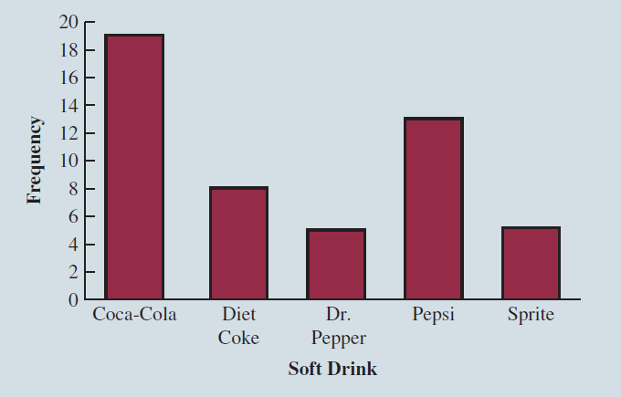
Bar Chart (2 of 2)
Bar chart of soft drink purchases

Slide 53
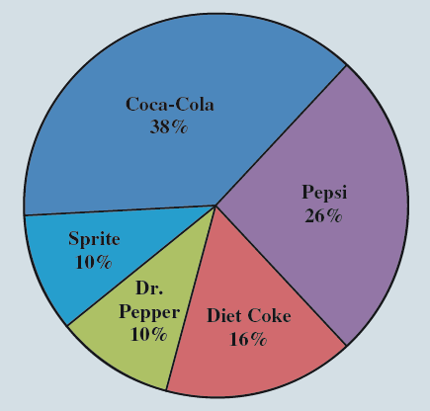
Pie Chart of Soft Drink Purchases

Slide 54
Summarizing Data for a Quantitative Variable
Frequency Distribution
Relative Frequency and Percent Frequency Distributions
Dot Plot
Histogram
Cumulative Distributions
Stem-and-Leaf Display

Slide 55
Frequency Distribution (2 of 9)
Example: Sanderson and Clifford
Year-End Audit Time (in Days)
12 15 20 22 14 | 14 15 27 21 18 | 19 18 22 33 16 | 18 17 23 28 13

Slide 56
Frequency Distribution (3 of 9)
The three steps necessary to define the classes for a frequency distribution with quantitative data are:
Step 1: Determine the number of non-overlapping classes.
Step 2: Determine the width of each class.
Step 3: Determine the class limits.

Slide 57
Frequency Distribution (4 of 9)
Guidelines for Determining the Number of Classes
Use between 5 and 20 classes.
Data sets with a larger number of elements usually require a larger number of classes.
Smaller data sets usually require fewer classes.
The goal is to use enough classes to show the variation in the data, but not so many classes that some contain only a few data items.

Slide 58
Frequency Distribution (5 of 9)
Guidelines for Determining the Width of Each Class
Use classes of equal width.
Making the classes the same width reduces the chance of inappropriate interpretations.

Slide 59
Frequency Distribution (6 of 9)
Note on Number of Classes and Class Width
In practice, the number of classes and the appropriate class width are determined by trial and error.
Once a possible number of classes is chosen, the appropriate class width is found.
The process can be repeated for a different number of classes.
Ultimately, the analyst uses judgment to determine the combination of the number of classes and class width that provides the best frequency distribution for summarizing the data.

Slide 60
Frequency Distribution (7 of 9)
Guidelines for Determining the Class Limits
Class limits must be chosen so that each data item belongs to one and only one class.
The lower class limit identifies the smallest possible data value assigned to the class.
The upper class limit identifies the largest possible data value assigned to the class.
The appropriate values for the class limits depend on the level of accuracy of the data.
An open-end class requires only a lower class limit or an upper class limit.

Slide 61
Frequency Distribution (8 of 9)
Class Midpoint
In some cases, we want to know the midpoints of the classes in a frequency distribution for quantitative data.
The class midpoint is the value halfway between the lower and upper class limits.

Slide 62
Frequency Distribution (9 of 9)
Example: Sanderson and Clifford
If we choose five classes:
Time in days | Frequency
10 to 14 | 4
15 to 19 | 8
20 to 24 | 5
25 to 29 | 2
30 to 34 | 1
Total | 20

Slide 63
Relative Frequency and Percent Frequency Distributions (1 of 2)
Example: Sanderson and Clifford
Audit time (in days) | Relative Frequency | Percent Frequency
10 to 14 | .20 (4/20) | 20 (0.2 × 100)
15 to 19 | .40 | 40
20 to 25 | .25 | 25
25 to 29 | .10 | 10
30 to 34 | .05 | 5
 | Total 1.00 | 100

Slide 64
Relative Frequency and Percent Frequency Distributions (2 of 2)
Example: Sanderson and Clifford
Insights obtained from the Percent Frequency Distribution:
40% of the audits required from 15 to 19 days.
Another 25% of the audits required 20 to 25 days.
Only 5% of the audits required more than 30 days.

Slide 65
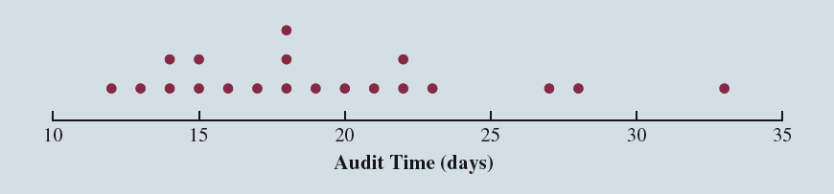
Dot Plot (2 of 2)
Example: Sanderson and Clifford

Slide 66
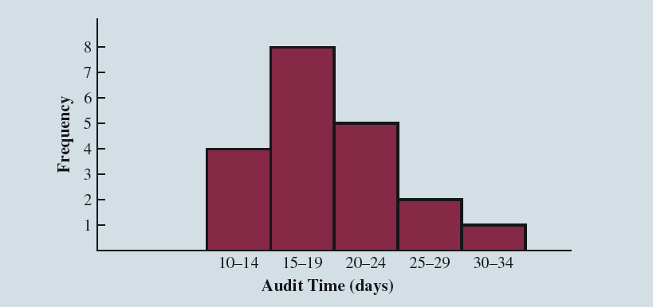
Histogram (2 of 2)
Example: Sanderson and Clifford

Slide 67
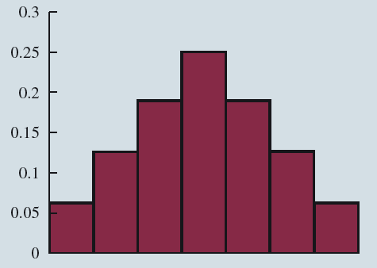
Histograms Showing Skewness (1 of 4)
Symmetric
Left tail is the mirror image of the right tail.
Example: Heights of People

Slide 68
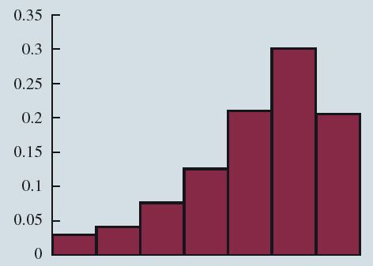
Histograms Showing Skewness (2 of 4)
Moderately Skewed Left
A longer tail to the left
Example: Exam Scores

Slide 69
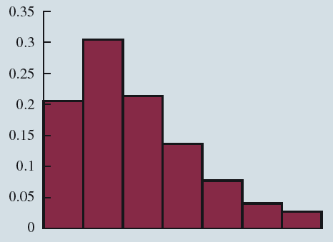
Histograms Showing Skewness (3 of 4)
Moderately Right Skewed
A longer tail to the right
Example: Housing Values

Slide 70
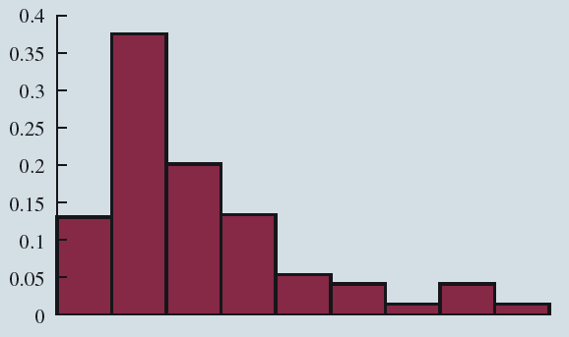
Histograms Showing Skewness (4 of 4)
Highly Skewed Right
A very long tail to the right
Example: Executive Salaries

Slide 71
Cumulative Distributions (3 of 3)
Example: Sanderson and Clifford
Audit time (Days) | Cumulative Frequency | Cumulative Relative Frequency | Cumulative Percent Frequency
Less than or equal to 14 | 4 | .20 | 20
Less than or equal to 19 | 12 | .60 | 60
Less than or equal to 24 | 17 | .85 | 85
Less than or equal to 29 | 19 | .95 | 95
Less than or equal to 34 | 20 | 1.00 | 100

Slide 72
Stem-and-Leaf Display (3 of 7)
Number of questions answered correctly by 50 students
112 | 73 | 126 | 82 | 92 | 115 | 95 | 84 | 68 | 100
72 | 92 | 128 | 104 | 108 | 76 | 141 | 119 | 98 | 85
69 | 76 | 118 | 132 | 96 | 91 | 81 | 113 | 115 | 94
97 | 86 | 127 | 134 | 100 | 102 | 80 | 98 | 106 | 106
107 | 73 | 124 | 83 | 92 | 81 | 106 | 75 | 95 | 119

Slide 73
Stem-and-Leaf Display (4 of 7)
6 | 9 | 8
7 | 2 | 3 | 6 | 3 | 6 | 5
8 | 6 | 2 | 3 | 1 | 1 | 0 | 4 | 5
9 | 7 | 2 | 2 | 6 | 2 | 1 | 5 | 8 | 8 | 5 | 4
10 | 7 | 4 | 8 | 0 | 2 | 6 | 6 | 0 | 6
11 | 2 | 8 | 5 | 9 | 3 | 5 | 9
12 | 6 | 8 | 7 | 4
13 | 2 | 4
14 | 1
Stem
Leaf

Slide 74
Summarizing Data for Two Variables using Tables
Thus far, we have focused on methods that are used to summarize the data for one variable at a time.
Often a decision maker is interested in tabular and graphical methods that will help illustrate the relationship between two variables.

Slide 75
Crosstabulation (1 of 3)
A crosstabulation is a tabular summary of data for two variables.
Crosstabulation can be used when:
one variable is categorical and the other is quantitative,
both variables are categorical, or
both variables are quantitative.
The left and top margin labels define the classes for the two variables.

Slide 76
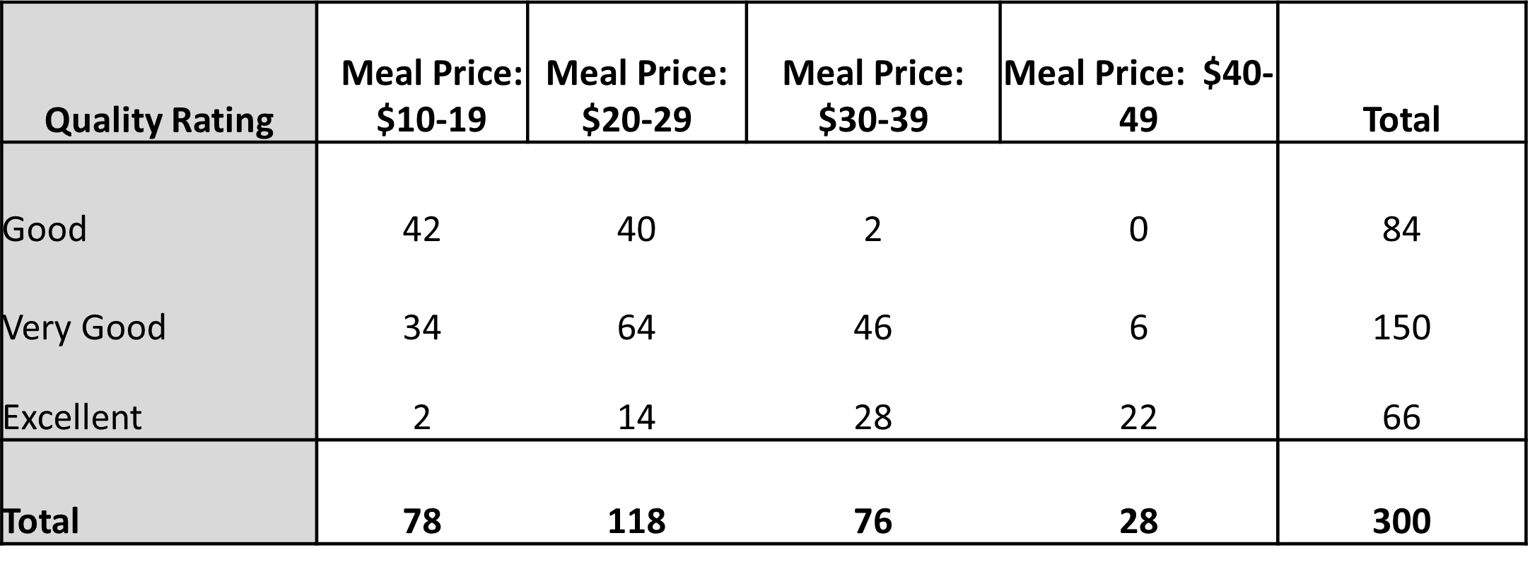
Crosstabulation (2 of 3)
Example: Zagat’s Restaurant Review
Crosstabulation of quality rating and meal price data for 300 Los Angeles restaurants is given here.

Slide 77
Crosstabulation (3 of 3)
Example: Zagat’s Restaurant Review
Insights gained from preceding crosstabulation:
Greatest number of restaurants in the sample (84) have a very good rating and meal prices in the $20 to 29 range.
Only 2 restaurants have an excellent rating and meal prices in the range of $10 to 19.

Slide 78
Crosstabulation: Row or Column Percentages
Converting the entries in the table into row percentages or column percentages can provide additional insight about the relationship between the two variables.

Slide 79
Crosstabulation: Row Percentages
Example: Zagat’s Restaurant Review
Meal Price
Quality Rating | $10 to 19 | $20 to 29 | $30 to 39 | $40 to 49 | Total
Good | 50 | 47.6 | 2.4 | 0 | 100
Very Good | 22.7 | 42.7 | 30.6 | 4 | 100
Excellent | 3 | 21.2 | 42.4 | 33.4 | 100
Good restaurants charging a meal price of $10 to 19 divided by total number of good restaurants:

Slide 80
Crosstabulation: Simpson’s Paradox
Data in two or more crosstabulations are often aggregated to produce a summary crosstabulation.
We must be careful in drawing conclusions about the relationship between the two variables in the aggregated crosstabulation.
In some cases the conclusions based upon an aggregated crosstabulation can be completely reversed if we look at the unaggregated data. The reversal of conclusions based on aggregate and unaggregated data is called Simpson’s paradox.

Slide 81
Summarizing Data for Two Variables Using Graphical Displays
In most cases, a graphical display is more useful than a table for recognizing patterns and trends.
Displaying data in creative ways can lead to powerful insights.
Scatter diagrams and trendlines are useful in exploring the relationship between two variables.

Slide 82
Scatter Diagram and Trendline
A scatter diagram is a graphical presentation of the relationship between two quantitative variables.
One variable is shown on the horizontal axis and the other variable is shown on the vertical axis.
The general pattern of the plotted points suggests the overall relationship between the variables.
A trendline provides an approximation of the relationship.

Slide 83
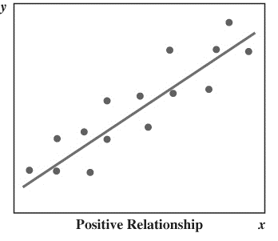
Scatter Diagram (1 of 5)
A Positive Relationship

Slide 84
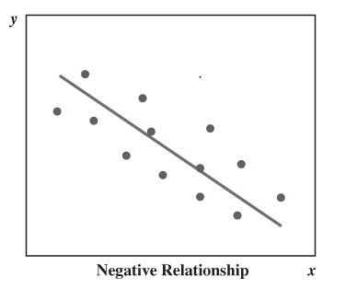
Scatter Diagram (2 of 5)
A Negative Relationship

Slide 85
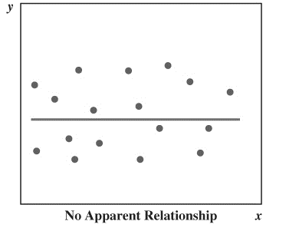
Scatter Diagram (3 of 5)
No Apparent Relationship

Slide 86
Scatter Diagram (4 of 5)
Example:
An electronics store in San Francisco wants to analyze the relationship between sales and advertising. Sample data for ten weeks with sales in hundreds of dollars is shown below:
Week | Number of Commercials (x) | Sales ($100s)(y)
1 | 2 | 50
2 | 5 | 57
3 | 1 | 41
4 | 3 | 54
5 | 4 | 54
6 | 1 | 38
7 | 5 | 63
8 | 3 | 48
9 | 4 | 59
10 | 2 | 46

Slide 87
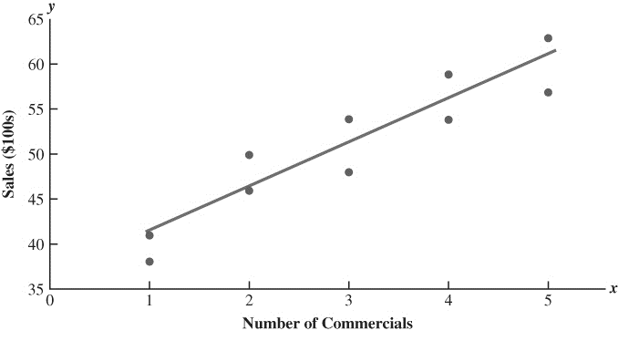
Scatter Diagram and Trendline for the San Francisco Electronics Store

Slide 88
Scatter Diagram (5 of 5)
Example
Insights gained from the San Francisco Electronics Store scatter diagram:
The scatter diagram indicates a positive relationship between the number of commercials and sales.
Higher sales are associated with greater number of commercials.
The relationship is not perfect; all plotted points in the scatter diagram are not on a straight line.

Slide 89
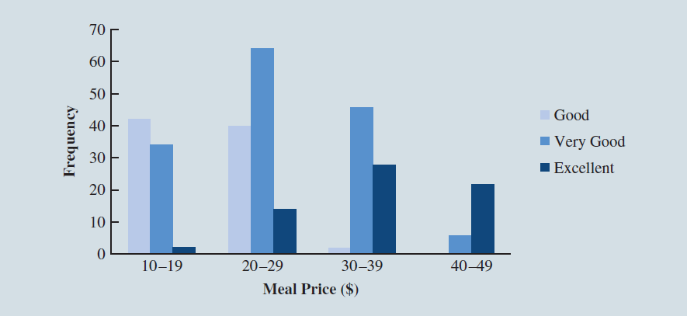
Side-by-Side Bar Chart (2 of 2)

Slide 90
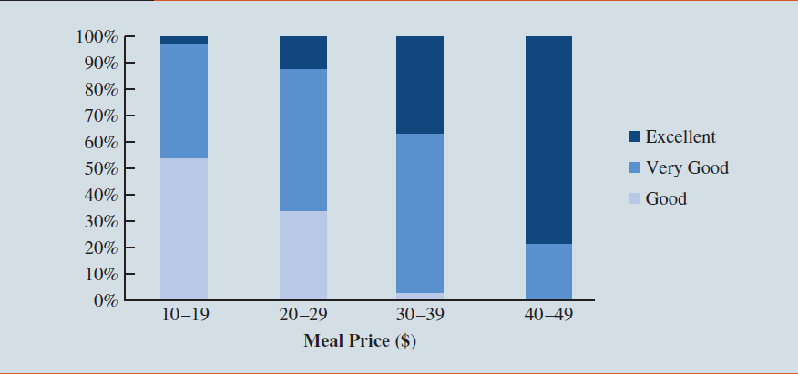
Stacked Bar Chart (2 of 2)

Slide 91
Data Visualization: Best Practices in Creating Effective Graphical Displays
Data visualization describes the use of graphical displays to summarize and present information about a data set.
The goal is to communicate as effectively and clearly as possible the key information about the data.

Slide 92
Creating Effective Graphical Displays
Creating effective graphical displays is as much art as it is science.
Guidelines:
Give the display a clear and concise title.
Keep the display simple.
Clearly label each axis and provide the units of measure.
If colors are used, make sure they are distinct.
If multiple colors or lines are used, provide a legend.

Slide 93
Choosing the Type of Graphical Display (1 of 3)
Displays used to show the distribution of data:
Bar Chart to show the frequency distribution or relative frequency distribution for categorical data
Pie Chart to show the relative frequency or percent frequency for categorical data
Dot Plot to show the distribution for quantitative data over the entire range of the data
Histogram to show the frequency distribution for quantitative data over a set of class intervals
Stem-and-Leaf Display to show both the rank order and shape of the distribution for quantitative data

Slide 94
Choosing the Type of Graphical Display (2 of 3)
Displays used to make comparisons:
Side-by-Side Bar Chart to compare two variables
Stacked Bar Chart to compare the relative frequency or percent frequency of two categorical variables

Slide 95
Choosing the Type of Graphical Display (3 of 3)
Displays used to show relationships:
Scatter Diagram to show the relationship between two quantitative variables
Trendline to approximate the relationship of data in a scatter diagram

Slide 96
Data Dashboards
A data dashboard is a widely used data visualization tool.
It organizes and presents key performance indicators (KPIs) used to monitor an organization or process.
It provides timely, summary information that is easy to read, understand, and interpret.
Guidelines:
Minimize the need for screen scrolling.
Avoid unnecessary use of color or 3D.
Use borders between charts to improve readability.

Slide 97
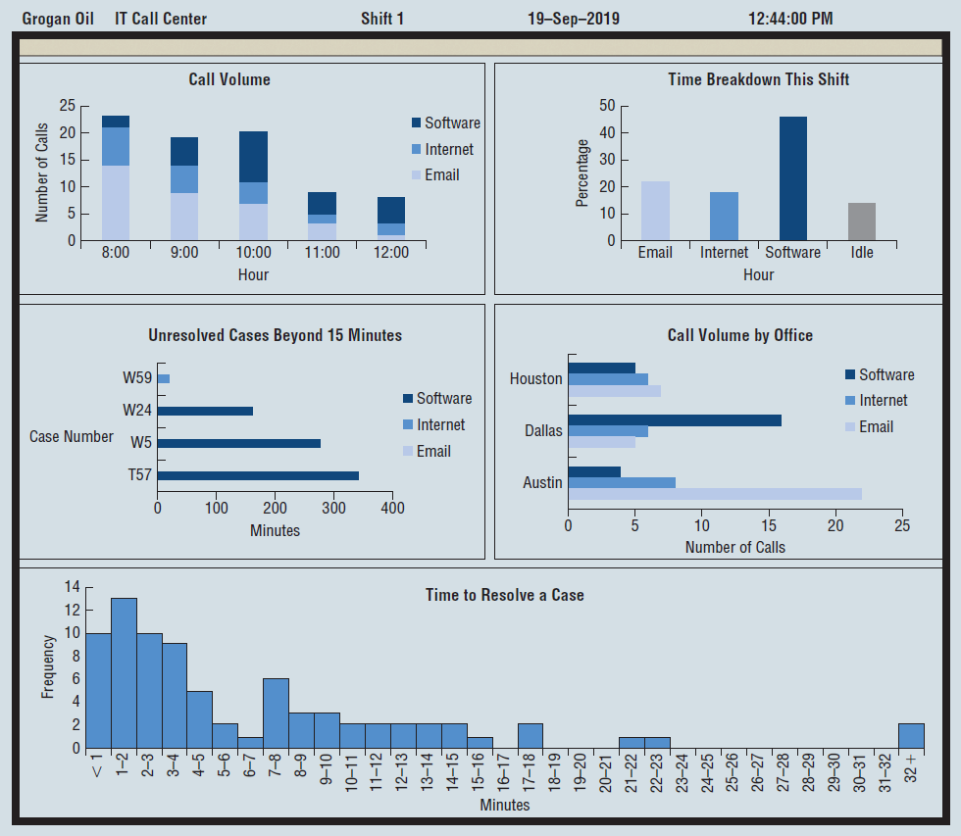
Data Dashboard Example

Slide 98
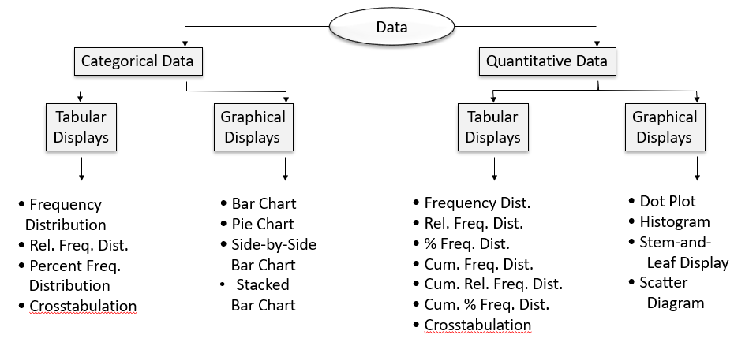
Tabular and Graphical Displays

Slide 99
Chapter 3, Part A Descriptive Statistics: Numerical Measures
Measures of Location
Measures of Variability

Slide 100
Numerical Measures
If the measures are computed for data from a sample, they are called sample statistics.
If the measures are computed for data from a population, they are called population parameters.
A sample statistic is referred to as the point estimator of the corresponding population parameter.

Slide 101
Measures of Location
Mean
Median
Mode
Weighted Mean
Geometric Mean
Percentiles
Quartiles

Slide 102
Mean
Perhaps the most important measure of location is the mean.
The mean provides a measure of central location.
The mean of a data set is the average of all the data values.
The sample mean
is the point estimator of the population mean μ.

Slide 103

Sample Mean $\overline{x}$
where:
= sum of the values of the n observations
n = number of observations in the sample

Slide 104
Population Mean μ
where:
= sum of the values of the n observations
n = number of observations in the population

Slide 105

Sample Mean $\overline{x}$ (1 of 2)
Example: Monthly Starting Salary
A placement office wants to know the average starting salary of business graduates. Monthly starting salaries for a sample of 12 business school graduates is provided here.
Graduate | Monthly Starting Salary ($) | Graduate | Monthly Starting Salary ($)
1 | 5850 | 7 | 5890
2 | 5950 | 8 | 6130
3 | 6050 | 9 | 5940
4 | 5880 | 10 | 6325
5 | 5755 | 11 | 5920
6 | 5710 | 12 | 5880

Slide 106

Sample Mean $\overline{x}$ (2 of 2)
Example: Monthly Starting Salary

Slide 107
Median (1 of 4)
The median of a data set is the value in the middle when the data items are arranged in ascending order.
Whenever a data set has extreme values, median is the preferred measure of central location.
The median is the measure of location most often reported for annual income and property value data.
A few extremely large incomes or property values can inflate the mean.

Slide 108
Median (2 of 4)
For an odd number of observations:
7 observations
26 | 18 | 27 | 12 | 14 | 27 | 19
12 | 14 | 18 | 19 | 26 | 27 | 27
In ascending order
Median is the middle value
Median = 19

Slide 109
Median (3 of 4)
For an even number of observations:
8 observations
26 | 18 | 27 | 12 | 14 | 27 | 19 | 30
12 | 14 | 18 | 19 | 26 | 27 | 27 | 30
In ascending order
Median is the average of the middle two values.

Slide 110
Median (4 of 4)
Example: Monthly Starting Salary
Averaging the 6th and 7th data values:
5,710 | 5,755
5,850 | 5,880
5,880 | 5,890
5,920 | 5,940
5,950 | 6,050
6,130 | 6,325
Note: The data is in ascending order.

Slide 111
Mode (1 of 2)
The mode of a data set is the value that occurs with greatest frequency.
The greatest frequency can occur at two or more different values.
If the data have exactly two modes, the data are bimodal.
If the data have more than two modes, the data are multimodal.

Slide 112
Mode (2 of 2)
Example: Monthly Starting Salary
The only monthly starting salary that occurs more than once is $5,880.
Mode = 5,880
5,710 | 5,755
5,850 | 5,880
5,880 | 5,890
5,920 | 5,940
5,950 | 6,050
6,130 | 6,325
Note: The data is in ascending order.

Slide 113
Weighted Mean (1 of 4)
In some instances the mean is computed by giving each observation a weight that reflects its relative importance.
The choice of weights depends on the application.
The weights might be the number of credit hours earned for each grade, as in GPA.
In other weighted mean computations, quantities such as pounds, dollars, or volume are frequently used.

Slide 114
Weighted Mean (2 of 4)
where:
Numerator: sum of the weighted data values
Denominator: sum of the weights
If data is from a population, μ replaces

Slide 115
Weighted Mean (3 of 4)
Example: Purchase of Raw Material
Consider the following sample of five purchases of a raw material over a period of three months:
Purchase | Cost per Pound ($) | Number of Pounds
1 | 3.00 | 1200
2 | 3.4 | 500
3 | 2.8 | 2750
4 | 2.9 | 1000
5 | 3.25 | 800

Slide 116
Weighted Mean (4 of 4)
Example: Purchase of raw material
Purchase | Cost per Pound ($) x_{i} | Number of Pounds w_{i} | w_{i}x_{i}
1 | 3.00 | 1200 | 3600
2 | 3.4 | 500 | 1700
3 | 2.8 | 2750 | 7700
4 | 2.9 | 1000 | 2900
5 | 255755 | 800 | 2600
FYI, equally weighted (simple) mean = $3.07

Slide 117
Geometric Mean (1 of 4)
The geometric mean is calculated by finding the nth root of the product of n values.
It is often used in analyzing growth rates in financial data (where using the arithmetic mean will provide misleading results).
It should be applied anytime you want to determine the mean rate of change over several successive periods (be it years, quarters, weeks, . . .).
Other common applications include changes in populations of species, crop yields, pollution levels, and birth and death rates.

Slide 118
Geometric Mean (2 of 4)

Slide 119
Geometric Mean (3 of 4)
Example: Mutual fund
Year | Annual Return % | Growth Factor
1 | −22.1 | 0.779
2 | 28.7 | 1.287
3 | 10.9 | 1.109
4 | 4.9 | 1.049
5 | 15.8 | 1.158
6 | 5.5 | 1.055
7 | −37.0 | 0.630
8 | 26.5 | 1.265
9 | 15.1 | 1.151
10 | 2.1 | 1.021

Slide 120
Geometric Mean (4 of 4)

Slide 121
Measures of Variability (1 of 2)
It is often desirable to consider measures of variability (dispersion), as well as measures of location.
For example, in choosing supplier A or supplier B we might consider not only the average delivery time for each but also the variability in delivery time for each.

Slide 122
Measures of Variability (2 of 2)
Range
Interquartile Range
Variance
Standard Deviation
Coefficient of Variation

Slide 123
Range (1 of 2)
The range of a data set is the difference between the largest and smallest data values.
It is the simplest measure of variability.
It is very sensitive to the smallest and largest data values.

Slide 124
Range (2 of 2)
Example: Monthly Starting Salary
5,710 | 5,755
5,850 | 5,880
5,880 | 5,890
5,920 | 5,940
5,950 | 6,050
6,130 | 6,325

Slide 125
Interquartile Range
The interquartile range of a data set is the difference between the third quartile and the first quartile.
It is the range for the middle 50% of the data.
It overcomes the sensitivity to extreme data values.

Slide 126
Interquartile Range (IQR)
Example: Monthly Starting Salary
5,710 | 5,755
5,850 | 5,880
5,880 | 5,890
5,920 | 5,940
5,950 | 6,050
6,130 | 6,325

Slide 127
Variance (1 of 2)
The variance is a measure of variability that utilizes all the data.
It is based on the difference between the value of each observation (x_{i}) and the mean (
for a sample, μ for a population).
The variance is useful in comparing the variability of two or more variables.

Slide 128
Variance (2 of 2)
The variance is the average of the squared differences between each data value and the mean.
The variance is computed as follows:
for a
sample
for a
population

Slide 129
Standard Deviation (1 of 2)
The standard deviation of a data set is the positive square root of the variance.
It is measured in the same units as the data, making it more easily interpreted than the variance.

Slide 130
Standard Deviation (2 of 2)
The standard deviation is computed as follows:
For a
sample
For a
population

Slide 131
Coefficient of Variation
The coefficient of variation indicates how large the standard deviation is in relation to the mean.
The coefficient of variation is computed as follows:
for a
sample
for a
population

Slide 132
Sample Variance, Standard Deviation, And Coefficient of Variation
Example: Monthly Starting Salary
Variance
Standard Deviation
Coefficient of Variation

Slide 133
Chapter 3, Part B Descriptive Statistics: Numerical Measures
Measures of Distribution Shape, Relative Location, and Detecting Outliers.
Five-Number Summaries and Boxplots
Measures of Association Between Two Variables
Data Dashboards: Adding Numerical Measures to Improve Effectiveness

Slide 134
Measures of Distribution Shape, Relative Location, and Detecting Outliers
Distribution Shape
z-Scores
Chebyshev’s Theorem
Empirical Rule
Detecting Outliers

Slide 135
Distribution Shape: Skewness (1 of 5)
An important measure of the shape of a distribution is called skewness.
The formula for the skewness of sample data is
Skewness can be easily computed using statistical software.

Slide 136
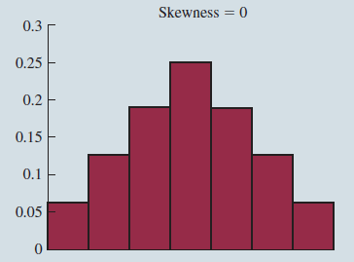
Distribution Shape: Skewness (2 of 5)
Symmetric (not skewed)
Skewness is zero.
Mean and median are equal.

Slide 137
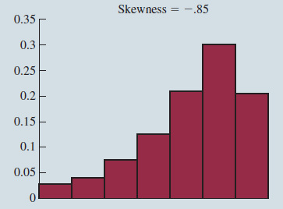
Distribution Shape: Skewness (3 of 5)
Moderately Skewed Left
Skewness is negative.
Mean will usually be less than the median.

Slide 138
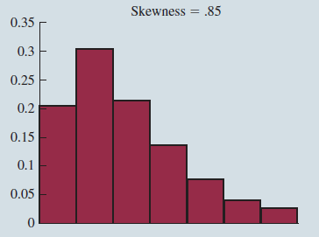
Distribution Shape: Skewness (4 of 5)
Moderately Skewed Right
Skewness is positive.
Mean will usually be more than the median.

Slide 139
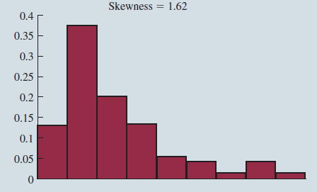
Distribution Shape: Skewness (5 of 5)
Highly Skewed Right
Skewness is positive (often above 1.0).
Mean will usually be more than the median.

Slide 140
z-Scores (1 of 3)
The z-score is often called the standardized value.
It denotes the number of standard deviations a data value
is from the mean.
Excel’s STANDARDIZE function can be used to compute the z-score.

Slide 141
z-Scores (2 of 3)
An observation’s z-score is a measure of the relative location of the observation in a data set.
A data value less than the sample mean will have a z-score less than zero.
A data value greater than the sample mean will have a z-score greater than zero.
A data value equal to the sample mean will have a z-score of zero.

Slide 142
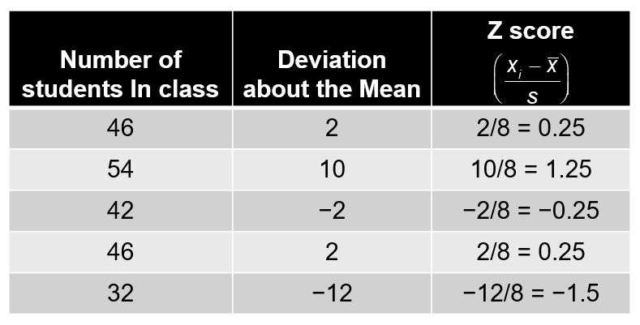
z-Scores (3 of 3)
Example: Class size data
Note:
for the given data.

Slide 143
Chebyshev’s Theorem (1 of 4)
At least
of the items in any data set will be within z standard deviations of the mean, where z is any value greater than 1.
Chebyshev’s theorem requires
but z need not be an integer.

Slide 144
Chebyshev’s Theorem (2 of 4)
At least 75% of the data values must be within
standard deviations of the mean.
At least 89% of the data values must be within
standard deviations of the mean.
At least 94% of the data values must be within
standard deviations of the mean.

Slide 145
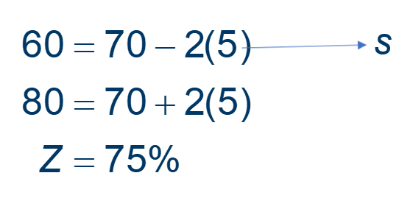
Chebyshev’s Theorem (3 of 4)
Example: Midterm scores of students
Suppose the midterm test scores of 100 students in a course had a mean of 70 and a standard deviation of 5. We want to know the number of students having test scores between 60 and 80.
60 and 80 are 2 standard deviations below and above the mean respectively.

Slide 146
Chebyshev’s Theorem (4 of 4)
Example: Midterm scores of students
Number of students having test scores between 58 and 82:

Slide 147
Empirical Rule (1 of 3)
When the data are believed to approximate a bell-shaped distribution:
The empirical rule can be used to determine the percentage of data values that must be within a specified number of standard deviations of the mean.
The empirical rule is based on the normal distribution, which is covered in Chapter 6.

Slide 148
Empirical Rule (2 of 3)
For data having a bell-shaped distribution:
Approximately 68% of the data values will be within +/−1 standard deviation of its mean.
Approximately 95% of the data values will be within +/ −2 standard deviations of its mean.
Almost all (approximately 99.7%) of the data values will be within +/ −3 standard deviations of its mean.

Slide 149
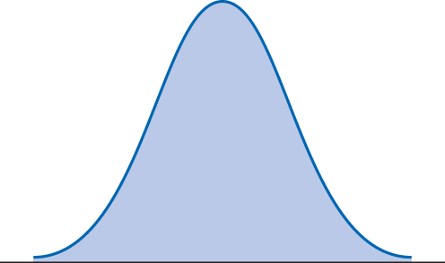
Empirical Rule (3 of 3)
Bell shaped distribution

Slide 150
Detecting Outliers
An outlier is an unusually small or unusually large value in a data set.
A data value with a z-score less than −3 or greater than +3 might be considered an outlier.
It might be:
an incorrectly recorded data value
a data value that was incorrectly included in the data set
a correctly recorded unusual data value that belongs in the data set

Slide 151
Outliers
Example: Class size data
−1.5 shows the fifth class size is farthest from the mean.
No outliers are present as the z values are within the +/−3 guideline.

Slide 152
Five-Number Summaries and Boxplots
Summary statistics and easy-to-draw graphs can be used to quickly summarize large quantities of data.
Two tools that accomplish this are five-number summaries and boxplots.

Slide 153
Five-Number Summary (1 of 2)
Smallest Value
First Quartile
Median
Third Quartile
Largest Value

Slide 154
Five-Number Summary (2 of 2)
Example: Monthly starting salary
Lowest Value = 5,710
Third Quartile = 6,025
First Quartile = 5,857.5
Median = 5905
Largest Value = 6,325
Monthly Starting Salary ($)
5,710 | 5,755
5,850 | 5,880
5,880 | 5,890
5,920 | 5,940
5,950 | 6,050
6,130 | 6,325

Slide 155
Boxplots and Outliers
Limits are located using the interquartile range (IQR).
Data outside these limits are considered outliers.
The locations of each outlier are shown with the symbol.

Slide 156
Boxplot (1 of 3)
A boxplot is a graphical summary of data that is based on a five-number summary.
A key to the development of a boxplot is the computation of the median and the quartiles,
Boxplots provide another way to identify outliers.

Slide 157
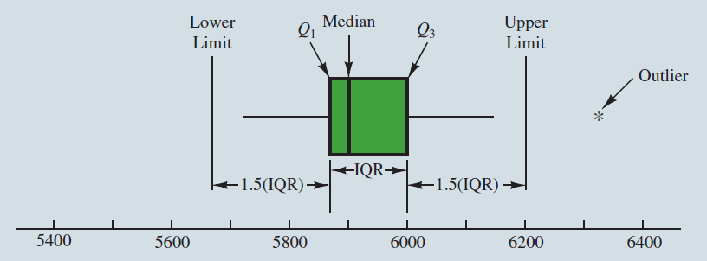
Boxplot (2 of 3)
Example Monthly starting salary
A box is drawn with its ends located at the first and third quartiles.
A vertical line is drawn in the box at the location of the median (second quartile).

Slide 158
Boxplot (3 of 3)
Example: Monthly starting salary
The lower limit is located 1.5(IQR) below
The upper limit is located 1.5(IQR) above
There is one outlier: 6,325.

Slide 159
Measures of Association Between Two Variables
Thus far we have examined numerical methods used to summarize the data for one variable at a time.
Often a manager or decision maker is interested in the relationship between two variables.
Two descriptive measures of the relationship between two variables are covariance and correlation coefficient.

Slide 160
Covariance (1 of 2)
The covariance is a measure of the linear association between two variables.
Positive values indicate a positive relationship.
Negative values indicate a negative relationship.

Slide 161
Covariance (2 of 2)
The covariance is computed as follows:
For samples:
For population:

Slide 162
Correlation Coefficient (1 of 3)
Correlation is a measure of linear association and not necessarily causation.
Just because two variables are highly correlated, it does not mean that one variable is the cause of the other.

Slide 163
Correlation Coefficient (2 of 3)
The correlation coefficient is computed as follows:
For samples:
For population:

Slide 164
Correlation Coefficient (3 of 3)
The coefficient can take on values between −1 and +1.
Values near −1 indicate a strong negative linear relationship.
Values near +1 indicate a strong positive linear relationship.
The closer the correlation is to zero, the weaker the relationship.

Slide 165
Covariance and Correlation Coefficient ( 1 of 4)
Example: San Francisco Electronics store
The store’s manager wants to determine the relationship between the number of weekend television commercials shown and the sales at the store during the following week.

Slide 166
Covariance and Correlation Coefficient ( 2 of 4)
Example: San Francisco Electronics Store
Week | Number of Commercials | Sales ($100s)
1 | 2 | 50
2 | 5 | 57
3 | 1 | 41
4 | 3 | 54
5 | 4 | 54
6 | 1 | 38
7 | 5 | 63
8 | 3 | 48
9 | 4 | 59
10 | 2 | 49

Slide 167
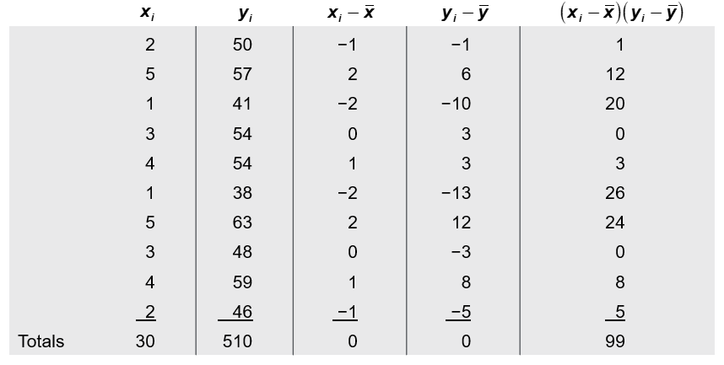
Covariance and Correlation Coefficient (3 of 4)

Slide 168
Covariance and Correlation Coefficient (4 of 4)
Example: San Francisco Electronics Store
Sample Covariance
Sample Correlation Coefficient

Slide 169
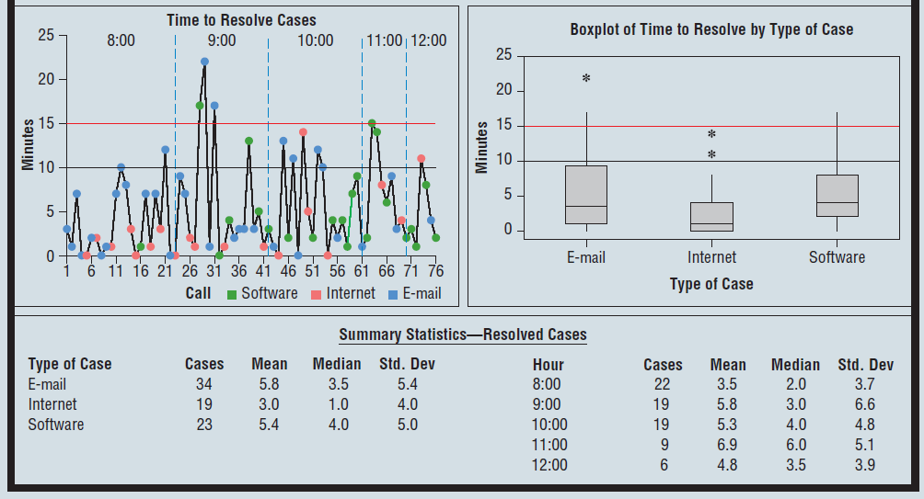
Data Dashboards: Adding Numerical Measures to Improve Effectiveness (2 of 2)

Slide 170
Chapter 4 Introduction to Probability
Experiments, Counting Rules, and Assigning Probabilities
Events and Their Probabilities
Some Basic Relationships of Probability
Conditional Probability
Bayes’ Theorem

Slide 171
Uncertainties
Managers often base their decisions on an analysis of uncertainties such as the following:
What are the chances that sales will decrease if we increase prices?
What is the likelihood a new assembly method will increase productivity?
What are the odds that a new investment will be profitable?

Slide 172
Probability
Probability is a numerical measure of the likelihood that an event will occur.
Probability values are always assigned on a scale from 0 to 1.
A probability near zero indicates an event is quite unlikely to occur.
A probability near one indicates an event is almost certain to occur.

Slide 173
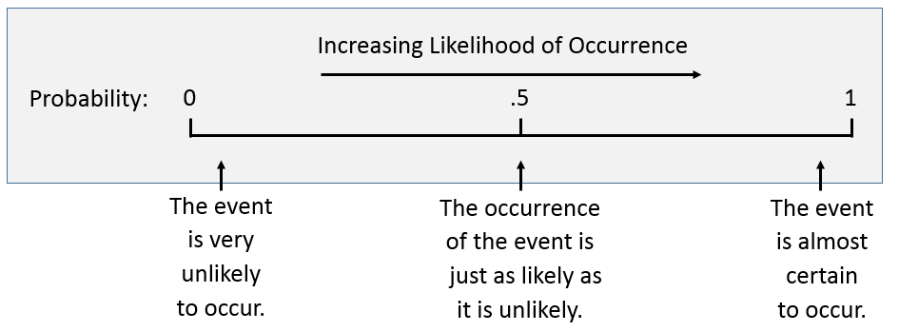
Probability as a Numerical Measure of the Likelihood of Occurrence

Slide 174
Assigning Probabilities (1 of 3)
Basic Requirements for Assigning Probabilities
The probability assigned to each experimental outcome must be between 0 and 1, inclusively.

Slide 175
Assigning Probabilities (2 of 3)
Basic Requirements for Assigning Probabilities
The sum of the probabilities for all experimental outcomes must equal 1.
where: n is the number of experimental outcomes

Slide 176
Assigning Probabilities (3 of 3)
Classical Method
Assigning probabilities based on the assumption of equally likely outcomes.
Relative Frequency Method
Assigning probabilities based on experimentation or historical data.
Subjective Method
Assigning probabilities based on judgment.

Slide 177
Classical Method
Example: Rolling a Die
If an experiment has n possible outcomes, the classical method would assign a probability of
to each outcome.
Experiment: Rolling a die
Sample Space: S = {1, 2, 3, 4, 5, 6}
Probabilities: Each sample point has a 1 in 6 chance of occurring

Slide 178
Relative Frequency Method (1 of 2)
Example: Waiting time in the X-ray department for a local hospital
Consider a study of waiting times in the X-ray department for a local hospital. A clerk recorded the number of patients waiting for service at 9:00 A.M on 20 successive days and obtained the following results:
Number waiting | Number of days outcome occurred
0 | 2
1 | 5
2 | 6
3 | 4
4 | 3
Total | 20

Slide 179
Relative Frequency Method (2 of 2)
Example: Waiting time in the X-ray department for a local hospital
Each probability assignment is given by dividing the frequency (number of days) by the total frequency (total number of days).
Number waiting | Number of days outcome occurred | Probability
0 | 2 | 2/20 = 0.1
1 | 5 | 0.25
2 | 6 | 0.30
3 | 4 | 0.20
4 | 3 | 0.15
Total | 20 | 1.00

Slide 180
Subjective Method (1 of 3)
When economic conditions or a company’s circumstances change rapidly it might be inappropriate to assign probabilities based solely on historical data.
We can use any data available as well as our experience and intuition, but ultimately a probability value should express our degree of belief that the experimental outcome will occur.
The best probability estimates often are obtained by combining the estimates from the classical or relative frequency approach with the subjective estimate.

Slide 181
Subjective Method (2 of 3)
Example:
Tom and Judy make an offer to purchase a house.
Possible outcomes:
Judy’s Probability estimates
Tom’s probability estimates

Slide 182
Subjective Method (3 of 3)
Example:
The assigned probabilities satisfy the two basic requirements.
The different probability estimates emphasize the personal nature of the subjective method.

Slide 183
Events and Their Probabilities (1 of 4)
An event is a collection of sample points.
The probability of any event is equal to the sum of the probabilities of the sample points in the event.
If we can identify all the sample points of an experiment and assign a probability to each, we can compute the probability of an event.

Slide 184
Events and Their Probabilities (2 of 4)
Completion time in months
Example:
Kentucky Power and Light Company (KP&L)
We have completion results for 40 KP&L projects.
Design | Construction | Sample Point | Number of past projects with this completion time | Probability
2 | 6 | (2,6) | 6 | 0.15
2 | 7 | (2,7) | 6 | 0.15
2 | 8 | (2,8) | 2 | 0.05
3 | 6 | (2,6) | 4 | 0.10
3 | 7 | (2,7) | 8 | 0.20
3 | 8 | (2,8) | 2 | 0.05
4 | 6 | (2,6) | 2 | 0.05
4 | 7 | (2,7) | 4 | 0.10
4 | 8 | (2,8) | 6 | 0.15

Slide 185
Events and Their Probabilities (3 of 4)
Example: Kentucky Power and Light Company (KP&L)

Slide 186
Events and Their Probabilities (4 of 4)
Example: Kentucky Power and Light Company (KP&L)

Slide 187
Some Basic Relationships of Probability
There are some basic probability relationships that can be used to compute the probability of an event without knowledge of all the sample point probabilities.
Complement of an Event
Union of Two Events
Intersection of Two Events
Mutually Exclusive Events

Slide 188
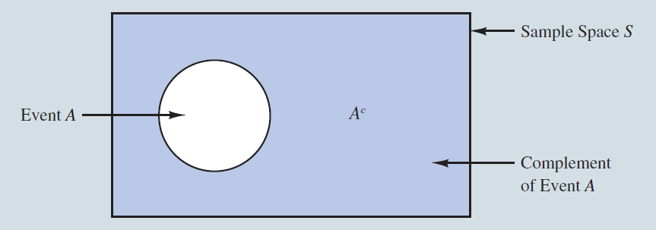
Complement of an Event
The complement of event A is defined to be the event consisting of all sample points that are not in A.
The complement of A is denoted by
Complement of event A is shaded.

Slide 189
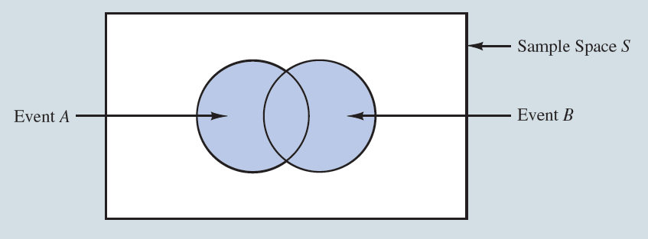
Union of Two Events
The union of events A and B is the event containing all sample points that are in A or B or both.
The union of events A and B is denoted by

Slide 190
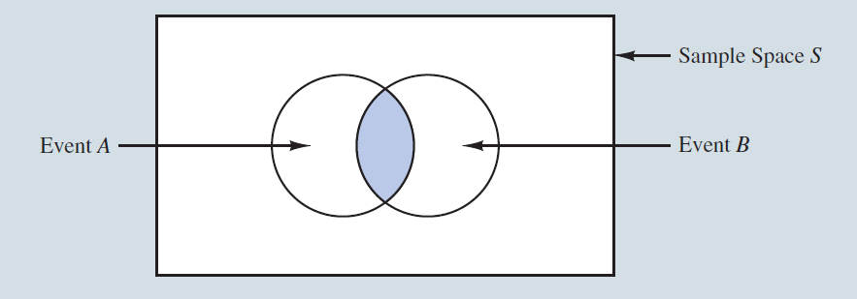
Intersection of Two Events
The intersection of events A and B is the set of all sample points that are in both A and B.
The intersection of events A and B is denoted by
Intersection of A and B

Slide 191
Addition Law (1 of 4)
The addition law provides a way to compute the probability of event A, or B, or both A and B occurring.
The law is written as:

Slide 192
Addition Law (2 of 4)
Example
A small assembly plant with 50 employees is carrying out performance evaluations. Each worker is expected to complete work assignments on time and in such a way that the assembled product will pass a final inspection. The results were as follows:
Result | Number of Employees | Relative Frequency
Late completion of work | 5 | 5/50 = 0.1
Assembled a defective work | 6 | 0.12
Completed work late and assembled defective work | 2 | 0.04

Slide 193
Addition Law (3 of 4)
Example
Event L = the event that the work is completed late
Event D = the event that the assembled product is defective
The production manager decided to assign poor performance ratings to any employee whose work is either late or defective.

Slide 194
Addition Law (4 of 4)

Slide 195
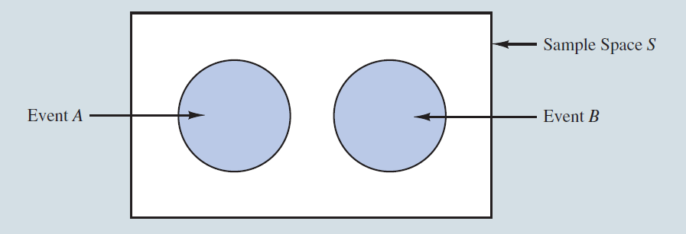
Mutually Exclusive Events (1 of 2)
Two events are said to be mutually exclusive if the events have no sample points in common.
Two events are mutually exclusive if, when one event occurs, the other cannot occur.

Slide 196
Mutually Exclusive Events (2 of 2)
If events A and B are mutually exclusive,
The addition law for mutually exclusive events is:
Note: There is no need to include

Slide 197
Conditional Probability (1 of 4)
The probability of an event given that another event has occurred is called a conditional probability.
The conditional probability of A given B is denoted by
A conditional probability is computed as follows:

Slide 198
Conditional Probability (2 of 4)
Example: Promotion status of police officers over the past two years
 | Men | Women | Total
Promoted | 288 | 36 | 324
Not Promoted | 672 | 204 | 876
Total | 960 | 240 | 1200

Slide 199
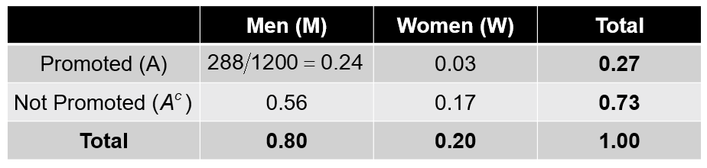
Conditional Probability (3 of 4)
Example: Promotion status of police officers over the past two years
Probability Table

Slide 200
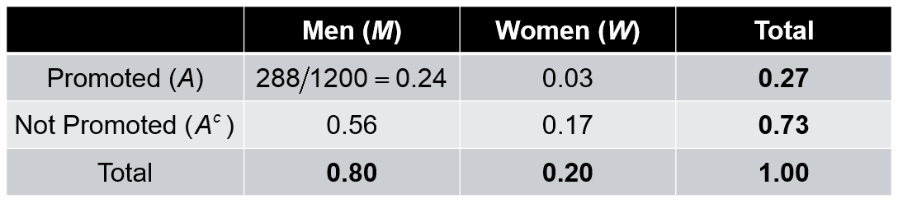
Joint Probability
Joint probability table
Joint probabilities appear in the center of the table.
Marginal probabilities appear in the margins of the table.

Slide 201
Conditional Probability (4 of 4)
Example: Promotion status of police officers over the past two years
From the table we know:

Slide 202
Multiplication Law (1 of 3)
The multiplication law provides a way to compute the probability of the intersection of two events.
The law is written as:

Slide 203
Multiplication Law (2 of 3)
Example: Newspaper circulation department
Event D = A household subscribes to the daily edition.
Event S = The household already holds a subscription to the Sunday edition.
Given:

Slide 204
Multiplication Law (3 of 3)
Example: Newspaper circulation department
What is the probability that the household subscribes to both the Sunday and daily editions of the newspaper?

Slide 205
Independent Events
If the probability of event A is not changed by the existence of event B, we would say that events A and B are independent.
Two events A and B are independent if:

Slide 206
Multiplication Law for Independent Events (1 of 3)
The multiplication law also can be used as a test to see if two events are independent.
The law is written as:

Slide 207
Multiplication Law for Independent Events (2 of 3)
Example : Use of credit card for purchase of gasoline
From past experience, it is known that 80% of customers use credit cards for the purchase of gasoline. The service station manger wants to determine the probability that the next two customers purchasing gasoline will each use a credit card.

Slide 208
Multiplication Law for Independent Events (3 of 3)
Example : Use of a credit card for purchase of gasoline
Event A: First customer uses a credit card
Event B: The second customer uses a credit card

Slide 209
Mutual Exclusiveness and Independence
Do not confuse the notion of mutually exclusive events with that of independent events.
Two events with nonzero probabilities cannot be both mutually exclusive and independent.
If one mutually exclusive event is known to occur, the other cannot occur; thus, the probability of the other event occurring is reduced to zero (and they are therefore dependent).
Two events that are not mutually exclusive might or might not be independent.

Slide 210
Chapter 5 Discrete Probability Distributions
Random Variables
Developing Discrete Probability Distributions
Expected Value and Variance
Bivariate distributions and Covariance
Financial Portfolios
Binomial Probability Distribution
Poisson Probability Distribution
Hypergeometric Probability Distribution

Slide 211
Random Variables (1 of 2)
A random variable is a numerical description of the outcome of an experiment.
A discrete random variable may assume either a finite number of values or an infinite sequence of values.
A continuous random variable may assume any numerical value in an interval or collection of intervals.

Slide 212
Discrete Random Variable with a Finite Number of Values
Example: An accountant taking CPA examination
The examination has four parts.
Let random variable x = the number of parts of the CPA examination passed
x may assume the finite number of values 0,1,2,3 or 4.

Slide 213
Discrete Random Variable with an Infinite Number of Values
Example: Cars arriving at a toll booth
Let x = number of cars arriving in one day,
where x can take on the values 0, 1, 2, . . .
We can count the customers arriving, but there is no finite upper limit on the number that might arrive.

Slide 214
Random Variables (2 of 2)
Random Experiment | Random Variable (x) | Possible Values for the Random Variable
Flip a coin | Face of coin showing | 1 if heads; 0 if tails
Roll a die | Number of dots showing on top of die | 1, 2, 3, 4, 5, 6
Contact five customers | Number of customers who place an order | 0, 1, 2, 3, 4, 5
Operate a health care clinic for one day | Number of patients who arrive | 0, 1, 2, 3, ...
Offer a customer the choice of two products | Product chosen by customer | 0 if none; 1 if choose product A; 2 if choose product B

Slide 215
Discrete Probability Distributions (1 of 8)
The probability distribution for a random variable describes how probabilities are distributed over the values of the random variable.
We can describe a discrete probability distribution with a table, graph, or formula.

Slide 216
Discrete Probability Distributions (2 of 8)
Two types of discrete probability distributions:
First type: uses the rules of assigning probabilities to experimental outcomes to determine probabilities for each value of the random variable.
Second type: uses a special mathematical formula to compute the probabilities for each value of the random variable.

Slide 217
Discrete Probability Distributions (3 of 8)
The probability distribution is defined by a probability function, denoted by f(x), that provides the probability for each value of the random variable.
The required conditions for a discrete probability function are:

Slide 218
Discrete Probability Distributions (4 of 8)
There are three methods for assigning probabilities to random variables:
Classical method
Subjective method
Relative frequency
The use of the relative frequency method to develop discrete probability distributions leads to what is called an empirical discrete distribution.

Slide 219
Discrete Probability Distributions (5 of 8)
Example: DiCarlo Motors
Using past data on daily car sales for 300 days, a tabular representation of the probability distribution for sales was developed.
Number of cars sold | Number of days | x | f(x)
0 | 54 | 0 | .18
1 | 117 | 1 | .39
2 | 72 | 2 | .24
3 | 42 | 3 | .14
4 | 12 | 4 | .04
5 | 3 | 5 | .01
Total | 300 |  | 1.00

Slide 220
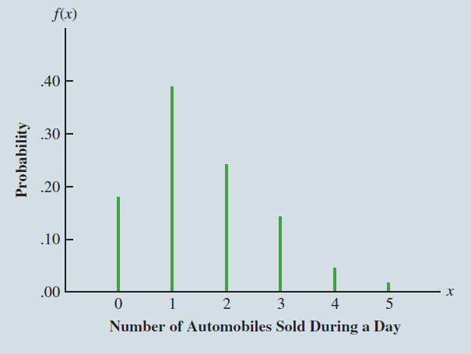
Discrete Probability Distributions (6 of 8)
Example: DiCarlo Motors
Graphical representation of the probability distribution

Slide 221
Discrete Probability Distributions (7 of 8)
In addition to tables and graphs, a formula that gives the probability function, f(x), for every value of x is often used to describe the probability distributions.
Some of the discrete probability distributions specified by formulas are
Discrete—uniform distribution
Binomial distribution
Poisson distribution
Hypergeometric distribution

Slide 222
Discrete Probability Distributions (8 of 8)
The discrete uniform probability distribution is the simplest example of a discrete probability distribution given by a formula.
The discrete uniform probability function is
where: n = the number of values the random variable may assume
The values of the random variable are equally likely.

Slide 223
Expected Value
The expected value, or mean, of a random variable is a measure of its central location.
The expected value is a weighted average of the values the random variable may assume. The weights are the probabilities.
The expected value does not have to be a value the random variable can assume.

Slide 224
Variance and Standard Deviation
The variance summarizes the variability in the values of a random variable.
The variance is a weighted average of the squared deviations of a random variable from its mean. The weights are the probabilities.
The standard deviation, σ, is defined as the positive square root of the variance.

Slide 225
Discrete Probability Distributions (1 of 2)
Example: DiCarlo Motors
x | f(x) | xf(x)
0 | .18 | .00
1 | .39 | .39
2 | .24 | .48
3 | .14 | .42
4 | .04 | .16
5 | .01 | .05
 | 1.00 | 1.50

Slide 226
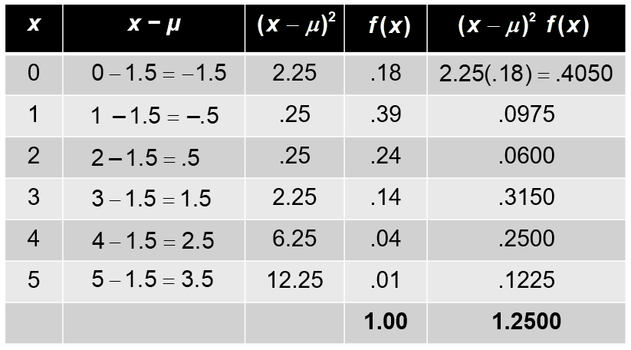
Discrete Probability Distributions (2 of 2)
Example: DiCarlo Motors
Standard deviation of daily sales = 1.118 cars

Slide 227
Bivariate Distributions
A probability distribution involving two random variables is called a bivariate probability distribution.
Each outcome of a bivariate experiment consists of two values, one for each random variable.
Example: Rolling a pair of dice
When dealing with bivariate probability distributions, we are often interested in the relationship between the random variables.

Slide 228
A Bivariate Discrete Probability Distribution (1 of 6)
Example: DiCarlo Motors
The crosstabulation of daily car sales for 300 days at DiCarlo’s Saratoga and Geneva dealership is given below:
Geneva Dealership | Saratoga Dealership 0 | 1 | 2 | 3 | 4 | 5 | Total
0 | 21 | 30 | 24 | 9 | 2 | 0 | 86
1 | 21 | 36 | 33 | 18 | 2 | 1 | 111
2 | 9 | 42 | 9 | 12 | 3 | 2 | 77
3 | 3 | 9 | 6 | 3 | 5 | 0 | 26
Total | 54 | 117 | 72 | 42 | 12 | 3 | 300

Slide 229
A Bivariate Discrete Probability Distribution (2 of 6)
Example: DiCarlo Motors
Bivariate empirical discrete probability distribution for daily sales at DiCarlo dealerships in Saratoga and Geneva is shown below.
Geneva Dealership | Saratoga Dealership 0 | 1 | 2 | 3 | 4 | 5 | Total
0 | .0700 | .1000 | .0800 | .0300 | .0067 | .0000 | .2867
1 | .0700 | .1200 | .1100 | .0600 | .0067 | .0033 | .3700
2 | .0300 | .1400 | .0300 | .0400 | .0100 | .0067 | .2567
3 | .0100 | .0300 | .0200 | .0100 | .0167 | .0000 | .0867
Total | .18 | .39 | .24 | .14 | .04 | .01 | 1.0000

Slide 230
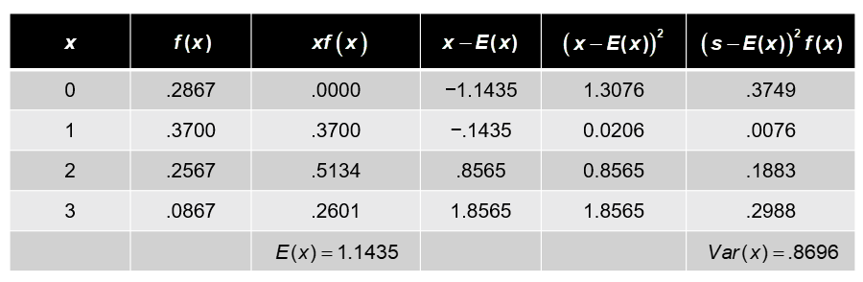
A Bivariate Discrete Probability Distribution (3 of 6)
Example: DiCarlo Motors
Expected value and variance for daily car sales at Geneva dealership.

Slide 231
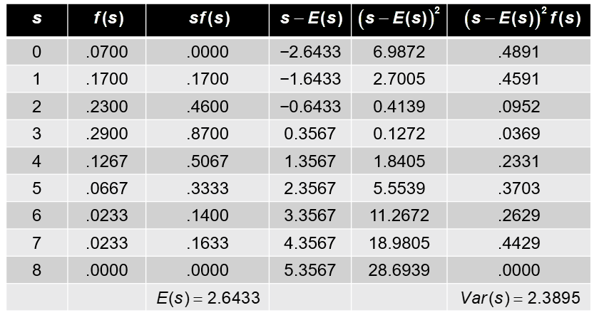
A Bivariate Discrete Probability Distribution (4 of 6)
Example: DiCarlo Motors
Expected value and variance for total daily car sales data.

Slide 232
A Bivariate Discrete Probability Distribution (5 of 6)
Covariance for random variables x and y.

Slide 233
A Bivariate Discrete Probability Distribution (6 of 6)
Correlation between random variables x and y

Slide 234
Binomial Probability Distribution (1 of 9)
Four Properties of a Binomial Experiment
The experiment consists of a sequence of n identical trials.
Two outcomes, success and failure, are possible on each trial.
The probability of a success, denoted by p, and failure denoted by 1−p does not change from trial to trial. (This referred to as the stationarity assumption.)
The trials are independent.

Slide 235
Binomial Probability Distribution (2 of 9)
Our interest is in the number of successes occurring in the n trials.
We let x denote the number of successes occurring in the n trials.

Slide 236
Binomial Probability Distribution (3 of 9)
Binomial Probability Function
where:

Slide 237
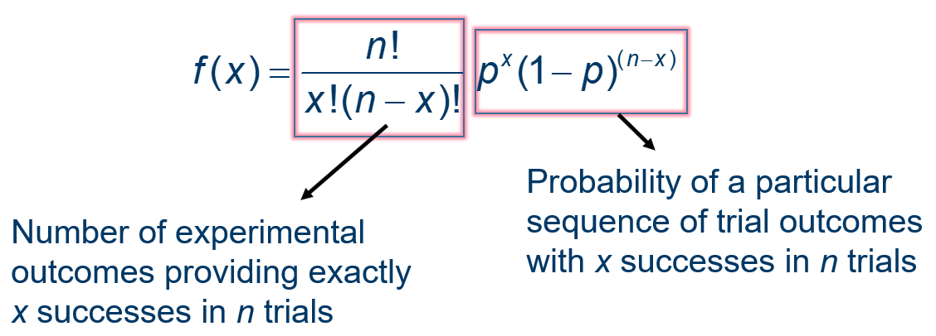
Binomial Probability Distribution (4 of 9)
Binomial Probability Function

Slide 238
Binomial Probability Distribution (5 of 9)
Example: Martin Clothing store
The store manager wants to determine the purchase decisions of next three customers who enter the clothing store. On the basis of past experience, the store manager estimates the probability that any one customer will make a purchase is .30.
What is the probability that two of the next three customers will make a purchase?

Slide 239
Binomial Probability Distribution (6 of 9)
Example: Martin Clothing store
Using S to denote success (a purchase) and F to denote failure (no purchase), we are interested in experimental outcomes involving two successes in the three trials.
The probability of the first two customers buying and the third customer not buying denoted by (S, S, F), is given by
With a .30 probability of a customer buying on any one trial, the probability of the first two customers buying and the third customer not buying is

Slide 240
Binomial Probability Distribution (7 of 9)
Example: Martin Clothing store
Two other experimental outcomes result in two successes and one failure. The probabilities for all three experimental outcomes involving two successes follow:
Experimental outcome | Probability
(S, S, F) | .063
(S, F, S) | .063
(F, S, S) | .063

Slide 241
Binomial Probability Distribution (8 of 9)
Example: Martin Clothing store
Using the probability function:
Let:

Slide 242
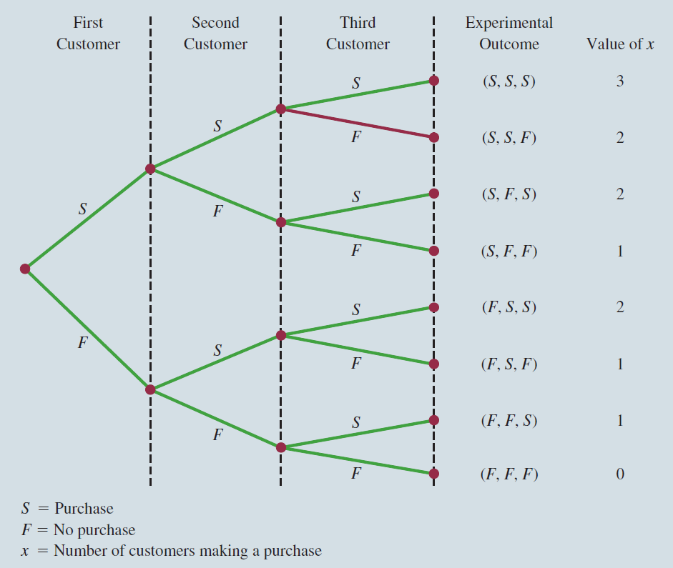
Binomial Probability Distribution (9 of 9)
Example: Martin Clothing store

Slide 243
Binomial Probabilities and Cumulative Probabilities
Statisticians have developed tables that give probabilities and cumulative probabilities for a binomial random variable.
These tables can be found in some statistics textbooks.
With modern calculators and the capability of statistical software packages, such tables are almost unnecessary.

Slide 244
Expected Value and Variance for Binomial Distribution (1 of 2)
Expected Value
Variance
Standard Deviation

Slide 245
Expected Value and Variance for Binomial Distribution (2 of 2)
Example: Martin Clothing store

Slide 246
Poisson Probability Distribution (1 of 7)
A Poisson distributed random variable is often useful in estimating the number of occurrences over a specified interval of time or space.
It is a discrete random variable that may assume an infinite sequence of values (x = 0, 1, 2, . . . ).

Slide 247
Poisson Probability Distribution (2 of 7)
Examples
Number of knotholes in 14 linear feet of pine board
Number of vehicles arriving at a toll booth in one hour
Number of leaks in 100 miles of pipeline
Bell Labs used the Poisson distribution to model the arrival of phone calls.

Slide 248
Poisson Probability Distribution (3 of 7)
Properties of a Poisson Experiment
The probability of an occurrence is the same for any two intervals of equal length.
The occurrence or nonoccurrence in any interval is independent of the occurrence or nonoccurrence in any other interval.

Slide 249
Poisson Probability Distribution (4 of 7)
Poisson Probability Function
where:

Slide 250
Poisson Probability Distribution (5 of 7)
Poisson Probability Function
Since there is no stated upper limit for the number of occurrences, the probability function f(x) is applicable for values x = 0, 1, 2, … without limit.
In practical applications, x will eventually become large enough so that f(x) is approximately zero and the probability of any larger values of x becomes negligible.

Slide 251
Poisson Probability Distribution (6 of 7)
Example: Arrivals at the emergency room
The average number of patients arriving at the emergency room at a large hospital in a 15-minute period of time on weekday mornings is 10.
What is the probability of 5 arrivals in a 15-minute period of time on a weekday morning?

Slide 252
Poisson Probability Distribution (7 of 7)
Example: Arrivals at the emergency room
Using the probability function:

Slide 253
Poisson Probability Distribution (1 of 2)
A property of the Poisson distribution is that the mean and variance are equal.

Slide 254
Poisson Probability Distribution (2 of 2)
Example: Arrivals at the emergency room
Variance for the number of patients arriving at the emergency room at a large hospital in a 15-minute period of time on weekday mornings is

Slide 255
Hypergeometric Probability Distribution (1 of 10)
The hypergeometric distribution is closely related to the binomial distribution.
However, for the hypergeometric distribution
the trials are not independent, and
the probability of success changes from trial to trial.

Slide 256
Hypergeometric Probability Distribution (2 of 10)
Hypergeometric Probability Function
where:
x = number of successes
n = number of trials
f(x) = probability of x successes in n trials
N = number of elements in the population
r = number of elements in the population labeled for success

Slide 257
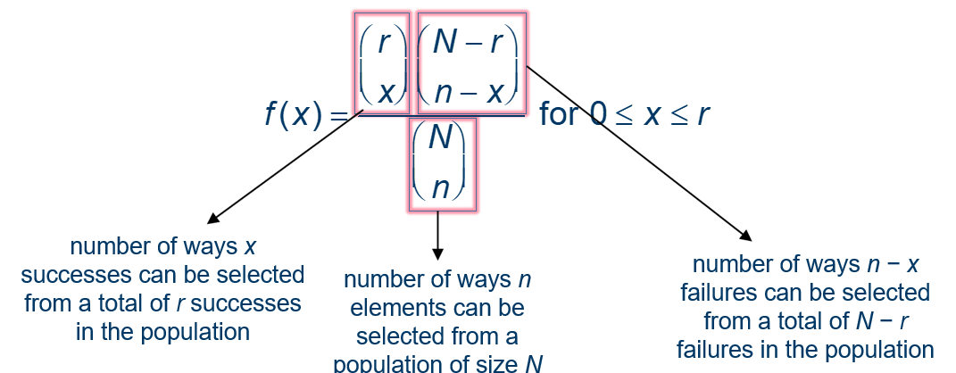
Hypergeometric Probability Distribution (3 of 10)
Hypergeometric Probability Function

Slide 258
Hypergeometric Probability Distribution (4 of 10)
Hypergeometric Probability Function
The probability function f(x) on the previous slide is usually applicable for values of x = 0, 1, 2, … n.
However, only following values of x are valid:
If these two conditions do not hold for a value of x, the corresponding f(x) equals 0.

Slide 259
Hypergeometric Probability Distribution (5 of 10)
Example: Ontario Electric
Electric fuses produced by Ontario Electric are packaged in boxes of 12 each. Suppose an inspector randomly selects 3 of the 12 fuses in a box for testing. If the box contains 5 defective fuses, what is the probability that the inspector will find exactly one of the three fuses defective?

Slide 260
Hypergeometric Probability Distribution (6 of 10)
Example: Ontario Electric
Using the probability function:
where:
x = 1 = number of defective fuse selected
n = 3 = number of fuses selected
N = 12 = number of fuses in total
r = 5 = number of defective fuses in total

Slide 261
Hypergeometric Probability Distribution (7 of 10)
Mean
Variance

Slide 262
Hypergeometric Probability Distribution (8 of 10)
Example: Ontario Electric
Mean
Variance
Standard deviation

Slide 263
Hypergeometric Probability Distribution (9 of 10)
Consider a hypergeometric distribution with n trials and let
denote the probability of a success on the first trial.
If the population size is large, the term
approaches 1.
The expected value and variance can be written as
Note that these are the expressions for the expected value and variance of a binomial distribution.

Slide 264
Hypergeometric Probability Distribution (10 of 10)
When the population size is large, a hypergeometric distribution can be approximated by a binomial distribution with n trials and a probability of success

Slide 265
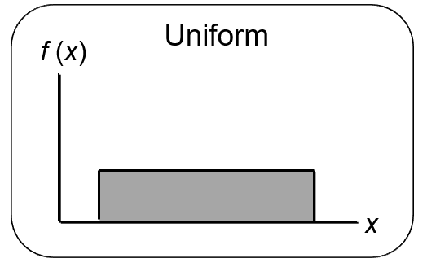
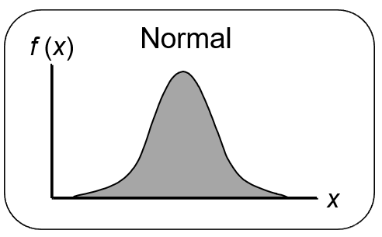
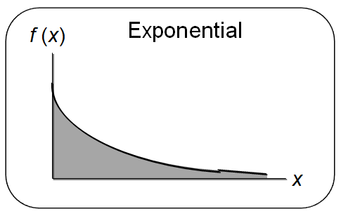
Chapter 6 Continuous Probability Distributions
Uniform Probability Distribution
Normal Probability Distribution
Exponential Probability Distribution

Slide 266
Continuous Probability Distributions (1 of 2)
A continuous random variable can assume any value in an interval on the real line or in a collection of intervals.
It is not possible to talk about the probability of the random variable assuming a particular value.
Instead, we talk about the probability of the random variable assuming a value within a given interval.

Slide 267



Continuous Probability Distributions (2 of 2)
The probability of the random variable assuming a value within some given interval from x₁ to x₂ is defined to be the area under the graph of the probability density function between x₁ and x₂.

Slide 268
Uniform Probability Distribution (1 of 7)
A random variable is uniformly distributed whenever the probability is proportional to the interval’s length.
The uniform probability density function is:
where: a = smallest value the variable can assume
b = largest value the variable can assume

Slide 269
Uniform Probability Distribution (2 of 7)
Expected Value of x
Variance of x

Slide 270
Uniform Probability Distribution (3 of 7)
Example: Flight time of an airplane traveling from Chicago to New York
Suppose the flight time can be any value in the interval from 120 minutes to 140 minutes.

Slide 271
Uniform Probability Distribution (4 of 7)
Uniform Probability Density Function
where:
x = Flight time of an airplane traveling from Chicago to New York

Slide 272
Uniform Probability Distribution (5 of 7)
Expected Value of x
Variance of x

Slide 273

Uniform Probability Distribution (6 of 7)
Example: Flight time of an airplane traveling from Chicago to New York

Slide 274

Uniform Probability Distribution (7 of 7)
Example: Flight time of an airplane traveling from Chicago to New York
Probability of a flight time between 120 and 130 minutes

Slide 275
Area as a Measure of Probability
The area under the graph of f(x) and probability are identical.
This is valid for all continuous random variables.
The probability that x takes on a value between some lower value x₁ and some higher value x₂ can be found by computing the area under the graph of f(x) over the interval from x₁ to x₂.

Slide 276
Normal Probability Distribution (1 of 10)
The normal probability distribution is the most common distribution for describing a continuous random variable.
It is widely used in statistical inference.
It has been used in a wide variety of applications including:
Heights of people
Test scores
Rainfall amounts
Scientific measurements
Abraham de Moivre, a French mathematician, published The Doctrine of Chances in 1733. He derived the normal distribution.

Slide 277
Normal Probability Distribution (2 of 10)
Normal Probability Density Function
Where µ = mean
σ = standard deviation
π = 3.14159
e = 2.71828

Slide 278
Normal Probability Distribution (3 of 10)
Characteristics
The distribution is symmetric; its skewness measure is zero.

Slide 279

Normal Probability Distribution (4 of 10)
Characteristics
The entire family of normal probability distributions is defined by its mean µ and its standard deviation σ.

Slide 280

Normal Probability Distribution (5 of 10)
Characteristics
The highest point on the normal curve is at the mean, which is also the median and mode.

Slide 281

Normal Probability Distribution (6 of 10)
Characteristics
The mean can be any numerical value: negative, zero, or positive.

Slide 282

Normal Probability Distribution (7 of 10)
Characteristics
The standard deviation determines the width of the curve: larger values result in wider, flatter curves.

Slide 283

Normal Probability Distribution (8 of 10)
Characteristics
Probabilities for the normal random variable are given by areas under the curve. The total area under the curve is 1 (.5 to the left of the mean and .5 to the right).

Slide 284
Normal Probability Distribution (9 of 10)
Characteristics (basis for the empirical rule)
68.3% of values of a normal random variable are within +/− 1 standard deviation of its mean.
95.4% of values of a normal random variable are within +/− 2 standard deviations of its mean.
99.7% of values of a normal random variable are within +/− 3 standard deviations of its mean.

Slide 285

Normal Probability Distribution (10 of 10)
Characteristics (basis for the empirical rule)

Slide 286
Standard Normal Probability Distribution (1 of 3)
Characteristics
A random variable having a normal distribution with a mean of 0 and a standard deviation of 1 is said to have a standard normal probability distribution.

Slide 287

Standard Normal Probability Distribution (2 of 3)
Characteristics
The letter z is used to designate the standard normal random variable.

Slide 288
Standard Normal Probability Distribution (3 of 3)
Converting to Standard Normal Distribution
We can think of z as a measure of the number of standard deviations x is from µ.

Slide 289
Standard Normal Probability Distribution (1 of 11)
Example: Grear Tire Company Problem
Grear Tire company has developed a new steel-belted radial tire to be sold through a chain of discount stores. But before finalizing the tire mileage guarantee policy, Grear’s managers want probability information about the number of miles of tires will last.

Slide 290
Standard Normal Probability Distribution (2 of 11)
Example: Grear Tire Company Problem
It was estimated that the mean tire mileage is 36,500 miles with a standard deviation of 5000. The manager now wants to know the probability that the tire mileage x will exceed 40,000.

Slide 291
Standard Normal Probability Distribution (3 of 11)
Example: Grear Tire Company Problem
Solving for the Probability
Step 1: Convert x to standard normal distribution.
Step 2: Find the area under the standard normal curve to the left of z = .7.

Slide 292
Standard Normal Probability Distribution (4 of 11)
Example: Grear Tire Company Problem
Cumulative Probability Table for the Standard Normal Distribution
z | .00 | .01 | .02 | .03 | .04 | .05 | .06 | .07 | .08 | .09
. | . | . | . | . | . | . | . | . | . | .
.5 | .6915 | .6950 | .6985 | .7019 | .7054 | .7088 | .7123 | .7157 | .7190 | .7224
.6 | .7257 | .7291 | .7324 | .7357 | .7389 | .7422 | .7454 | .7486 | .7517 | .7549
.7 | .7580 | .7611 | .7642 | .7673 | .7704 | .7734 | .7764 | .7794 | .7823 | .7852
.8 | .7881 | .7910 | .7939 | .7967 | .7995 | .8023 | .8051 | .8078 | .8106 | .8133
.9 | .8159 | .8186 | .8212 | .8238 | .8264 | .8289 | .8315 | .8340 | .8365 | .8389
. | . | . | . | . | . | . | . | . | . | .

Slide 293
Standard Normal Probability Distribution (5 of 11)
Example: Grear Tire Company Problem
Solving for the Probability
Step 3: Compute the area under the standard normal curve to the right of z = .7

Slide 294

Standard Normal Probability Distribution (6 of 11)
Example: Grear Tire Company Problem

Slide 295

Standard Normal Probability Distribution (7 of 11)
Example: Grear Tire Company Problem

Slide 296
Standard Normal Probability Distribution (8 of 11)
Example: Grear Tire Company Problem
What should be the guaranteed mileage if Grear wants no more than 10% of tires to be eligible for the discount guarantee?
(Hint: Given a probability, we can use the standard normal table in an inverse fashion to find the corresponding z value.)

Slide 297

Standard Normal Probability Distribution (9 of 11)
Example: Grear Tire Company Problem
Solving for the guaranteed mileage

Slide 298
Standard Normal Probability Distribution (10 of 11)
Example: Grear Tire Company Problem—Solving for the guaranteed mileage
Step 1: Find the z value that cuts off an area of .1 in the left tail of the standard normal distribution.
z | .00 | .01 | .02 | .03 | .04 | .05 | .06 | .07 | .08 | .09
. | . | . | . | . | . | . | . | . | . | .
−1.5 | 0.0668 | 0.0655 | 0.0643 | 0.0630 | 0.0618 | 0.0606 | 0.0594 | 0.0582 | 0.0571 | 0.0559
−1.4 | 0.0808 | 0.0793 | 0.0778 | 0.0764 | 0.0749 | 0.0735 | 0.0721 | 0.0708 | 0.0694 | 0.0681
−1.3 | 0.0968 | 0.0951 | 0.0934 | 0.0918 | 0.0901 | 0.0885 | 0.0869 | 0.0853 | 0.0838 | 0.0823
−1.2 | 0.1151 | 0.1131 | 0.1112 | 0.1093 | 0.1075 | 0.1056 | 0.1038 | 0.1020 | 0.1003 | 0.0985
−1.1 | 0.1357 | 0.1335 | 0.1314 | 0.1292 | 0.1271 | 0.1251 | 0.1230 | 0.1210 | 0.1190 | 0.1170
. | . | . | . | . | . | . | . | . | . | .

Slide 299
Standard Normal Probability Distribution (11 of 11)
From the table we see that z = −1.28 cuts off an area of 0.1 in the lower tail.
Step 2: Convert z_{.1} to the corresponding value of x.
Thus a guarantee of 30,100 miles will meet the requirement that approximately 10% of the tires will be eligible for the guarantee.

Slide 300
Exponential Probability Distribution (1 of 6)
The exponential probability distribution is useful in describing the time it takes to complete a task.
The exponential random variables can be used to describe:
Time between vehicle arrivals at a toll booth
Time required to complete a questionnaire
Distance between major defects in a highway
In waiting line applications, the exponential distribution is often used for service times.

Slide 301
Exponential Probability Distribution (2 of 6)
A property of the exponential distribution is that the mean and standard deviation are equal.
The exponential distribution is skewed to the right. Its skewness measure is 2.

Slide 302
Exponential Probability Distribution (3 of 6)
Density Function
where: µ = expected value or mean
e = 2.71828

Slide 303
Exponential Probability Distribution (4 of 6)
Cumulative Probabilities
where:
x₀ = some specific value of x

Slide 304
Exponential Probability Distribution (5 of 6)
Example: Loading time for trucks
Suppose x represents the loading time for a truck at the Schips loading dock and follows exponential distribution. If the mean or average loading time is 15 minutes, what is the probability that loading a truck will take 6 minutes or less?

Slide 305
Exponential Probability Distribution (6 of 6)
Example: Loading time for trucks

Slide 306

Relationship between the Poisson and Exponential Distributions

Slide 307
Chapter 7 Sampling and Sampling Distributions
Selecting a Sample
Point Estimation
Introduction to Sampling Distributions
Sampling Distribution of
Sampling Distribution of
Other Sampling Methods
Big data and Errors in Sampling

Slide 308
Introduction (1 of 2)
An element is the entity on which data are collected.
A population is a collection of all the elements of interest.
A sample is a subset of the population.
The sampled population is the population from which the sample is drawn.
A frame is a list of the elements that the sample will be selected from.

Slide 309
Introduction (2 of 2)
The reason we select a sample is to collect data to answer a research question about a population.
The sample results provide only estimates of the values of the population characteristics.
The reason is simply that the sample contains only a portion of the population.
With proper sampling methods, the sample results can provide “good” estimates of the population characteristics.

Slide 310
Selecting a Sample
Sampling from a Finite Population
Sampling from an Infinite Population

Slide 311
Sampling from a Finite Population (1 of 4)
Finite populations are often defined by lists such as:
Organization membership roster
Credit card account numbers
Inventory product numbers
A simple random sample of size n from a finite population of size N is a sample selected such that each possible sample of size n has the same probability of being selected.

Slide 312
Sampling from a Finite Population (2 of 4)
In large sampling projects, computer-generated random numbers are often used to automate the sample selection process.

Slide 313
Sampling from a Finite Population (3 of 4)
Example: National Baseball League teams
There are 15 teams that played in the 2019 National Baseball League. Suppose we want to select a simple random sample of 5 teams to conduct in-depth interviews about how they manage their minor legal franchises.

Slide 314
Sampling from a Finite Population (4 of 4)
Example: National Baseball League teams
Step 1: Assign a random number to each of the 15 teams in the population.
The random numbers generated by Excel’s RAND function follow a uniform probability distribution between 0 and 1.
Step 2: Select the five teams corresponding to the 5 smallest random numbers as the sample.

Slide 315
Sampling from an Infinite Population (1 of 3)
Sometimes we want to select a sample but find it is not possible to obtain a list of all elements in the population.
As a result, we cannot construct a frame for the population.
Hence, we cannot use the random number selection procedure.
Most often this situation occurs in infinite population cases.

Slide 316
Sampling from an Infinite Population (2 of 3)
Populations are often generated by an ongoing process where there is no upper limit on the number of units that can be generated.
Some examples of on-going processes, with infinite populations, are:
Parts being manufactured on a production line
Transactions occurring at a bank
Telephone calls arriving at a technical help desk
Customers entering a store

Slide 317
Sampling from an Infinite Population (3 of 3)
In the case of an infinite population, we must select a random sample in order to make valid statistical inferences about the population from which the sample is taken.
A random sample from an infinite population is a sample selected such that the following conditions are satisfied.
Each element selected comes from the population of interest.
Each element is selected independently.

Slide 318
Point Estimation (1 of 5)
Point estimation is a form of statistical inference.
In point estimation we use the data from the sample to compute a value of a sample statistic that serves as an estimate of a population parameter.
We refer to
as the point estimator of the population mean µ.
s is the point estimator of the population standard deviation σ.
is the point estimator of the population proportion p.

Slide 319
Point Estimation (2 of 5)
Example: EAI Employee Data
Out of a total number of 2,500 employees, a simple random sample of 30 employees and corresponding data on annual salary and management training program participation are shown in the given table. x_{1,} x_{2 …..} x_{n} is used to denote annual salary of the employees, and the participation in the management training program is indicated by a yes / no.

Slide 320
Point Estimation (3 of 5)
Annual Salary ($) | Management Training Program | Annual Salary ($) | Management Training Program | Annual Salary ($) | Management Training Program
X₁ ₌ 69094.30 | YES | 65,922.60 | YES | 65,120.90 | YES
X₂ ₌ 73263.90 | YES | 77,268.40 | NO | 71,753.00 | YES
69,643.50 | YES | 75,688.40 | YES | 74,391.80 | NO
69,894.90 | YES | 71,564.70 | NO | 70,164.20 | NO
67,621.60 | NO | 76,188.20 | NO | 72,973.60 | NO
75,924.00 | YES | 71,766.00 | YES | 70,241.30 | NO
69,092.30 | YES | 72,541.30 | NO | 72,793.90 | NO
71,404.40 | YES | 64980.00 | YES | 70,979.40 | YES
70,957.70 | YES | 71,932.60 | YES | 75,860.90 | YES
75,109.70 | YES | 72,973.00 | YES | 77,309.10 | NO

Slide 321
Point Estimation (4 of 5)
To estimate the value of population parameter, we can compute the corresponding characteristic of the sample, referred to as a sample statistic.
Note: Different random numbers will identify different sample which would result different point estimates.

Slide 322
Point Estimation (5 of 5)
Example: EAI Employee Data
as Point Estimator of µ
s as Point Estimator of σ
as Point Estimator of p

Slide 323

Summary of Point Estimates Obtained from a Simple Random Sample
Population Parameter | Parameter value | Point estimator | Point estimate
µ = Population mean annual salary | $ 71,800 | $\overline{x}$ = Sample mean annual salary | $ 71,814
σ = Population standard deviation for annual salary | $ 4,000 | s = Sample standard deviation for annual salary | $ 3,348
p = Population proportion having completed MTP | .60 | $\overline{p}$ = Sample proportion having completed the MTP | .63

Slide 324
Practical Advice
The target population is the population we want to make inferences about.
The sampled population is the population from which the sample is actually taken.
Whenever a sample is used to make inferences about a population, we should make sure that the targeted population and the sampled population are in close agreement.

Slide 325


Sampling Distribution of $\overline{x}$ (1 of 13)
Process of Statistical Inference

Slide 326

Sampling Distribution of $\overline{x}$ (2 of 13)
The sampling distribution of__
is the probability distribution of all possible values of the sample mean
Expected Value of
where: µ = the population mean
When the expected value of the point estimator equals the population parameter, we say the point estimator is unbiased.

Slide 327

Sampling Distribution of $\overline{x}$ (3 of 13)
We will use the following notations to define the standard deviation of the sampling distribution of

Slide 328

Sampling Distribution of $\overline{x}$ (4 of 13)
Standard Deviation of
Finite Population
Infinite Population
A finite population is treated as being infinite if
is the finite population correction factor.
is referred to as the standard error of the mean.

Slide 329

Sampling Distribution of $\overline{x}$(5 of 13)
When the population has a normal distribution, the sampling distribution of
is normally distributed for any sample size.
In most applications, the sampling distribution of
can be approximated by a normal distribution whenever the sample is size 30 or more.
In cases where the population is highly skewed or outliers are present, samples of size 50 may be needed.

Slide 330

Sampling Distribution of $\overline{x}$ (6 of 13)
The sampling distribution of
can be used to provide probability information about how close the sample mean
is to the population mean µ.

Slide 331
Central Limit Theorem
When the population from which we are selecting a random sample does not have a normal distribution, the central limit theorem is helpful in identifying the shape of the sampling distribution of
CENTRAL LIMIT THEOREM
In selecting random samples of size n from a population, the sampling distribution of the sample mean
can be approximated by a normal distribution as the sample size becomes large.

Slide 332


Sampling Distribution of $\overline{x}$ (7 of 13)
Example: EAI Employee Data
Note:
Because sample is less than 5% of the population size, we ignore the finite population correction factor.

Slide 333

Sampling Distribution of $\overline{x}$ (8 of 13)
Example: EAI Employee Data
Suppose the personnel director believes the sample mean will be an acceptable estimate of population mean if the sample mean is within $500 of the population mean.
What is the probability that the sample mean computed using a simple random sample of 30 employees will be within $500 of population mean?

Slide 334

Sampling Distribution of $\overline{x}$ (9 of 13)
Example: EAI Employee Data
Step 1: Calculate the z-value at the upper endpoint of the interval.
Step 2: Find the area under the curve to the left of the upper endpoint.

Slide 335

Sampling Distribution of $\overline{x}$ (10 of 13)
Example: EAI Employee Data
Cumulative Probabilities for the Standard Normal Distribution
Z | .00 | .01 | .02 | .03 | .04 | .05 | .06 | .07 | .08 | .09
. | . | . | . | . | . | . | . | . | . | .
.5 | .6915 | .6950 | .6985 | .7019 | .7054 | .7088 | .7123 | .7157 | .7190 | .7224
.6 | .7257 | .7291 | .7324 | .7357 | .7389 | .7422 | .7454 | 7.486 | .7517 | .7549
.7 | .7580 | .7611 | .7642 | .7673 | .7704 | .7734 | .7764 | .7794 | .7823 | .7852
.8 | .7881 | .7910 | .7939 | .7967 | .7995 | .8023 | .8051 | .8078 | .8106 | .8133
.9 | .8159 | .8186 | .8212 | .8238 | .8264 | .8289 | .8315 | .8340 | .8365 | .8389
. | . | . | . | . | . | . | . | . | . | .

Slide 336

Sampling Distribution of $\overline{x}$ (11 of 13)
Example: EAI Employee Data
Step 3: Calculate the z-value at the lower endpoint of the interval.
Step 4: Find the area under the curve to the left of the lower endpoint.

Slide 337

Sampling Distribution of $\overline{x}$ (12 of 13)
Example: EAI Employee Data
Step 5: Calculate the area under the curve between the lower and upper endpoints of the interval.

Slide 338


Sampling Distribution of $\overline{x}$ (13 of 13)
Example: EAI Employee Data

Slide 339

Relationship Between the Sample Size and the Sampling Distribution of $\overline{x}$ (1 of 4)
Example: EAI Employee Data
Suppose we select a simple random sample of 100 employees instead of the 30 originally considered.
remains at 71,800.
regardless of the sample size. In our example,
Whenever the sample size is increased, the standard error of the mean
is decreased. With the increase in the sample size to n = 100, the standard error of the mean is decreased from 730.3 to 400.

Slide 340


Relationship Between the Sample Size and the Sampling Distribution of $\overline{x}$ (2 of 4)
Example: EAI Employee Data

Slide 341

Relationship Between the Sample Size and the Sampling Distribution of $\overline{x}$ (3 of 4)
Example: EAI Employee data
Recall that when
we follow the same
as we showed earlier
Now, using Excel with
Because the sampling distribution with
has a smaller standard error, the values of
have less variability and tend to be closer to the population mean than the values of

Slide 342


Relationship Between the Sample Size and the Sampling Distribution of $\overline{x}$ (4 of 4)
Example: EAI Employee Data

Slide 343


Sampling Distribution of $\overline{p}$ (1 of 9)
Making inferences about a population proportion

Slide 344

Sampling Distribution of $\overline{p}$ (2 of 9)
The sampling distribution of__
is the probability distribution of all possible values of the sample proportion
Expected Value of

Slide 345

Sampling Distribution of $\overline{p}$ (3 of 9)
Standard Deviation of
Finite Population
Infinite Population
is referred to as the standard error of the proportion.
is the finite population correction factor.

Slide 346

Sampling Distribution of $\overline{p}$ (4 of 9)
The sampling distribution of
can be approximated by a normal distribution whenever the sample size is large enough to satisfy the two conditions:
When these conditions are satisfied, the probability distribution of x in the sample proportion,
can be approximated by a normal distribution (because n is a constant, the sampling distribution of
can also be approximated by a normal distribution).

Slide 347

Sampling Distribution of $\overline{p}$ (5 of 9)
Example: EAI Employee Data
For the EAI study we know that the population proportion of employees who participated in the management training program is
What is the probability that a simple random sample of 30 employees will provide an estimate of the population proportion of employees attending management program that is within plus or minus .05 of the actual population proportion?

Slide 348

Sampling Distribution of $\overline{p}$ (6 of 9)
Example: EAI Employee Data
For our example, with
the normal distribution is an acceptable approximation because:

Slide 349


Sampling Distribution of $\overline{p}$ (7 of 9)
Example: EAI Employee Data

Slide 350

Sampling Distribution of $\overline{p}$ (8 of 9)
Example: EAI Employee Data
Entering the formula = NORM.DIST(.55,.60,.0894,TRUE) in a cell provides the cumulative probability corresponding to
The value is .2880.
So, the probability of

Slide 351


Sampling Distribution of $\overline{p}$ (9 of 9)
Example: EAI Employee Data

Slide 352
Other Sampling Methods
Stratified Random Sampling
Cluster Sampling
Systematic Sampling
Convenience Sampling
Judgment Sampling

Slide 353
Stratified Random Sampling (1 of 2)
The population is first divided into groups of elements called strata.
Each element in the population belongs to one and only one stratum.
Best results are obtained when the elements within each stratum are as much alike as possible (i.e. a homogeneous group).

Slide 354
Stratified Random Sampling (2 of 2)
A simple random sample is taken from each stratum.
Formulas are available for combining the stratum sample results into one population parameter estimate.
Advantage: If strata are homogeneous, this method is as “precise” as simple random sampling but with a smaller total sample size.
Example: The basis for forming the strata might be department, location, age, industry type, and so on.

Slide 355
Cluster Sampling (1 of 2)
The population is first divided into separate groups of elements called clusters.
Ideally, each cluster is a representative small-scale version of the population (i.e. heterogeneous group).
A simple random sample of the clusters is then taken.
All elements within each sampled (chosen) cluster form the sample.

Slide 356
Cluster Sampling (2 of 2)
Advantage: The close proximity of elements can be cost effective (i.e., many sample observations can be obtained in a short time).
Disadvantage: This method generally requires a larger total sample size than simple or stratified random sampling.
Example: A primary application is area sampling, where clusters are city blocks or other well-defined areas.

Slide 357
Systematic Sampling (1 of 2)
If a sample size of n is desired from a population containing N elements, we might sample one element for every N/n elements in the population.
We randomly select one of the first N/n elements from the population list.
We then select every N/nth element that follows in the population list.

Slide 358
Systematic Sampling (2 of 2)
This method has the properties of a simple random sample, especially if the list of the population elements is a random ordering.
Advantage: The sample usually will be easier to identify than it would be if simple random sampling were used.
Example: Selecting every 100th listing in a telephone book after the first randomly selected listing

Slide 359
Convenience Sampling (1 of 2)
It is a nonprobability sampling technique. Items are included in the sample without known probabilities of being selected.
The sample is identified primarily by convenience.
Example: A professor conducting research might use student volunteers to constitute a sample.

Slide 360
Convenience Sampling (2 of 2)
Advantage: Sample selection and data collection are relatively easy.
Disadvantage: It is impossible to determine how representative of the population the sample is.

Slide 361
Judgment Sampling (1 of 2)
The person most knowledgeable on the subject of the study selects elements of the population that he or she feels are most representative of the population.
It is a nonprobability sampling technique.
Example: A reporter might sample three or four senators, judging them as reflecting the general opinion of the senate.

Slide 362
Judgment Sampling (2 of 2)
Advantage: It is a relatively easy way of selecting a sample.
Disadvantage: The quality of the sample results depends on the judgment of the person selecting the sample.

Slide 363
Recommendation
It is recommended that probability sampling methods (simple random, stratified, cluster, or systematic) be used.
For these methods, formulas are available for evaluating the “goodness” of the sample results in terms of the closeness of the results to the population parameters being estimated.
An evaluation of the goodness cannot be made with nonprobability (convenience or judgment) sampling methods.

Slide 364
Errors in Sampling (1 of 2)
The difference between the value of sample statistic and the corresponding value of the population parameters is called the sampling error.
Deviations of the sample from the population that occur for reasons other than random sampling are referred to as nonsampling errors.
Nonsampling errors can occur in a sample or a census.

Slide 365
Errors in Sampling (2 of 2)
Reasons for Nonsampling Errors
Coverage error
Non-response error
Interviewer error
Processing error
Measurement error

Slide 366
Steps to Minimize Nonsampling Errors
Carefully define the target population and design the data collection procedure.
Carefully design the data collection process and train the data collectors.
Pretest the data collection procedure.
Use stratified random sampling when population-level information about an important qualitative characteristic is available.
Use systematic sampling when population-level information about an important quantitative characteristic is available.

Slide 367
Chapter 8 Interval Estimation
Population Mean: σ Known
Population Mean: σ Unknown
Determining the Sample Size
Population Proportion
Big data and Interval estimation

Slide 368
Margin of Error and the Interval Estimate (1 of 2)
A point estimator cannot be expected to provide the exact value of the population parameter.
An interval estimate can be computed by adding and subtracting a margin of error to the point estimate.
The purpose of an interval estimate is to provide information about how close the point estimate is to the value of the parameter.

Slide 369
Margin of Error and the Interval Estimate (2 of 2)
The general form of an interval estimate of a population mean is

Slide 370
Interval Estimate of a Population Mean: σ Known (1 of 11)
In order to develop an interval estimate of a population mean, the margin of error must be computed using either:
the population standard deviation σ, or
the sample standard deviation s
σ is rarely known exactly, but often a good estimate can be obtained based on historical data or other information.
We refer to such cases as the σ known case.

Slide 371

Interval Estimate of a Population Mean: σ Known (2 of 11)
There is a
probability that the value of a sample mean will provide a margin of error of
or less.

Slide 372

Interval Estimate of a Population Mean: σ Known (3 of 11)

Slide 373
Interval Estimate of a Population Mean: σ Known (4 of 11)
Interval Estimate of µ
where:
is the sample mean
is the confidence coefficient
is the z value providing an area of α/2 in the upper tail of the standard normal probability distribution
σ is the population standard deviation
n is the sample size

Slide 374
Interval Estimate of a Population Mean: σ Known (5 of 11)
for the Most Commonly Used Confidence Levels
Values of
Confidence level | α | α/2 | z_{α/2}
90% | .1 | .05 | 1.645
95% | .05 | .025 | 1.960
99% | .01 | .005 | 2.576

Slide 375
Meaning of Confidence
Because 90% of all the intervals constructed using
will contain the
population mean, we say we are 90% confident that the interval
includes the population mean µ.
We say that this interval has been established at the 90% confidence level.
The value .90 is referred to as the confidence coefficient.

Slide 376
Interval Estimate of a Population Mean: σ Known (6 of 11)
Example: Lloyds Department store
Each week Lloyds department store selects a simple random sample of 100 customers in order to learn about the amount spent per shopping trip. The historical data indicates that the population follows a normal distribution.
During most recent week, Lloyd’s surveyed 100 customers (n = 100) and obtained a sample mean of
Based on historical data, Lloyd’s now assumes a known value of
The confidence coefficient to be used in the interval estimate is .95.

Slide 377
Interval Estimate of a Population Mean: σ Known (7 of 11)
Example: Lloyds Department store
95% of the sample means that can be observed are within
of the
population mean µ. The margin of error is:

Slide 378
Interval Estimate of a Population Mean: σ Known (8 of 11)
Example: Lloyds Department store
Interval estimate of µ is:
We are 95% confident that the interval contains the population mean.

Slide 379
Interval Estimate of a Population Mean: σ Known (9 of 11)
Example: Lloyds Department store
Confidence level | Margin of Error | Interval estimate
90% | 3.92 | 78.08 – 85.92
95% | 3.29 | 78.71 – 85.29
99% | 5.15 | 76.85 – 87.15
In order to have a higher degree of confidence, the margin of error and thus the width of the confidence interval must be larger.

Slide 380
Interval Estimate of a Population Mean: σ Known (10 of 11)
Adequate Sample Size
In most applications, a sample size of
is adequate.
If the population distribution is highly skewed or contains outliers, a sample size of 50 or more is recommended.
If the population is not normally distributed but is roughly symmetric, a sample size as small as 15 will suffice.
If the population is believed to be at least approximately normal, a sample size of less than 15 can be used.

Slide 381
Interval Estimate of a Population Mean: σ Known (11 of 11)
If an estimate of the population standard deviation σ cannot be developed prior to sampling, we use the sample standard deviation s to estimate σ.
This is the σ unknown case.
In this case, the interval estimate for µ is based on the t distribution.
(We’ll assume for now that the population is normally distributed.)

Slide 382
t Distribution (1 of 6)
William Gosset, writing under the name “Student,” is the founder of the t distribution.
Gosset was an Oxford graduate in mathematics and worked for the Guinness Brewery in Dublin.
He developed the t distribution while working on small-scale materials and temperature experiments.

Slide 383
t Distribution (2 of 6)
The t distribution is a family of similar probability distributions.
A specific t distribution depends on a parameter known as the degrees of freedom.
Degrees of freedom refer to the number of independent pieces of information that go into the computation of s.

Slide 384
t Distribution (3 of 6)
A t distribution with more degrees of freedom has less dispersion.
As the degrees of freedom increase, the difference between the t distribution and the standard normal probability distribution becomes smaller and smaller.

Slide 385

t Distribution (4 of 6)
Comparison of the standard normal distribution with t distributions having 10 and 20 degrees of freedom.

Slide 386
t Distribution (5 of 6)
For more than 100 degrees of freedom, the standard normal z value provides a good approximation to the t value.
The standard normal z values can be found in the infinite degrees row (labeled ∞) of the t distribution table.

Slide 387

t Distribution (6 of 6)
Selected values from the t distribution table

Slide 388
Interval Estimate of a Population Mean: σ Unknown (1 of 5)
where:
= the sample mean
= the confidence coefficient
= the t value providing an area of
in the upper tail of a t distribution with
degrees of freedom
s = the sample standard deviation
n = the sample size

Slide 389
Interval Estimate of a Population Mean: σ Unknown (2 of 5)
Example: Credit card debt for the population of US households
The credit card balances of a sample of 70 households provided a mean credit card debt of $9,312 with a sample standard deviation of $4,007.
Let us provide a 95% confidence interval estimate of the mean credit card debt for the population of US households. We will assume this population to be normally distributed.

Slide 390

Interval Estimate of a Population Mean: σ Unknown (3 of 5)
At 95% confidence,

Slide 391
Interval Estimate of a Population Mean: σ Unknown (4 of 5)
Example: Credit card debt for the population of U.S. households
We are 95% confident that the mean credit card debt for the population of U.S. households is between $8,357 and $10,267.

Slide 392
Interval Estimate of a Population Mean: σ Unknown (5 of 5)
Adequate Sample Size
Usually, a sample size of
is adequate when using the expression
to develop an interval estimate of a population mean.
If the population distribution is highly skewed or contains outliers, a sample size of 50 or more is recommended.
If the population is not normally distributed but is roughly symmetric, a sample size as small as 15 will suffice.
If the population is believed to be at least approximately normal, a sample size of less than 15 can be used.

Slide 393

Summary of Interval Estimation Procedures for a Population Mean

Slide 394
Sample Size for an Interval Estimate of a Population Mean (1 of 5)
Let E = the desired margin of error.
E is the amount added to and subtracted from the point estimate to obtain an interval estimate.
If a desired margin of error is selected prior to sampling, the sample size necessary to satisfy the margin of error can be determined.

Slide 395
Sample Size for an Interval Estimate of a Population Mean (2 of 5)
Margin of Error
Necessary Sample Size

Slide 396
Sample Size for an Interval Estimate of a Population Mean (3 of 5)
The Necessary Sample Size equation requires a value for the population standard deviation σ.
If σ is unknown, a preliminary or planning value for σ can be used in the equation.
Use the estimate of the population standard deviation computed in a previous study.
Use a pilot study to select a preliminary study and use the sample standard deviation from the study.
Use judgment or a “best guess” for the value of σ.

Slide 397
Sample Size for an Interval Estimate of a Population Mean (4 of 5)
Example: Cost of renting Automobiles in United States
A previous study that investigated the cost of renting automobiles in the United States found a mean cost of approximately $55 per day for renting a midsize automobile with a standard deviation of $9.65.
Suppose the project director wants an estimate of the population mean daily rental cost such that there is a .95 probability that the sampling error is $2 or less.
How large of a sample size is needed to meet the required precision?

Slide 398
Sample Size for an Interval Estimate of a Population Mean (5 of 5)
Example: Cost of renting Automobiles in United States
At 95% confidence,
Recall that
The sample size needs to be at least 90 mid size automobile rentals in order to satisfy the project director’s $2 margin-of-error requirement.

Slide 399
Interval Estimate of a Population Proportion (1 of 6)
The general form of an interval estimate of a population proportion is:

Slide 400
Interval Estimate of a Population Proportion (2 of 6)
The sampling distribution of
plays a key role in computing the margin of
error for this interval estimate.
The sampling distribution of
can be approximated by a normal distribution
whenever

Slide 401

Interval Estimate of a Population Proportion (3 of 6)
Normal Approximation of Sampling Distribution of

Slide 402
Interval Estimate of a Population Proportion (4 of 6)
is the confidence coefficient,
is the z value providing an area of
in the upper tail of the
standard normal probability distribution, and
is the sample proportion

Slide 403
Interval Estimate of a Population Proportion (5 of 6)
Example: Survey of women golfers
A national survey of 900 women golfers was conducted to learn how women golfers view their treatment at golf courses in United States. The survey found that 396 of the women golfers were satisfied with the availability of tee times.
Suppose one wants to develop a 95% confidence interval estimate for the proportion of the population of women golfers satisfied with the availability of tee times.

Slide 404
Interval Estimate of a Population Proportion (6 of 6)
Example: Survey of women golfers
Survey results enable us to state with 95% confidence that between 40.76% and 47.24% of all women golfers are satisfied with the availability of tee times.

Slide 405
Sample Size for an Interval Estimate of a Population Proportion (1 of 5)
Margin of Error
Solving for the necessary sample size n, we get
will not be known until after we have selected the sample. We will
use the planning value p* for

Slide 406
Sample Size for an Interval Estimate of a Population Proportion (2 of 5)
Necessary Sample Size
The planning value p* can be chosen by one of the following procedures:
1. Using the sample proportion from a previous sample of the same or similar units.
2. Selecting a preliminary sample and using the sample proportion from this sample.
3. Using judgment or a “best guess” for a p* value.
4. Otherwise, use .50 as the p* value.

Slide 407
Sample Size for an Interval Estimate of a Population Proportion (3 of 5)
Example: Survey of women golfers
Suppose the survey director wants to estimate the population proportion with a margin of error of .025 at 95% confidence.
How large of a sample size is needed to meet the required precision? (A previous sample of similar units yielded .44 for the sample proportion.)

Slide 408
Sample Size for an Interval Estimate of a Population Proportion (4 of 5)
Example: Survey of women golfers
A sample of size 1515 is needed to reach a desired precision of + .025 at 95% confidence.

Slide 409
Sample Size for an Interval Estimate of a Population Proportion (5 of 5)
Note: We used .44 as the best estimate of p in the preceding expression. If no information is available about p, then .5 is often assumed because it provides the highest possible sample size. If we had used p = .5, the recommended n would have been 1537.

Slide 410
Implications of Big Data
As the sample size becomes extremely large, the margin of error becomes extremely small and resulting confidence intervals become extremely narrow.
No interval estimate will accurately reflect the parameter being estimated unless the sample is relatively free of nonsampling error.
Statistical inference along with information collected from other sources can help in making the most informed decision.

Slide 411
Chapter 9 Hypothesis Testing
Developing Null and Alternative Hypotheses
Type I and Type II Errors
Population Mean: σ Known
Population Mean: σ Unknown
Population Proportion

Slide 412
Hypothesis Testing
Hypothesis testing can be used to determine whether a statement about the value of a population parameter should or should not be rejected.
The null hypothesis, denoted by H₀, is a tentative assumption about a population parameter.
The alternative hypothesis, denoted by H_{a}, is the opposite of what is stated in the null hypothesis.
The hypothesis testing procedure uses data from a sample to test the two competing statements indicated by H₀ and H_{a}.

Slide 413
Developing Null and Alternative Hypotheses (1 of 7)
It is not always obvious how the null and alternative hypotheses should be formulated.
Care must be taken to structure the hypotheses appropriately so that the test conclusion provides the information the researcher wants.
The context of the situation is very important in determining how the hypotheses should be stated.
In some cases it is easier to identify the alternative hypothesis first. In other cases the null is easier.
Correct hypothesis formulation will take practice.

Slide 414
Developing Null and Alternative Hypotheses (2 of 7)
Alternative Hypothesis as a Research Hypothesis
Many applications of hypothesis testing involve an attempt to gather evidence in support of a research hypothesis.
In such cases, it is often best to begin with the alternative hypothesis and make it the conclusion that the researcher hopes to support.
The conclusion that the research hypothesis is true is made if the sample data provide sufficient evidence to show that the null hypothesis can be rejected.

Slide 415
Developing Null and Alternative Hypotheses (3 of 7)
Alternative Hypothesis as a Research Hypothesis
Example:
A new teaching method is developed that is believed to be better than the current method.
Alternative Hypothesis:
The new teaching method is better.
Null Hypothesis:
The new method is no better than the old method.

Slide 416
Developing Null and Alternative Hypotheses (4 of 7)
Alternative Hypothesis as a Research Hypothesis
Example:
A new sales force bonus plan is developed in an attempt to increase sales.
Alternative Hypothesis:
The new bonus plan increases sales.
Null Hypothesis:
The new bonus plan does not increase sales.

Slide 417
Developing Null and Alternative Hypotheses (5 of 7)
Alternative Hypothesis as a Research Hypothesis
Example:
A new drug is developed with the goal of lowering blood pressure more than the existing drug.
Alternative Hypothesis:
The new drug lowers blood pressure more than the existing drug.
Null Hypothesis:
The new drug does not lower blood pressure more than the existing drug.

Slide 418
Developing Null and Alternative Hypotheses (6 of 7)
The null hypothesis as an assumption to be challenged:
We might begin with a belief or assumption that a statement about the value of a population parameter is true.
We then using a hypothesis test to challenge the assumption and determine if there is statistical evidence to conclude that the assumption is incorrect.
In these situations, it is helpful to develop the null hypothesis first.

Slide 419
Developing Null and Alternative Hypotheses (7 of 7)
The null hypothesis as an assumption to be challenged:
Example:
The label on a soft drink bottle states that it contains 67.6 fluid ounces.
Null Hypothesis:
The label is correct.
Alternative Hypothesis:
The label is incorrect.

Slide 420
Summary of Forms for Null and Alternative Hypotheses about a Population Mean
The equality part of the hypotheses always appears in the null hypothesis.
In general, a hypothesis test about the value of a population mean µ must take one of the following three forms (where µ₀ is the hypothesized value of the population mean).
One-tailed (lower-tail):
One-tailed (upper-tail):
Two-tailed test:

Slide 421
Null and Alternative Hypotheses (1 of 2)
Example: Metro EMS
A major West Coast city hospital provides one of the most comprehensive emergency medical services in the world. Operating in a multiple hospital system with approximately 20 mobile medical units, the service goal is to respond to medical emergencies with a mean time of 12 minutes or less.
The director of medical services wants to formulate a hypothesis test that could use a sample of emergency response times to determine whether or not the service goal of 12 minutes or less is being achieved.

Slide 422
Null and Alternative Hypotheses (2 of 2)
The emergency service is meeting the response goal; no follow-up action is necessary.
The emergency service is not meeting the response goal; appropriate follow-up action is necessary.
where: µ = mean response time for the population of medical emergency requests

Slide 423
Type I Error
Because hypothesis tests are based on sample data, we must allow for the possibility of errors.
A Type I error is rejecting H₀ when it is true.
The probability of making a Type I error when the null hypothesis is true as an equality is called the level of significance.
Applications of hypothesis testing that only control the Type I error are often called significance tests.

Slide 424
Type II Error
A Type II error is accepting H₀ when it is false.
It is difficult to control the probability of making a Type II error.
Statisticians avoid the risk of making a Type II error by using “do not reject H₀” and not “accept H₀”.

Slide 425

Type I and Type II Errors
Example: Metro EMS

Slide 426
p-Value Approach to One-Tailed Hypothesis Testing
The p-value is the probability computed using the test statistic, that measures the support (or lack of support) provided by the sample for the null hypothesis.
If the p-value is less than or equal to the level of significance α, the value of the test statistic is in the rejection region.
Reject H₀ if the p-value

Slide 427
Suggested Guidelines for Interpreting p-Values
Less than .01
Overwhelming evidence to conclude H_{a} is true.
Between .01 and .05
Strong evidence to conclude H_{a} is true.
Between .05 and .10
Weak evidence to conclude H_{a} is true.
Greater than .10
Insufficient evidence to conclude H_{a} is true.

Slide 428
Critical Value Approach to One-Tailed Hypothesis Testing (1 of 2)
The test statistic z has a standard normal probability distribution.
We can use the standard normal probability distribution table to find the z-value with an area of a in the lower (or upper) tail of the distribution.
The value of the test statistic that establishes the boundary of the rejection region is called the critical value for the test.
The rejection rule is:
Lower tail: Reject H₀ if
Upper tail: Reject H₀ if

Slide 429
Steps of Hypothesis Testing (1 of 2)
Step 1. Develop the null and alternative hypotheses.
Step 2. Specify the level of significance α.
Step 3. Collect the sample data and compute the value of the test statistic.
p-Value Approach
Step 4. Use the value of the test statistic to compute the p-value.
Step 5. Reject H₀ if p-value

Slide 430
Steps of Hypothesis Testing (2 of 2)
Critical Value Approach
Step 4. Use the level of significance α to determine the critical value and the rejection rule.
Step 5. Use the value of the test statistic and the rejection rule to determine whether to reject H₀.

Slide 431
Lower-Tailed Test about a Population Mean: σ Known (1 of 2)
Example: Hilltop Coffee
FTC wants to check Hilltop’s claim that its large can of coffee contains 3 pounds of coffee. The FTC director wants to perform a hypothesis test, with a .01 level of significance, to check Hilltop’s claim. Suppose a random sample of 36 cans provides a sample mean of
Previous FTC tests show that the population standard deviation can be assumed known with a value of
and also show that the population of filling weights can be assumed to have a normal distribution.

Slide 432
One-Tailed Tests about a Population Mean: σ Known (1 of 3)
Example: Hilltop Coffee
p -Value and Critical Value Approaches
Develop the hypotheses.
Specify the level of significance.
Compute the value of the test statistic.

Slide 433
One-Tailed Tests about a Population Mean: σ Known (2 of 3)
Example: Hilltop Coffee
p-value Approach
Compute the p-value.
For
, using standard normal probability, we find that the lower tail area is .0038.
Determine whether to reject H₀.
Because p-value
, we reject H₀.

Slide 434

Lower-Tailed Test about a Population Mean: σ Known (2 of 2)
Example: Hilltop Coffee
p-value:
so reject H₀.

Slide 435
One-Tailed Tests about a Population Mean: σ Known (3 of 3)
Example: Hilltop Coffee
Critical Value Approach
Determine the critical value and rejection rule.
For
Reject
Determine whether to reject H₀.
we reject H₀.
Because
We conclude that Hilltop Coffee is underfilling cans.

Slide 436

Critical Value Approach to One-Tailed Hypothesis Testing (2 of 2)
Example: Hilltop Coffee

Slide 437
p-Value Approach to Two-Tailed Hypothesis Testing
Compute the p-value using the following three steps:
Compute the value of the test statistic z.
If z is in the upper tail
compute the probability that z is greater than or
equal to the value of the test statistic. If z is in the lower tail
compute
the probability that z is less than or equal to the value of the test statistic.
Double the tail area obtained in step 2 to obtain the p-value.
The rejection rule: Reject H₀ if the p-value

Slide 438
Critical Value Approach to Two-Tailed Hypothesis Testing
The critical values will occur in both the lower and upper tails of the standard normal curve.
Use the standard normal probability distribution table to find
in the upper tail of the distribution).
(the z-value with an area of
The rejection rule is: Reject

Slide 439
Two-Tailed Tests about a Population Mean: σ Known (1 of 9)
Example: MaxFlight Inc.
MaxFlight produces golf balls with a mean driving distance of 295 yards. Its quality control program involves taking periodic samples of 50 golf balls to monitor the manufacturing process.
Quality assurance procedures call for the continuation of the process if the sample results are consistent with the assumption that the mean driving distance for the population of golf balls is 295 yards; otherwise the process will be adjusted.

Slide 440
Two-Tailed Tests about a Population Mean: σ Known (2 of 9)
Example: MaxFlight Inc.
Assume that a sample of 50 golf balls provided a sample mean of 297.6 yards. The population standard deviation is believed to be 12 yards.
Perform a hypothesis test, at the .05 level of significance, to help determine whether the ball manufacturing process should continue operating or be stopped and corrected.

Slide 441
Two-Tailed Tests about a Population Mean: σ Known (3 of 9)
Example: MaxFlight Inc.
p-value and Critical Value Approaches
Determine the hypotheses.
2. Specify the level of significance.
Compute the value of the test statistic.

Slide 442
Two-Tailed Tests about a Population Mean: σ Known (4 of 9)
Example: MaxFlight Inc.
p-value Approach
Compute the p-value.
For z = 1.53, the standard normal distribution table shows
Determine whether to reject H₀.
we do not reject H₀.
There is sufficient statistical evidence to infer that the null hypothesis is true and so no action needs to be taken to adjust MaxFlight’s manufacturing process.

Slide 443

Two-Tailed Tests about a Population Mean: σ Known (5 of 9)
Example: MaxFlight Inc.
p-Value Approach

Slide 444
Two-Tailed Tests about a Population Mean: σ Known (6 of 9)
Example: MaxFlight Inc.
Critical Value Approach
Determine the critical value and rejection rule.
Determine whether to reject H₀.
we cannot reject H₀.
There is sufficient statistical evidence to infer that the null hypothesis cannot be rejected.

Slide 445

Two-Tailed Tests about a Population Mean: σ Known (7 of 9)
Example: MaxFlight Inc.
Critical Value Approach

Slide 446
Relationship between Interval Estimation and Hypothesis Testing (1 of 2)
Select a simple random sample from the population and use the value of the sample mean
to develop the confidence interval for the population mean µ.
(Confidence intervals are covered in Chapter 8.)
If the confidence interval contains the hypothesized value µ₀, do not reject H₀. Otherwise, reject H₀. (Actually, H₀ should be rejected if µ₀ happens to be equal to one of the end points of the confidence interval.)

Slide 447
Relationship between Interval Estimation and Hypothesis Testing (2 of 2)
Example: MaxFlight Inc.
The 97% confidence interval for µ is
is in this, the null hypothesis,
Because the hypothesized value for the population mean,
cannot be rejected.

Slide 448
Tests About a Population Mean: σ Unknown (1 of 2)
Test Statistic:
This test statistic has a t distribution with
degrees of freedom.

Slide 449
Tests about a Population Mean: σ Unknown (2 of 2)
Rejection Rule: p-value Approach
Reject H₀ if
Rejection Rule: Critical Value Approach

Slide 450
p-Values and the t Distribution (1 of 2)
The format of the t distribution table provided in most statistics textbooks does not have sufficient detail to determine the exact p-value for a hypothesis test.
However, we can still use the t distribution table to identify a range for the p-value.
An advantage of computer software packages is that the computer output will provide the p-value for the t distribution.

Slide 451
p-Values and the t Distribution (2 of 2)
Example:
A business travel magazine wants to classify transatlantic gateway airports according to the mean rating for the population of business travelers. A rating scale with a low score of 0 and a high score of 10 will be used, and airports with a population mean rating greater than 7 will be designated as superior service airports.
A sample of 60 business travelers were surveyed at London’s Heathrow Airport, which provided a sample mean rating of
and a sample standard deviation of s = 1.052.
Do the data indicate that Heathrow should be designated as a superior service airport?

Slide 452
One-Tailed Test about a Population Mean: σ Unknown (1 of 3)
p-value and Critical Value Approaches
Determine the hypotheses.
Specify the level of significance.
Compute the value of the test statistic.

Slide 453
One-Tailed Test about a Population Mean: σ Unknown (2 of 3)
p-value Approach
Compute the p-value. For t = 1.84, the p-value must be less than .05 (for t = 1.671) and greater than 0.25 (for t = 2.001).
Determine whether to reject H₀.
We reject the null hypothesis. Heathrow should be classified as a superior service airport.

Slide 454
One-Tailed Test about a Population Mean: σ Unknown (3 of 3)
Critical Value Approach
Determine the critical value and rejection rule.
Determine whether to reject H₀.
we reject H₀. Heathrow should be classified as a superior service airport.

Slide 455
A Summary of Forms for Null and Alternative Hypotheses about a Population Proportion
The equality part of the hypotheses always appears in the null hypothesis.
In general, a hypothesis test about the value of a population proportion p must take one of the following three forms (where p₀ is the hypothesized value of the population proportion).

Slide 456
Tests about a Population Proportion (1 of 6)
Test Statistic:
where:

Slide 457
Tests about a Population Proportion (2 of 6)
Rejection Rule: p-value Approach
Rejection Rule: Critical Value Approach

Slide 458
Tests about a Population Proportion (3 of 6)
Example: Pine Creek Golf Course
Over the past year, 20% of the players at Pine Creek were women. In an effort to increase the proportion of women players, Pine Creek implemented a special promotion design to attract women golfers. The manager now wants to determine if the proportion of women players has increased.
A random sample of 400 players were selected and 100 of the players were women. The level of significance is

Slide 459
Tests about a Population Proportion (4 of 6)
p-value and Critical Value Approaches
Determine the hypotheses
Specify the level of significance.
Compute the value of the test statistic.

Slide 460
Tests about a Population Proportion (5 of 6)
p-value Approach
4. Compute the p-value.
For z = 2.5, lower tail area = .9938.
Determine whether to reject H₀.

Slide 461
Tests About a Population Proportion (6 of 6)
Critical Value Approach
Determine the critical values and rejection rule.
Determine whether to reject H₀.

Slide 462
Chapter 10, Part A Inference about Means and Proportions with Two Populations
Inferences About the Difference Between Two Population Means: σ₁ and σ₂ Known
Inferences About the Difference Between Two Population Means: σ₁ and σ₂ Unknown
Inferences About the Difference Between Two Population Means: Matched Samples

Slide 463
Inferences about the Difference between Two Population Means: σ₁ and σ₂ Known
Interval Estimation of
Hypothesis Tests About

Slide 464
Estimating the Difference between Two Population Means (1 of 2)
Let μ₁ equal the mean of population 1 and μ₂ equal the mean of population 2.
The difference between the two population means is
To estimate
we will select a simple random sample of size n₁ from population 1 and a simple random sample of size n₂ from population 2.
Let
equal the mean of sample 1 and
equal the mean of sample 2.
The point estimator of the difference between the means of the populations 1 and 2 is

Slide 465

Sampling Distribution of $\overline{x}1$ − $\overline{x}2$
Standard Deviation (Standard Error)
where:

Slide 466
Interval Estimate of μ₁ − μ₂: σ₁ and σ₂ Known (1 of 4)
Interval Estimate
where:
1 − α is the confidence coefficient

Slide 467
Interval Estimate of μ₁ − μ₂: σ₁ and σ₂ Known (2 of 4)
Example: Homestyle Furniture
Homestyle sells furniture at two stores in Buffalo, New York: One is in the inner city and other in suburban shopping centre. There is difference in the types of furniture sold in each store, and manager believes this can be attributed to the difference in customer demographics.
The manager wants to investigate the difference in mean age of customers who shop at two stores.

Slide 468
Interval Estimate of μ₁ − μ₂: σ₁ and σ₂ Known (3 of 4)
Example: Homestyle Furniture
 | Inner-City Store | Suburban Store
Sample Size | 36 | 49
Sample Mean | 40 years | 35 years
Standard deviation | 9 years | 10 years
(Based on previous studies)

Slide 469
Interval Estimate of μ₁ − μ₂: σ₁ and σ₂ Known (4 of 4)
Example: Homestyle Furniture
Let us develop a 95% confidence interval estimate of the difference between the mean age of the customers who shop at two stores.

Slide 470

Estimating the Difference between Two Population Means (2 of 2)

Slide 471
Point Estimate of μ₁ − μ₂ (1 of 2)
Example: Homestyle Furniture
Point estimate of
where:

Slide 472
Interval Estimation of μ₁ − μ₂: σ₁ and σ₂ Known (1 of 2)
Example: Homestyle Furniture
We are 95% confident that the difference between mean age of inner-city and suburban store customers is .94 years to 9.06 years.

Slide 473
Hypothesis Tests about μ₁ − μ₂: σ₁ and σ₂ Known (1 of 8)
Hypotheses
Left-tailed
Right-tailed
Two-tailed
Test Statistic

Slide 474
Hypothesis Tests about μ₁ − μ₂: σ₁ and σ₂ Known (2 of 8)
Example: Training Centers
A standardized examination was given to the individuals who are trained at two different centres to evaluate the difference in education quality between them.
Let

Slide 475
Hypothesis Tests about μ₁ − μ₂: σ₁ and σ₂ Known (3 of 8)
Example: Training Centers
 | A | B
Sample Size | 30 | 40
Sample Mean | 82 | 78
Standard deviation | 10 | 10
(Based on previous studies)

Slide 476
Hypothesis Tests about μ₁ − μ₂: σ₁ and σ₂ Known (4 of 8)
Example: Training Centers
Can we conclude, using α = .05, that no difference exists between the training quality provided at the two centers?

Slide 477
Hypothesis Tests about μ₁ − μ₂: σ₁ and σ₂ Known (5 of 8)
Example: Training Centers
p -Value and Critical Value Approaches
Develop the hypotheses.
(two-tailed test)
where
2. Specify the level of significance α = .05

Slide 478
Hypothesis Tests about μ₁ − μ₂: σ₁ and σ₂ Known (6 of 8)
Example: Training Centers
p-Value and Critical Value Approaches
Compute the value of the test statistic.

Slide 479
Hypothesis Tests about μ₁ − μ₂: σ₁ and σ₂ Known (7 of 8)
Example: Training Centers
p-Value Approach
Compute the p–value.
For z = 1.66, the area to the left is .9515.
The area in the upper tail of the distribution is
Determine whether to reject H₀.
At the .05 level of significance, the sample evidence indicates there is no difference in quality between training centers.

Slide 480
Hypothesis Tests about μ₁ − μ₂: σ₁ and σ₂ Known (8 of 8)
Example: Training Centers
Critical Value Approach
Determine the critical value and rejection rule.
Determine whether to reject H₀.
At the .05 level of significance, the sample evidence indicates there is no difference in quality between training centers.

Slide 481
Inferences about the Difference between Two Population Means: σ₁ and σ₂ Unknown
Interval Estimation of
Hypothesis Tests about

Slide 482
Interval Estimation of μ₁ − μ₂: σ₁ and σ₂ Unknown (1 of 5)
When σ₁ and σ₂ are unknown, we will:
Use the sample standard deviations s₁ and s₂ as estimates of σ₁ and σ₂, and
Replace

Slide 483
Interval Estimation of μ₁ − μ₂: σ₁ and σ₂ Unknown (2 of 5)
Interval Estimate
where the degrees of freedom for t_{α/2} are:

Slide 484
Difference between Two Population Means: σ₁ and σ₂ Unknown (1 of 3)
Example: Clearwater National Bank
Clearwater National Bank wants to compare the account checking practices by the customers at two of its branch banks: Cherry Grove Branch and Beechmont Branch. A random sample of 28 and 22 checking accounts is selected from these branches respectively. The sample statistics are shown on the next slide.

Slide 485
Difference between Two Population Means: σ₁ and σ₂ Unknown (2 of 3)
Example: Clearwater National Bank
 | Cherry Grove | Beechmont
Sample Size | 28 | 22
Sample Mean | $1025 | $910
Sample Standard | $150 | $125
Deviation

Slide 486
Difference between Two Population Means: σ₁ and σ₂ Unknown (3 of 3)
Example: Clearwater National Bank
Let us develop a 95% confidence interval estimate of the difference between the population mean checking account balances at the two branch banks.

Slide 487
Point Estimate of μ₁ − μ₂ (2 of 2)
Example: Clearwater National Bank
where:

Slide 488
Interval Estimation of μ₁ − μ₂: σ₁ and σ₂ Unknown (3 of 5)
Example: Clearwater National Bank
The degrees of freedom for

Slide 489
Interval Estimation of μ₁ − μ₂: σ₁ and σ₂ Unknown (4 of 5)
Example: Clearwater National Bank
We are 95% confident that the difference between the mean accounting checking balances maintained by the customers at Cherry Grove branch and the Beechmont branch is $37 to $193.

Slide 490
Hypothesis Tests about μ₁ − μ₂: σ₁ and σ₂ Unknown (1 of 7)
Hypotheses
Left-tailed
Right-tailed
Two-tailed
Test Statistic

Slide 491
Hypothesis Tests about μ₁ − μ₂: σ₁ and σ₂ Unknown (2 of 7)
Example: Computer software package
A new computer software package is developed to reduce the time required to design, develop and implement an information system. To evaluate the benefits a random sample of 24 system analysts is selected, 12 of them using current technology and other 12 using new software package.
Can we conclude, using a .05 level of significance, that the mean project completion time for system analysts using the new software package is lesser than the mean project completion time for system analysts using current technology?

Slide 492
Hypothesis Tests about μ₁ − μ₂: σ₁ and σ₂ Unknown (3 of 7)
Example: Computer software package
Current Technology | New Software
300 | 274
280 | 220
344 | 308
385 | 336
372 | 198
360 | 300
288 | 315
321 | 258
376 | 318
290 | 310
301 | 332
283 | 263
Summary Statistics
Sample Size | 12 | 12
Sample Mean | 325 | 286
Sample SD | 40 | 44

Slide 493
Hypothesis Tests about μ₁ − μ₂: σ₁ and σ₂ Unknown (4 of 7)
Example: Computer software package
p-Value approach
Develop the hypotheses. Right-tailed test:

Slide 494
Hypothesis Tests about μ₁ − μ₂: σ₁ and σ₂ Unknown (5 of 7)
Example: Computer software package
p-Value approach
Specify the level of significance
3. Compute the value of the test statistic.

Slide 495
Hypothesis Tests about μ₁ − μ₂: σ₁ and σ₂ Unknown (6 of 7)
Example: Computer software package
p-Value approach
Compute the p-value.
The degrees of freedom for t_{α} are:

Slide 496

Hypothesis Tests about μ₁ − μ₂: σ₁ and σ₂ Unknown (7 of 7)
Example: Computer software package
From the table, we see p-value is
between .025 and .01.
Determine whether to reject H₀.
There is sufficient statistical evidence that
(i.e., new software package provides a smaller population mean completion time).

Slide 497
Inferences about the Difference between Two Population Means: Matched Samples (1 of 6)
With a matched-sample design, each sampled item provides a pair of data values.
This design often leads to a smaller sampling error than the independent-sample design because variation between sampled items is eliminated as a source of sampling error.

Slide 498
Inferences about the Difference between Two Population Means: Matched Samples (2 of 6)
Example: Comparison of production methods
Two production methods are tested under similar conditions. A random sample of six workers is used.
Task Completion Times For a Matched Sample Design
Worker | Completion Time for Method 1 (Minutes) | Completion Time for Method 2 (Minutes) | Difference in Completion Times (d_{i} )
1 | 6.0 | 5.4 | .6
2 | 5.0 | 5.2 | -.2
3 | 7.0 | 6.5 | .5
4 | 6.2 | 5.9 | .3
5 | 6.0 | 6.0 | .0
6 | 6.4 | 5.8 | .6

Slide 499
Inferences about the Difference between Two Population Means: Matched Samples (3 of 6)
Example: Comparison of production methods
Each worker provides a pair of data values, one for each production method. The test is conducted to determine if the mean completion times differ between the two methods.

Slide 500
Inferences about the Difference between Two Population Means: Matched Samples (4 of 6)
p-value approach
Develop the hypotheses.
Let µ_{d} = the mean of the difference in values for the population of workers

Slide 501
Inferences about the Difference between Two Population Means: Matched Samples (5 of 6)
p-value approach
Specify the level of significance.
Compute the value of the test statistic.

Slide 502

Inferences about the Difference between Two Population Means: Matched Samples (6 of 6)
p-value approach
Compute the p-value.
For
the p-value is between .10 and .05. (This is a two-tailed test, so we double the upper-tail areas of .05 and .025.)
Determine whether to reject H₀.

Slide 503
Chapter 10, Part B Inference about Means and Proportions with Two Populations
Inferences about the Difference between Two Population Proportions

Slide 504
Inferences about the Difference between Two Population Proportions
Interval Estimation of
Hypothesis Tests about

Slide 505
Sampling Distribution of p₁ – p₂ (1 of 2)
Standard Deviation (Standard Error)
where:

Slide 506
Sampling Distribution of p₁ – p₂ (2 of 2)
If the sample sizes are large, the sampling distribution of can be approximated by a normal probability distribution.
The sample sizes are sufficiently large if all of these conditions are met:
and
and

Slide 507
Interval Estimation of p₁ – p₂ (1 of 5)
Interval Estimate

Slide 508
Interval Estimation of p₁ – p₂ (2 of 5)
Example: Tax preparation firm
A tax preparation firm is interested in comparing the quality of work at two of its regional offices. By randomly selecting samples of tax returns prepared at each office and verifying the sample return’s accuracy, the firm will be able to estimate the proportion of erroneous returns prepared at each office.

Slide 509
Interval Estimation of p₁ – p₂ (3 of 5)
Example: Tax preparation firm
Independent random samples from the two offices provide the following information:
Office 1
Office 2
Number of returns with errors = 35
Number of returns with errors = 27

Slide 510
Point Estimator of the Difference between Two Population Proportions
Example: Tax preparation firm

Slide 511
Interval Estimation of p₁ - p₂ (4 of 5)
Example: Tax preparation firm
The 90% confidence interval for the difference in the proportion of erroneous tax returns prepared by two offices is .005 to .095.

Slide 512
Hypothesis Tests about p₁ – p₂ (1 of 8)
We focus on tests involving no difference between the two population proportions
Left-tailed
Right-tailed
Two-tailed

Slide 513
Hypothesis Tests about p₁ – p₂ (2 of 8)
Standard Error of when
Pooled Estimator of p when

Slide 514
Hypothesis Tests about p₁ – p₂ (3 of 8)
Test Statistic

Slide 515
Hypothesis Tests about p₁ – p₂ (4 of 8)
Example: Tax preparation firm
Let us assume that the firm wants to use a hypothesis test to determine whether the error proportions differ between the two offices.
Can we conclude, using a .10 level of significance, that the error proportions differ between the two offices?

Slide 516
Hypothesis Tests about p₁ – p₂ (5 of 8)
Example: Tax preparation firm
p-value approach
Develop the hypotheses.

Slide 517
Hypothesis Tests about p₁ – p₂ (6 of 8)
Example: Tax preparation firm
p-value approach
Specify the level of significance.
Compute the value of the test statistic.

Slide 518
Hypothesis Tests about p₁ – p₂ (7 of 8)
Example: Tax preparation firm
p-value Approach
4. Compute the p-value. For z = 1.85, the area in the upper tail is
Doubling this for a two-tailed test,
Determine whether to reject H₀.
Because
we reject H₀.
We can conclude that the error rates differ between two offices.

Slide 519
Chapter 11: Inferences about Population Variances
Inference about a Population Variance
Inferences about Two Populations Variances

Slide 520
Inferences about a Population Variance (1 of 2)
A variance can provide important decision-making information.
Consider the production process of filling containers with a liquid detergent product.
The mean filling weight is important, but so too is the variance of the filling weights.
By selecting a sample of containers, we can compute a sample variance for the amount of detergent placed in a container.
If the sample variance is excessive, overfilling and underfilling may be occurring even though the mean is correct.

Slide 521
Inferences about a Population Variance (2 of 2)
Interval Estimation
Hypothesis Testing

Slide 522
Chi-Square Distribution (1 of 2)
The chi-square distribution is the sum of squared standardized normal random variables such as
and so on.
The chi-square distribution is based on sampling from a normal population.
The sampling distribution of
has a chi-square distribution
whenever a simple random sample of size n is selected from a normal population.
We can use the chi-square distribution to develop interval estimates and conduct hypothesis tests about a population variance.

Slide 523

Examples of Sampling Distribution of (n − 1)s²/𝜎²

Slide 524
Chi-Square Distribution (2 of 2)
We will use the notation
to denote the value for the chi-square distribution
that provides an area of α to the right of the stated
For example, there is a .95 probability of obtaining a

Slide 525

Interval Estimation of χ2

Slide 526
Interval Estimation of σ² (1 of 6)
There is a
probability of obtaining a
value such that
Substituting
Performing algebraic manipulation, we get

Slide 527
Interval Estimation of σ² (2 of 6)
Interval Estimate of a Population Variance
degrees of freedom and where
is the confidence coefficient.

Slide 528
Interval Estimation of σ
Interval Estimate of a Population Standard Deviation
Taking the square root of the upper and lower limits of the variance interval provides the confidence interval for the population standard deviation.

Slide 529
Interval Estimation of σ² (3 of 6)
Example: Liquid detergent product filling process
The filling mechanism for the process of filling liquid detergent product in a container is adjusted such that mean filling weight is 16 ounces per container. A sample of 20 containers was taken to test this. If the sample variance is modest, the production process will be continued. If the sample variance is excessive, the filling mechanism will be readjusted to reduce the filling variance.

Slide 530
Interval Estimation of σ² (4 of 6)
Example: Liquid detergent product filling process
The sample variance for the filling quantities is found to be

Slide 531

Interval Estimation of σ² (5 of 6)
Example: Liquid detergent product filling process
Selected Values from the Chi-Square Distribution Table

Slide 532
Interval Estimation of σ² (6 of 6)
A 95% confidence interval for the population variance is given by:
Taking the square root of these values provides a 95% confidence interval for the population standard deviation.

Slide 533
Hypothesis Testing about a Population Variance (1 of 12)
Left-Tailed Test
Hypotheses
where
is the hypothesized value for the population variance
Test Statistic

Slide 534
Hypothesis Testing about a Population Variance (2 of 12)
Left-Tailed Test
Rejection Rule

Slide 535
Hypothesis Testing about a Population Variance (3 of 12)
Right-Tailed Test
Hypotheses
where
is the hypothesized value for the population variance
Test Statistic

Slide 536
Hypothesis Testing about a Population Variance (4 of 12)
Right-Tailed Test
Rejection Rule

Slide 537
Hypothesis Testing about a Population Variance (5 of 12)
Two-Tailed Test
Hypotheses
where
is the hypothesized value for the population variance
Test Statistic

Slide 538
Hypothesis Testing about a Population Variance (6 of 12)
Two-Tailed Test
Rejection Rule

Slide 539
Hypothesis Testing about a Population Variance (7 of 12)
Example: St. Louis Metro Bus Company
St. Louis Metro Bus Company wants to promote an image of reliability by encouraging its drivers to maintain consistent schedules. The company specifies an arrival time variance of 4 or less when arrival times are measured in minutes.
We will conduct a hypothesis test
to determine whether the arrival time population variance is excessive.

Slide 540
Hypothesis Testing about a Population Variance (8 of 12)
Example: St. Louis Metro Bus Company
Hypotheses:
(right-tailed test)

Slide 541
Hypothesis Testing about a Population Variance (9 of 12)
Example: St. Louis Metro Bus Company
A random sample of 24 bus arrivals taken at a downtown intersection provided a sample variance of
Test Statistic

Slide 542

Hypothesis Testing about a Population Variance (10 of 12)
Example: St. Louis Metro Bus Company
Using p-value approach
the conclusion that the population variance of the arrival times is excessive.

Slide 543

Hypothesis Testing about a Population Variance (11 of 12)
Example: St. Louis Metro Bus Company
Rejection Region

Slide 544

Hypothesis Testing about a Population Variance (12 of 12)
Using critical-value approach
From the table
Rejection Rule: Reject H₀ if
Because
we cannot reject the null hypothesis.

Slide 545
Inferences about Two Population Variances
We may want to compare the variances in:
product quality resulting from two different production processes,
temperatures for two heating devices, or
assembly times for two assembly methods.
We use data collected from two independent random sample, one from population 1 and another from population 2.
The two sample variances will be the basis for making inferences about the two population variances.

Slide 546
Hypothesis Testing about the Variances of Two Populations (1 of 12)
One-Tailed Test
Hypotheses:
Denote the population providing the larger sample variance as population 1.
Test Statistic:

Slide 547
Hypothesis Testing about the Variances of Two Populations (2 of 12)
One-Tailed Test
Rejection Rule:
Critical-value approach: Reject H₀ if
(numerator) and
(denominator) d.f.

Slide 548
Hypothesis Testing about the Variances of Two Populations (3 of 12)
Two-Tailed Test
Hypotheses:
Denote the population providing the larger sample variance as population 1.
Test Statistic:

Slide 549
Hypothesis Testing about the Variances of Two Populations (4 of 12)
Two-Tailed Test
Rejection Rule:
(numerator) and
(denominator) d.f.

Slide 550
Hypothesis Testing about the Variances of Two Populations (5 of 12)
Example: Dullus County School
Dullus County school wants to select one among the Milbank Company and Gulf Park Company for the bus service contract for the coming year. The variance of arrival / pickup time will be used as a primary measure of the quality of service.
We will conduct a hypothesis test with
to see if the variances are equal for Milbank Company and Gulf Park Company.

Slide 551
Hypothesis Testing about the Variances of Two Populations (6 of 12)
Example: Dullus County School
Hypotheses

Slide 552
Hypothesis Testing about the Variances of Two Populations (7 of 12)
Example: Dullus County School
A sample of 26 arrival times for the Milbank service provided a sample variance of 48 and a sample of 16 arrival times for the Gulf Park service provided a sample variance of 20.
Because the Milbank sample provided a larger sample variance, we will denote Milbank as population 1.

Slide 553
Hypothesis Testing about the Variances of Two Populations (8 of 12)
Example: Dullus County School

Slide 554

Hypothesis Testing about the Variances of Two Populations (9 of 12)
Example: Dullus County School
Determining and Using the p-value
is between 2.28 and 2.69, the area in the upper tail of the distribution is between .05 and .025.
Because
But this is a two-tailed test; after doubling the upper-tail area, the p-value is between .05 and .10.

Slide 555
Hypothesis Testing about the Variances of Two Populations (10 of 12)
Example: Dullus County School
Critical-value approach
The F distribution table (on next slide) shows that with
25 d.f. (numerator), and 15 d.f. (denominator),

Slide 556
Hypothesis Testing about the Variances of Two Populations (11 of 12)
Example: Dullus County School
Denominator Degrees of Freedom | Area in Upper Tail | 10 | 15 | 20 | 25 | 30
10 | .10 | 2.32 | 2.24 | 2.20 | 2.17 | 2.16
 | .05 | 2.98 | 2.85 | 2.77 | 2.73 | 2.70
 | .025 | 3.72 | 3.52 | 3.42 | 3.35 | 3.31
 | .01 | 4.85 | 4.56 | 4.41 | 4.31 | 4.25
15 | .10 | 2.06 | 1.97 | 1.92 | 1.89 | 1.87
 | .05 | 2.54 | 2.40 | 2.33 | 2.28 | 2.25
 | .025 | 3.06 | 2.86 | 2.76 | 2.69 | 2.64
 | .01 | 3.80 | 3.52 | 3.37 | 3.28 | 3.21
20 | .10 | 1.94 | 1.84 | 1.79 | 1.76 | 1.74
 | .05 | 2.35 | 2.20 | 2.12 | 2.07 | 2.04
 | .025 | 2.77 | 2.57 | 2.46 | 2.40 | 2.35
 | .01 | 3.37 | 3.09 | 2.94 | 2.84 | 2.78
Numerator Degrees of Freedom

Slide 557
Hypothesis Testing about the Variances of Two Populations (12 of 12)
Example: Dullus County School
Because
is greater than 2.28, we reject null hypothesis.
Conclusion: The two buses differ in terms of pickup/delivery time variances.

Slide 558
Chapter 12 Tests of Goodness of Fit, Independence, and Multiple Proportions
Goodness of Fit Test
Test of Independence
Testing for Equality of Three or More Population Proportions

Slide 559
Tests of Goodness of Fit, Independence, and Multiple Proportions
In this chapter we introduce three additional hypothesis-testing procedures.
The test statistic and the distribution used are based on the chi-square
distribution.
In all cases, the data are categorical.

Slide 560
Goodness of Fit Test: Multinomial Probability Distribution (1 of 4)
1. State the null and alternative hypotheses.
The population follows a multinomial distribution with specified probabilities for each of the k categories
The population does not follow a multinomial distribution with specified probabilities for each of the k categories

Slide 561
Goodness of Fit Test: Multinomial Probability Distribution (2 of 4)
2. Select a random sample and record the observed frequency, f_{i} , for each of the k categories.
3. Assuming H₀ is true, compute the expected frequency, e_{i} , in each category by multiplying the category probability by the sample size

Slide 562
Goodness of Fit Test: Multinomial Probability Distribution (3 of 4)
Compute the value of the test statistic.
where:
provided that the expected frequencies are 5 or more for all categories.
Note: The test statistic has a chi-square distribution with

Slide 563
Goodness of Fit Test: Multinomial Probability Distribution (4 of 4)
Rejection rule:

Slide 564
Multinomial Distribution Goodness of Fit Test (1 of 10)
Example: Scott Marketing Research
A market share study conducted by Scott Marketing research has identified that the market for product X is shared by three companies: A, B and C. Company C plans to introduce a new and improved product to replace its current entry in the market. It wants Scott Marketing research to determine whether the new product will alter the market share for the three companies.

Slide 565
Multinomial Distribution Goodness of Fit Test (2 of 10)
Example: Scott Marketing Research
Using the historical market shares, we have a multinomial probability distribution with
Scott Marketing research conducts a sample study using a consumer panel of 200 customers.
A hypothesis test can be used to determine whether the new product of company C is likely to change the historical market shares for the three companies. We will use an
level of significance.

Slide 566
Multinomial Distribution Goodness of Fit Test (3 of 10)
Example: Scott Marketing Research
Hypotheses
The probabilities are not
where:

Slide 567
Multinomial Distribution Goodness of Fit Test (4 of 10)
Example: Scott Marketing Research
Expected Frequencies
Category | Expected Frequency
Company A | 200(.30) = 60
Company B | 200 (.50) = 100
Company C | 200 (.20) = 40
Total | 200

Slide 568
Multinomial Distribution Goodness of Fit Test (5 of 10)
Example: Scott Marketing Research
Observed Frequencies (from the sample study)
Category | Observed Frequency
Company A | 48
Company B | 98
Company C | 51
Total | 200

Slide 569
Multinomial Distribution Goodness of Fit Test (6 of 10)
Example: Scott Marketing Research
Test Statistic

Slide 570

Multinomial Distribution Goodness of Fit Test (7 of 10)
Example: Scott Marketing Research
Conclusion Using the p-Value Approach

Slide 571
Multinomial Distribution Goodness of Fit Test (8 of 10)
Example: Scott Marketing Research
Conclusion Using the Critical-Value Approach
Rejection rule

Slide 572

Multinomial Distribution Goodness of Fit Test (9 of 10)
Example: Scott Marketing Research bar chart of market shares by company before and after the new product for company C.

Slide 573
Test of Independence (1 of 11)
Set up the null and alternative hypotheses.
H₀: The two categorical variables are independent
H_{a}: The two categorical variables are not independent
Select a random sample and record the observed frequency, f_{ij} , for each cell of the contingency table.
3. Compute the expected frequency, e_{ij} , for each cell.

Slide 574
Test of Independence (2 of 11)
Compute the test statistic.
Determine the rejection rule.

Slide 575
Test of Independence (3 of 11)
Example: Beer Industry Association
A sample of 200 beer drinkers is taken. The sample result is summarised in the following table.
Observed frequencies
Gender
 |  | Male | Female | Total
Beer Preference | Light | 51 | 39 | 90
 | Regular | 56 | 21 | 77
 | Dark | 25 | 8 | 33
 | Total | 132 | 68 | 200

Slide 576
Test of Independence (4 of 11)
Example: Beer Industry Association
Hypotheses
H₀: Beer preference is independent of gender
H_{a}: Beer preference is not independent of gender

Slide 577
Test of Independence (5 of 11)
Example: Beer Industry Association
Expected frequencies
Gender
 |  | Male | Female | Total
Beer Preference | Light | 59.4 | 30.6 | 90
 | Regular | 50.82 | 26.18 | 77
 | Dark | 21.78 | 11.22 | 33
 | Total | 132 | 68 | 200

Slide 578
Test of Independence (6 of 11)
Example: Beer Industry Association
Rejection Rule

Slide 579

Test of Independence (7 of 11)
Example: Beer Industry Association
Computation of Chi-square test statistic

Slide 580

Test of Independence (8 of 11)
Example: Beer Industry Association
Conclusion Using the p-Value Approach

Slide 581
Test of Independence (9 of 11)
Example: Beer Industry Association
Conclusion Using the Critical-Value Approach
We reject, at the .05 level of significance, the assumption that the beer preference is independent of the gender of the beer drinker.

Slide 582

Test of Independence (10 of 11)
Example: Beer Industry Association
Bar chart comparison of beer preference by gender

Slide 583
Testing for Equality of Population Proportions for Three or More Populations
Using the notation

Slide 584
Testing the Equality of Population Proportions for Three or More Populations (1 of 13)
If H₀ cannot be rejected, we cannot detect a difference among the k population proportions.
If H₀ can be rejected, we can conclude that not all k population proportions are equal.
Further analyses can be done to conclude which population proportions are significantly different from others.

Slide 585
Testing the Equality of Population Proportions for Three or More Populations (2 of 13)
Example: Customer loyalty for automobiles
Suppose in a particular study we want to compare the customer loyalty for three automobiles: Chevrolet Impala, Ford Fusion and Honda Accord.

Slide 586
Testing the Equality of Population Proportions for Three or More Populations (3 of 13)
Example: Customer loyalty for automobiles
We begin by taking a sample of owners from each of the three populations.
Each sample contains categorical data indicating whether the respondents are likely or not likely to repurchase the automobile.

Slide 587
Testing the Equality of Population Proportions for Three or More Populations (4 of 13)
Example: Customer loyalty for automobiles
Observed frequencies (Sample results)
Automobile Owners
 |  | Chevrolet Impala | Ford Fusion | Honda Accord | Total
Likely to Repurchase | Yes | 69 | 120 | 123 | 312
 | No | 56 | 80 | 52 | 188
 | Total | 125 | 200 | 175 | 500

Slide 588
Testing the Equality of Population Proportions for Three or More Populations (5 of 13)
Next, we determine the expected frequencies under the assumption H₀ is correct
Expected Frequencies under the assumption H₀ is true:
If a significant difference exists between the observed and expected frequencies, H₀ can be rejected.

Slide 589
Testing the Equality of Population Proportions for Three or More Populations (6 of 13)
Example: Customer loyalty for automobiles
Expected frequencies (Computed)
Automobile Owners
 |  | Chevrolet Impala | Ford Fusion | Honda Accord | Total
Likely to Repurchase | Yes | 78 | 124.8 | 109.2 | 312
 | No | 47 | 75.2 | 65.8 | 188
 | Total | 125 | 200 | 175 | 500

Slide 590
Testing the Equality of Population Proportions for Three or More Populations (7 of 13)
Next, compute the value of the chi-square test statistic.

Slide 591

Testing the Equality of Population Proportions for Three or More Populations (8 of 13)
Computation of the Chi-Square Test Statistic.
Notes:
fdf – adfj

Slide 592
Testing the Equality of Population Proportions for Three or More Populations (9 of 13)
Rejection Rule

Slide 593

Testing the Equality of Population Proportions for Three or More Populations (10 of 13)
Example: Customer loyalty for automobiles
Conclusion Using the p-Value Approach

Slide 594
Testing the Equality of Population Proportions for Three or More Populations (11 of 13)
Example: Customer loyalty for automobiles
Conclusion using the critical-value approach
Conclusion: There is a difference in brand loyalties among Chevrolet Impala, Ford Fusion, and Honda accord owners.

Slide 595
Testing the Equality of Population Proportions for Three or More Populations (13 of 13)
We have concluded that the population proportions for the three populations of automobile owners are not equal.
To identify where the differences between population proportions exist, we will rely on a multiple comparisons procedure.

Slide 596
Multiple Comparisons Procedure (1 of 4)
We begin by computing the three sample proportions.
We will use a multiple comparison procedure known as the Marascuillo procedure.

Slide 597
Multiple Comparisons Procedure (2 of 4)
Marascuillo Procedure
We compute the absolute value of the pairwise difference between sample proportions.

Slide 598
Multiple Comparisons Procedure (3 of 4)
Critical Values for the Marascuillo Pairwise Comparison
For each pairwise comparison compute a critical value as follows:

Slide 599

Multiple Comparisons Procedure (4 of 4)
Pairwise Comparison Tests

Slide 600
Chapter 13, Part A Experimental Design and Analysis of Variance
An Introduction to Experimental Design and Analysis of Variance
Analysis of Variance and the Completely Randomized Design
Multiple Comparison Procedures

Slide 601
An Introduction to Experimental Design and Analysis of Variance (1 of 3)
Statistical studies can be classified as being either experimental or observational.
In an experimental study, one or more factors are controlled so that data can be obtained about how the factors influence the variables of interest.
In an observational study, no attempt is made to control the factors.
Cause-and-effect relationships are easier to establish in experimental studies than in observational studies.
Analysis of variance (ANOVA) can be used to analyze the data obtained from experimental or observational studies.

Slide 602
An Introduction to Experimental Design and Analysis of Variance (2 of 3)
In this chapter three types of experimental designs are introduced:
a completely randomized design
a randomized block design
a factorial experiment

Slide 603
An Introduction to Experimental Design and Analysis of Variance (3 of 3)
A factor is a variable that the experimenter has selected for investigation.
A treatment is a level of a factor.
Experimental units are the objects of interest in the experiment.
A completely randomized design is an experimental design in which the treatments are randomly assigned to the experimental units.

Slide 604
Analysis of Variance: A Conceptual Overview (1 of 5)
Analysis of Variance (ANOVA) can be used to test for the equality of three or more population means.
Data obtained from observational or experimental studies can be used for the analysis.
We want to use the sample results to test the following hypotheses:

Slide 605
Analysis of Variance: A Conceptual Overview (2 of 5)
If H₀ is rejected, we cannot conclude that all population means are different.
Rejecting H₀ means that at least two population means have different values.

Slide 606
Analysis of Variance: A Conceptual Overview (3 of 5)
Assumptions for Analysis of Variance
For each population, the response (dependent) variable is normally distributed.
The variance of the response variable, denoted σ ², is the same for all of the populations.
The observations must be independent.

Slide 607

Analysis of Variance: A Conceptual Overview (4 of 5)

Slide 608

Analysis of Variance: A Conceptual Overview (5 of 5)

Slide 609
Analysis of Variance and the Completely Randomized Design
Between-Treatments Estimate of Population Variance
Within-Treatments Estimate of Population Variance
Comparing the Variance Estimates: The F Test
ANOVA Table

Slide 610
Between-Treatments Estimate of Population Variance σ²
The estimate of σ ² based on the variation of the sample means is called the mean square due to treatments and is denoted by MSTR.
Numerator is called the sum of squares due to treatments (SSTR).
Denominator is the degrees of freedom associated with SSTR.

Slide 611
Within-Treatments Estimate of Population Variance σ²
The estimate of σ ² based on the variation of the sample observations within each sample is called the mean square error and is denoted by MSE.
Numerator is called the sum of squares due to error (SSE).
Denominator is the degrees of freedom associated with SSE.

Slide 612
Comparing the Variance Estimates: The F Test (1 of 2)
If the null hypothesis is true and the ANOVA assumptions are valid, the sampling distribution of MSTR/MSE is an F distribution with MSTR d.f.
If the means of the k populations are not equal, the value of MSTR/MSE will be inflated because MSTR overestimates σ ².
Hence, we will reject H₀ if the resulting value of MSTR/MSE appears to be too large to have been selected at random from the appropriate F distribution.

Slide 613

Comparing the Variance Estimates: The F Test (2 of 2)
Sampling Distribution of MSTR/MSE

Slide 614

ANOVA Table for a Completely Randomized Design (1 of 3)
SST is partitioned into SSTR and SSE.
SST’s degrees of freedom (d.f.) are partitioned into SSTR’s d.f. and SSE’s d.f.

Slide 615
ANOVA Table for a Completely Randomized Design (2 of 3)
SST divided by its degrees of freedom
is the overall sample
that would be obtained if we treated the entire set of observations as one data set.
With the entire data set as one sample, the formula for computing the total sum of squares, SST, is:

Slide 616
ANOVA Table for a Completely Randomized Design (3 of 3)
ANOVA can be viewed as the process of partitioning the total sum of squares and the degrees of freedom into their corresponding sources: treatments and error.
Dividing the sum of squares by the appropriate degrees of freedom provides the variance estimates, the F value and the p-value used to test the hypothesis of equal population means.

Slide 617
Test for the Equality of k Population Means (1 of 2)
Hypotheses
Test Statistic

Slide 618
Test for the Equality of k Population Means (2 of 2)
Rejection Rule

Slide 619
Testing for the Equality of k Population Means: A Completely Randomized Design (1 of 7)
Example: Chemitech experiment
Chemitech developed a new filtration system for municipal water supplies. There are different methods that can be used to assemble the system. Chemitech has narrowed down to three methods: A, B and C and wants to determine which assembly method can produce the greatest number of filtration systems per week.

Slide 620
Testing for the Equality of k Population Means: A Completely Randomized Design (2 of 7)
Example: Chemitech experiment
For the purpose, it selected 15 workers and then randomly assigned each of the three treatments to 5 of the workers.
Factor: Assembly method
Treatments: A, B and C
Experimental units: Employees
Response units: Number of units produced

Slide 621
Testing for the Equality of k Population Means: A Completely Randomized Design (3 of 7)
Observation | A | B | C
1 | 58 | 58 | 48
2 | 64 | 69 | 57
3 | 55 | 71 | 59
4 | 66 | 64 | 47
5 | 67 | 68 | 49
Sample mean | 62 | 66 | 52
Sample variance | 27.5 | 26.5 | 31.0
Sample standard deviation | 5.244 | 5.148 | 5.568

Slide 622
Testing for the Equality of k Population Means: A Completely Randomized Design (4 of 7)
Example: Chemitech experiment
Hypotheses
where:

Slide 623
Testing for the Equality of k Population Means: A Completely Randomized Design (5 of 7)
Example: Chemitech experiment
Mean Square between Treatments
Because the sample sizes are all equal:
Mean Square Error

Slide 624
Testing for the Equality of k Population Means: A Completely Randomized Design (6 of 7)
Example: Chemitech experiment
Rejection Rule

Slide 625

Testing for the Equality of k Population Means: A Completely Randomized Design (7 of 7)
Example: Chemitech experiment
Test Statistic
Conclusion
The p-value is less than .01, where F = 9.18. (Excel provides a p-value of .004.) Therefore, we reject H₀.
There is sufficient evidence to conclude that the means of three populations are not equal.

Slide 626
ANOVA Table for a Completely Randomized Design
Example: Chemitech experiment
Source of Variation | Sum of Squares | Degrees of Freedom | Mean Square | F | p- Value
Treatments | 520 | 2 | 260.00 | 9.18 | .004
Error | 340 | 12 | 28.33
Total | 860 | 14

Slide 627
Testing for the Equality of k Population Means: An Observational Study (1 of 11)
Example: National Computer Products, Inc. (NCP)
NCP manufactures printers and fax machines at plants located in Atlanta, Dallas and Seattle. To measure how much employees at each plants know about quality management, a random sample of 6 employees was selected from each plant and the employees selected were given quality awareness examination.

Slide 628
Testing for the Equality of k Population Means: An Observational Study (2 of 11)
Example: National Computer Products, Inc. (NCP)
Managers want to know if there is significant difference in the mean examination score for the employees at three plants. An F test will be conducted using

Slide 629
Testing for the Equality of k Population Means: An Observational Study (3 of 11)
Example: National Computer Products, Inc. (NCP)
A simple random sample of 6 employees from each of the three plants was taken and their examination score was tabulated.
Factor: Quality awareness
Treatments: Atlanta, Dallas, Seattle
Experimental units: Employees
Response units: Examination score

Slide 630
Testing for the Equality of k Population Means: An Observational Study (4 of 11)
Observation | Atlanta | Dallas | Seattle
1 | 85 | 71 | 59
2 | 75 | 75 | 64
3 | 82 | 73 | 62
4 | 76 | 74 | 69
5 | 71 | 69 | 75
6 | 85 | 82 | 67
Sample mean | 79 | 74 | 66
Sample variance | 34 | 20 | 32
Sample standard deviation | 5.83 | 4.47 | 5.66

Slide 631
Testing for the Equality of k Population Means: An Observational Study (5 of 11)
Example: National Computer Products, Inc. (NCP)
p-Value and Critical-Value Approaches
Develop the hypotheses.
where:

Slide 632
Testing for the Equality of k Population Means: An Observational Study (6 of 11)
Example: National Computer Products, Inc. (NCP)
p-Value and Critical Value Approaches
Specify the level of significance.
Compute the value of the test statistic.
Mean square due to treatments (sample sizes are all equal):

Slide 633
Testing for the Equality of k Population Means: An Observational Study (7 of 11)
Example: National Computer Products, Inc. (NCP)
p-Value and Critical Value Approaches
4. Compute the value of the test statistic.
Mean square due to error:

Slide 634
Testing for the Equality of k Population Means: An Observational Study (8 of 11)
Example: National Computer Products, Inc. (NCP)
Source of Variation | Sum of squares | Degrees of freedom | Mean square | F | p-value
Treatments | 516 | 2 | 258 | 15
Error | 430 | 15 | 28.667
Total | 846 | 17

Slide 635
Testing for the Equality of k Population Means: An Observational Study (9 of 11)
Example: National Computer Products, Inc. (NCP)
Rejection Rule

Slide 636
Testing for the Equality of k Population Means: An Observational Study (10 of 11)
Example: National Computer Products, Inc. (NCP)
p-Value Approach
Compute the p-value.
Determine whether to reject H₀.

Slide 637
Testing for the Equality of k Population Means: An Observational Study (11 of 11)
Example: National Computer Products, Inc. (NCP)
Critical-Value Approach
Determine the critical value and rejection rule.
Determine whether to reject H₀.
We can conclude that the mean examination scores of employees working at different plants is not the same.

Slide 638
Multiple Comparison Procedures
Suppose that analysis of variance has provided statistical evidence to reject the null hypothesis of equal population means.
Fisher’s least significant difference (LSD) procedure can be used to determine where the differences occur.

Slide 639
Fisher’s LSD Procedure (1 of 2)
Hypotheses
Test Statistic

Slide 640
Fisher’s LSD Procedure (2 of 2)
Rejection Rule

Slide 641

Fisher’s LSD Procedure Based on the Test Statistic $\overline{x}i−\overline{x}j$ (1 of 6)
Hypotheses
Test Statistic
Rejection Rule

Slide 642

Fisher’s LSD Procedure Based on the Test Statistic $\overline{x}i−\overline{x}j$ (2 of 6)
Example: Chemitech Experiment
Recall the Chemitech experiment where the managers wanted to know if there is difference in mean number of units produced per week when different assembly methods are used.
Analysis of variance has provided statistical evidence to reject the null hypothesis of equal population means. Fisher’s least significant difference (LSD) procedure can be used to determine where the differences occur.

Slide 643

Fisher’s LSD Procedure Based on the Test Statistic $\overline{x}i−\overline{x}j$ (3 of 6)
Example: Chemitech Experiment

Slide 644

Fisher’s LSD Procedure Based on the Test Statistic $\overline{x}i−\overline{x}j$ (4 of 6)
LSD for Method A and Method B
Conclusion: The mean number of units produced per week for method A is equal to the population mean for method B.

Slide 645

Fisher’s LSD Procedure Based on the Test Statistic $\overline{x}i−\overline{x}j$ (5 of 6)
LSD for Method B and Method C
Conclusion: The mean number of units produced per week for method B is not equal to the population mean for method C.

Slide 646

Fisher’s LSD Procedure Based on the Test Statistic $\overline{x}i−\overline{x}j$ (6 of 6)
LSD for Method A and Method C
Conclusion: The mean number of units produced per week for method A is not equal to the population mean for method C. So A and B both differ from method C.

Slide 647
Type I Error Rates
The experiment-wise Type I error rate gets larger for problems with more populations (larger k).

Slide 648
Chapter 13, Part B Experimental Design and Analysis of Variance
Randomized Block Design
Factorial Experiment

Slide 649
Randomized Block Design (1 of 10)
Experimental units are the objects of interest in the experiment.
A completely randomized design is an experimental design in which the treatments are randomly assigned to the experimental units.
If the experimental units are heterogeneous, blocking can be used to form homogeneous groups, resulting in a randomized block design.

Slide 650
Randomized Block Design (2 of 10)
ANOVA Procedure
For a randomized block design the sum of squares total (SST) is partitioned into three groups:
sum of squares due to treatments,
sum of squares due to blocks, and
sum of squares due to error.

Slide 651

Randomized Block Design (3 of 10)
ANOVA Table

Slide 652
Randomized Block Design (4 of 10)
Example: Air Traffic Controller Stress Test
A study measuring the fatigue and stress of air traffic controllers resulted in proposals for modification and redesign of the controller’s workstation. Three alternatives are selected for the purpose. A test needs to be conducted to determine to what extent the three alternatives differ in terms of their effect on controller stress.

Slide 653
Randomized Block Design (5 of 10)
Example: Air Traffic Controller Stress Test
Factor . . . Workstation
Treatments . . . System A, B and C
Blocks . . . Controllers
Response variable . . . Miles per gallon

Slide 654
Randomized Block Design (6 of 10)
Example: Air Traffic Controller Stress Test
 |  | Treatments | Treatments | Treatments
 |  | System A | System B | System C | Block Means
 | Controller 1 | 15 | 15 | 18 | 16
Blocks | Controller 2 | 14 | 14 | 14 | 14
 | Controller 3 | 10 | 11 | 15 | 12
 | Controller 4 | 13 | 12 | 17 | 14
 | Controller 5 | 16 | 13 | 16 | 15
 | Controller 6 | 13 | 13 | 13 | 13
 | Treatment Means | 13.5 | 13 | 15.5

Slide 655
Randomized Block Design (7 of 10)
Example: Air Traffic Controller Stress Test
Mean Square Due to Treatments
The overall sample mean is 14. Thus,
Mean Square Due to Blocks
Mean Square Due to Error

Slide 656
Randomized Block Design (8 of 10)
Example: Air Traffic Controller Stress Test
ANOVA Table
Source of Variation | Sum of Squares | Degrees of Freedom | Mean Square | F | p- value
Treatments | 21 | 2 | 10.5 | 10.5/1.9 = 5.53 | .024
Blocks | 30 | 5 | 6.0
Errors | 19 | 10 | 1.9
Total | 70 | 17

Slide 657
Randomized Block Design (9 of 10)
Example: Air Traffic Controller Stress Test
Rejection Rule

Slide 658
Randomized Block Design (10 of 10)
Example: Air Traffic Controller Stress Test
Test Statistic
Conclusion
The p-value is between
(Excel provides a p-value of .024). Therefore, we reject H₀.
and conclude that the population mean stress levels differ for the three workstation alternatives.

Slide 659
Factorial Experiment
In some experiments we want to draw conclusions about more than one variable or factor.
Factorial experiments and their corresponding ANOVA computations are valuable designs when simultaneous conclusions about two or more factors are required.
The term factorial is used because the experimental conditions include all possible combinations of the factors.
For example, for a levels of factor A and b levels of factor B, the experiment will involve collecting data on ab treatment combinations.

Slide 660
Two-Factor Factorial Experiment (1 of 9)
ANOVA Procedure
The ANOVA procedure for the two-factor factorial experiment is similar to the completely randomized experiment and the randomized block experiment.
We again partition the sum of squares total (SST) into its sources.

Slide 661

Two-Factor Factorial Experiment (2 of 9)
ANOVA table with r replications

Slide 662
Two-Factor Factorial Experiment (3 of 9)
Step 1 Compute the total sum of squares
Step 2 Compute the sum of squares for factor A
Step 3 Compute the sum of squares for factor B

Slide 663
Two-Factor Factorial Experiment (4 of 9)
Step 4 Compute the sum of squares for interaction
Step 5 Compute the sum of squares due to error

Slide 664
Two-Factor Factorial Experiment (5 of 9)
Example: GMAT test scores
A study was conducted to determine if the GMAT preparation programmes affect GMAT scores. The GMAT exam is generally taken by students from College of business, College of engineering and the College of Arts and Sciences. The test also intended to check if the student’s undergraduate college affected the GMAT scores.

Slide 665
Two-Factor Factorial Experiment (6 of 9)
Example: GMAT test scores
Six students from each of the undergraduate schools are selected and are two of them are randomly assigned to each preparation program,
resulting in 18 students being
used in the study.
 |  | Factor B College | Factor B College | Factor B College
 |  | Business | Engineering | Arts and Sciences
Factor A | Three-hour review | 500 | 540 | 480
 |  | 580 | 460 | 400
Preparation program | One-day program | 460 | 560 | 420
 |  | 540 | 620 | 480
 | 10 – week course | 560 | 600 | 480
 |  | 600 | 580 | 410

Slide 666
Two-Factor Factorial Experiment (7 of 9)
Example: GMAT test scores
Factors
Main effect (Factor A): Do the preparation programs differ in terms of effect GMAT scores?
Main effect (Factor B): Do the undergraduate colleges differ in terms of effect on GMAT scores?
Interaction effect: Do students in some colleges do better on one type of preparation program whereas others do better on a different type of preparation program?
Replications: 2

Slide 667
Two-Factor Factorial Experiment (8 of 9)
Example: GMAT test scores
ANOVA table with r replications
Source of Variation | Sum of Squares | Degrees of Freedom | Mean Square | F | p- Value
Factor A | 6100 | 2 | 3050 | 1.3829 | .2994
Factor B | 45300 | 2 | 22,650 | 10.2695 | .0048
Interaction | 11,200 | 4 | 2,800 | 1.2695 | .3503
Error | 19,850 | 9 | 2,205.5556
Total | 82,450 | 17

Slide 668
Two-Factor Factorial Experiment (9 of 9)
Example: GMAT test scores
Conclusions Using the p-Value Approach
There is no significant difference among the three preparation programs
Undergraduate colleges do not provide same preparation for performance on the GMAT.
No significant interaction effect.

Slide 669
Chapter 14, Part A Simple Linear Regression
Simple Linear Regression Model
Least Squares Method
Coefficient of Determination
Model Assumptions
Testing for Significance

Slide 670
Simple Linear Regression (1 of 6)
Managerial decisions often are based on the relationship between two or more variables.
Regression analysis can be used to develop an equation showing how the variables are related.
The variable being predicted is called the dependent variable and is denoted by y.
The variables being used to predict the value of the dependent variable are called the independent variables and are denoted by x.

Slide 671
Simple Linear Regression (2 of 6)
Simple linear regression involves one independent variable and one dependent variable.
The relationship between the two variables is approximated by a straight line.
Regression analysis involving two or more independent variables is called multiple regression.

Slide 672
Simple Linear Regression Model (1 of 5)
The equation that describes how y is related to x and an error term is called the regression model.
The simple linear regression model is:
where:
are called parameters of the model,
ε is a random variable called the error term.

Slide 673
Simple Linear Regression Equation (2 of 5)
The Simple Linear Regression Equation is:
Graph of the regression equation is a straight line.
is the y intercept of the regression line.
is the slope of the regression line.
E(y) is the expected value of y for a given x value.

Slide 674

Simple Linear Regression Equation (3 of 5)
Positive Linear Relationship

Slide 675

Simple Linear Regression Equation (4 of 5)
Negative Linear Relationship

Slide 676

Simple Linear Regression Equation (5 of 5)
No Relationship

Slide 677
Estimated Simple Linear Regression Equation
The estimated simple linear regression equation
The graph is called the estimated regression line.

Slide 678

Estimation Process

Slide 679
Least Squares Method (1 of 3)
Least Squares Criterion
where:

Slide 680
Least Squares Method (2 of 3)
Slope for the Estimated Regression Equation
where:

Slide 681
Least Squares Method (3 of 3)
y-Intercept for the Estimated Regression Equation

Slide 682
Simple Linear Regression (3 of 6)
Example: Armand’s Pizza Parlor Restaurants
Data was collected from a sample of 10 Armand’s Pizza Parlor Restaurants near college campuses. For the ith observation or restaurant in the sample,

Slide 683
Simple Linear Regression (4 of 6)
Example: Armand’s Pizza Parlor Restaurants
Restaurant | Student population (1000s) | Quarterly sales ($1000s)
1 | 2 | 58
2 | 6 | 105
3 | 8 | 88
4 | 8 | 118
5 | 12 | 117
6 | 16 | 137
7 | 20 | 157
8 | 20 | 169
9 | 22 | 149
10 | 26 | 202

Slide 684

Simple Linear Regression (5 of 6)
Example:
Armand’s
Pizza Parlor
Restaurants

Slide 685
Simple Linear Regression (6 of 6)
Example: Armand’s Pizza Parlor Restaurants
Slope for the Estimated Regression Equation
y-Intercept for the Estimated Regression Equation
Estimated Regression Equation

Slide 686

Estimated Regression Equation
Example: Armand’s Pizza Parlor Restaurants
Excel Worksheet

Slide 687
Using Excel’s Chart Tools for Scatter Diagram & Estimated Regression Equation (1 of 4)
Example: Armand’s Pizza Parlor Restaurants
Producing a Scatter Diagram
Step 1 Select cells B2:C11
Step 2 Click the Insert tab on the Ribbon
Step 3 In the Charts group, click Insert Scatter (X,Y) or Bubble Chart
Step 4 When the list of scatter diagram subtypes appears,
Click Scatter (chart in upper left corner)

Slide 688
Using Excel’s Chart Tools for Scatter Diagram & Estimated Regression Equation (2 of 4)
Example: Armand’s Pizza Parlor Restaurants
Editing a Scatter Diagram
Step 1 Click the Chart Title and replace it with Armand’s Pizza Parlors
Step 2 Click the Chart Elements button
Step 3 When the list of chart elements appears:
Click Axis Titles (creates placeholders for titles)
Click Gridlines (to deselect gridlines option)
Click Trendline

Slide 689
Using Excel’s Chart Tools for Scatter Diagram & Estimated Regression Equation (3 of 4)
Example: Armand’s Pizza Parlor Restaurants
Editing a Scatter Diagram (continued)
Step 4 Click the horizontal Axis Title and replace it with Student population (1000s)
Step 5 Click the Vertical (Value) Axis Title and replace it with Quarterly Sales ($1000s)
Step 6 Select the Format Trendline option
Step 7 When the Format Trendline dialog box appears:
Select Display equation on chart
Click the Fill & Line button
In the Dash type box, select Solid
Close the Format Trendline dialog box

Slide 690

Using Excel’s Chart Tools for Scatter Diagram & Estimated Regression Equation (4 of 4)
Example: Armand’s Pizza Parlor Restaurants

Slide 691

Coefficient of Determination (1 of 3)
Relationship Among SST, SSR, SSE
where:
SST = total sum of squares
SSR = sum of squares due to regression
SSE = sum of squares due to error

Slide 692
Coefficient of Determination (2 of 3)
The coefficient of determination is:
where:
SSR = sum of squares due to regression
SST = total sum of squares

Slide 693
Coefficient of Determination (3 of 3)
Example: Armand’s Pizza Parlor Restaurants
The regression relationship is very strong; 90.27% of the variability in the sales can be explained by the linear relationship between the size of the student population and sales.

Slide 694
Using Excel to Compute the Coefficient of Determination (1 of 2)
Adding
Value to Scatter Diagram
Step 1 Right-click on the trendline and select the
Format Trendline option
Step 2 When the Format Trendline dialog box appears:
Select Display R-squared on chart
Close the Format Trendline dialog box

Slide 695

Using Excel to Compute the Coefficient of Determination (2 of 2)
Example: Armand’s Pizza Parlor Restaurants
Adding
Value to Scatter Diagram

Slide 696
Sample Correlation Coefficient (1 of 2)
where:

Slide 697
Sample Correlation Coefficient (2 of 2)
Example: Armand’s Pizza Parlor Restaurants

Slide 698
Assumptions About the Error Term ε
Model assumptions
The error term ε is a random variable with mean of zero.
The variance of ε, denoted by
, is the same for all values of the
independent variable.
The values of ε are independent.
The error term ε is a normally distributed random variable for all values of x.

Slide 699
Testing for Significance (1 of 3)
To test for a significant regression relationship, we must conduct a hypothesis test to determine whether the value of
Two tests are commonly used:
t Test
and
F test
Both the t test and F test require an estimate of
, the variance of ε in the
regression model.

Slide 700
Testing for Significance (2 of 3)
An Estimate of
The mean square error (MSE) provides the estimate of
and the notation
where:

Slide 701
Testing for Significance (3 of 3)
An Estimate of σ
To estimate σ, we take the square root of
The resulting s is called the standard error of the estimate.

Slide 702
Testing for Significance: t Test (1 of 4)
Hypotheses
Test Statistic

Slide 703
Testing for Significance: t Test (2 of 4)
Rejection Rule
where:

Slide 704
Testing for Significance: t Test (3 of 4)
Determine the hypotheses.
Specify the level of significance.
Select the test statistic.
State the rejection rule.

Slide 705
Testing for Significance: t Test (4 of 4)
Compute the value of the test statistic.
Determine whether to reject

Slide 706
Confidence Interval for β₁ (1 of 3)
We can use a 99% confidence interval for
to test the hypotheses just used in
the t test.

Slide 707
Confidence Interval for β₁ (2 of 3)
The form of a confidence interval for
where:

Slide 708
Confidence Interval for β₁ (3 of 3)
Rejection Rule
if 0 is not included in the confidence interval for
99% Confidence Interval for
Conclusion
0 is not included in the confidence interval. Reject

Slide 709
Testing for Significance: F Test (1 of 4)
Hypotheses
Test Statistic

Slide 710
Testing for Significance: F Test (2 of 4)
Rejection Rule
where:

Slide 711
Testing for Significance: F Test (3 of 4)
Determine the hypotheses.
Specify the level of significance.
Select the test statistic.
State the rejection rule.

Slide 712
Testing for Significance: F Test (4 of 4)
Compute the value of the test statistic.
Determine whether to reject
The statistical evidence is sufficient to conclude that a significant relationship exists between the size of the student population and quarterly sales

Slide 713
Some Cautions about the Interpretation of Significance Tests
Rejecting
and concluding that the relationship between x and y
is significant does not enable us to conclude that a cause-and-effect relationship is present between x and y.
Because we are able to reject
and demonstrate statistical
significance does not enable us to conclude that there is a linear relationship between x and y.

Slide 714
Chapter 14, Part B Simple Linear Regression
Using the Estimated Regression Equation for Estimation and Prediction
Excel’s Regression Tool
Residual Analysis: Validating Model Assumptions
Outliers and Influential Observations

Slide 715
Using the Estimated Regression Equation for Estimation and Prediction (1 of 2)
A confidence interval is an interval estimate of the mean value of y for a given value of x.
A prediction interval is used whenever we want to predict an individual value of y for a new observation corresponding to a given value of x.
The margin of error is larger for a prediction interval.

Slide 716
Using the Estimated Regression Equation for Estimation and Prediction (2 of 2)
Confidence Interval Estimate of
Prediction Interval Estimate of
where:
confidence coefficient is
is based on a t distribution with
degrees of freedom.

Slide 717
Point Estimation
Example: Armand’s Pizza Parlors
To predict quarterly sales for a new restaurant, Armand’s is considering building near Talbot College, a campus with 10,000 students,
Quarterly sales of $110,000

Slide 718
Confidence Interval for E(y*) (1 of 2)
Example: Armand’s Pizza Parlors
Estimate of the Standard Deviation of

Slide 719
Confidence Interval for E(y*) (2 of 2)
Example: Armand’s Pizza Parlors
95% confidence interval of the mean quarterly sales for all Armand’s restaurants located near campuses with 10,000 students is

Slide 720
Prediction Interval for y* (1 of 2)
Example: Armand’s Pizza Parlors
Estimate of the Standard Deviation of an Individual Value of

Slide 721
Prediction Interval for y* (2 of 2)
95% prediction interval for quarterly sales for the new Armand’s restaurant located near Talbot College is

Slide 722
Residual Analysis: Validating Model Assumptions
If the assumptions about the error term ε appear questionable, the hypothesis tests about the significance of the regression relationship and the interval estimation results may not be valid.
The residuals provide the best information about ε.
Residual for observation i
Much of the residual analysis is based on an examination of graphical plots.

Slide 723
Residual Plot Against x (1 of 7)
If the assumption that the variance of ε is the same for all values of x is valid, and the assumed regression model is an adequate representation of the relationship between the variables, then the residual plot should give an overall impression of a horizontal band of points.

Slide 724

Residual Plot Against x (2 of 7)

Slide 725

Residual Plot Against x (3 of 7)

Slide 726

Residual Plot Against x (4 of 7)

Slide 727

Residual Plot Against x (5 of 7)
Example:
Armand’s Pizza Parlors

Slide 728

Residual Plot Against x (6 of 7)
Example: Armand’s Pizza Parlors
Plot of the residuals against
independent variable x.

Slide 729

Using Excel to Produce a Residual Plot
Example:
Armand’s Pizza Parlors

Slide 730
Standardized Residuals
Standardized Residual for Observation I
where

Slide 731
Standardized Residual Plot (1 of 4)
The standardized residual plot can provide insight about the assumption that the error term ε has a normal distribution.
If this assumption is satisfied, the distribution of the standardized residuals should appear to come from a standard normal probability distribution.

Slide 732

Standardized Residual Plot (2 of 4)
Example:
Armand’s Pizza Parlors

Slide 733

Standardized Residual Plot (3 of 4)
Example:
Armand’s Pizza Parlors

Slide 734
Standardized Residual Plot (4 of 4)
All of the standardized residuals are between −2 and +2 indicating that there is no reason to question the assumption that ε has a normal distribution.

Slide 735

Using Excel to construct a Standardized Residual Plot
Example:
Armand’s Pizza Parlors

Slide 736
Outliers and Influential Observations
Detecting Outliers
An outlier is an observation that is unusual in comparison with the other data.
Minitab classifies an observation as an outlier if its standardized residual value is < −2 or > +2.
This standardized residual rule sometimes fails to identify an unusually large observation as being an outlier.

Slide 737
Chapter 15 Multiple Regression
Multiple Regression Model
Least Squares Method
Multiple Coefficient of Determination
Model Assumptions
Testing for Significance
Using the Estimated Regression Equation for Estimation and Prediction
Categorical Independent Variables
Residual Analysis

Slide 738
Multiple Regression
In this chapter, we continue our study of regression analysis by considering situations involving two or more independent variables.
This subject area, called multiple regression analysis, enables us to consider more factors and thus obtain better estimates than are possible with simple linear regression.

Slide 739
Multiple Regression Model
The equation that describes how the dependent variable y is related to the independent variables
and an error term is:
where:
are the parameters, and ε is a random variable called the error term.

Slide 740
Multiple Regression Equation
The equation that describes how the mean value of y is related to

Slide 741
Estimated Multiple Regression Equation
A simple random sample is used to compute sample statistics
that are used as the point estimators of the parameters

Slide 742

Estimation Process

Slide 743
Least Squares Method
Least Squares Criterion
Computation of Coefficient Values
The formulas for the regression coefficients
involve the use of matrix algebra. We will rely on computer software packages to perform the calculations.
The emphasis will be on how to interpret the computer output rather than on how to make the multiple regression computations.

Slide 744
Multiple Regression Model (1 of 3)
Example: Butler Trucking Company
Managers at Butler Trucking Company want to develop better work schedules for their drivers. They believed that the total daily travel time would be closely related to the number of miles traveled in making the daily deliveries and also to the number of deliveries.
A simple random sample of 10 driving assignments was taken.

Slide 745

Multiple Regression Model (2 of 3)
Example: Butler Trucking Company

Slide 746
Multiple Regression Model (3 of 3)
Example: Butler Trucking Company
Suppose we believe that total daily travel time (y) is related to
by the following regression model:
where

Slide 747

Solving for the Estimates of β₀, β₁, β₂ (1 of 2)
Example: Butler Trucking Company

Slide 748
Estimated Regression Equation
Example: Butler Trucking Company

Slide 749
Interpreting the Coefficients (1 of 3)
In multiple regression analysis, we interpret each regression coefficient as follows:
represents an estimate of the change in y corresponding to a 1-unit change in
when all other independent variables are held constant.

Slide 750
Interpreting the Coefficients (2 of 3)
Example: Butler Trucking Company
.0611 is an estimate of the expected increase in travel time corresponding to an increase of one mile in the distance traveled when the number of deliveries is held constant.

Slide 751
Interpreting the Coefficients (3 of 3)
Example: Butler Trucking Company
.9234 is an estimate of the expected increase in travel time corresponding to an increase of one delivery when the number of miles traveled is held constant.

Slide 752

Multiple Coefficient of Determination (1 of 3)
Relationship Among SST, SSR, SSE
where:

Slide 753

Multiple Coefficient of Determination (2 of 3)
Example: Butler Trucking Company
ANOVA Output

Slide 754
Multiple Coefficient of Determination (3 of 3)
Example: Butler Trucking Company

Slide 755
Adjusted Multiple Coefficient of Determination
Adding independent variables, even ones that are not statistically significant, causes the prediction errors to become smaller, thus reducing the sum of squares due to error, SSE.
The adjusted multiple coefficient of determination compensates for the number of independent variables in the model.

Slide 756
Adjusted Multiple Coefficient of Determination (2 of 2)
Example: Butler Trucking Company

Slide 757
Assumptions About the Error Term ε in the Multiple Regression Model
The error term ε is a random variable with mean of zero.
The variance of ε , denoted by
is the same for all values of the independent variables.
The values of ε are independent.
The error term ε is a normally distributed random variable reflecting the deviation between the y value and the expected value of y given by

Slide 758
Testing for Significance
In simple linear regression, the F and t tests provide the same conclusion.
In multiple regression, the F and t tests have different purposes.

Slide 759
Testing for Significance: F Test (1 of 3)
The F test is used to determine whether a significant relationship exists between the dependent variable and the set of all the independent variables.
The F test is referred to as the test for overall significance.

Slide 760
Testing for Significance: t Test (1 of 3)
If the F test shows an overall significance, the t test is used to determine whether each of the individual independent variables is significant.
A separate t test is conducted for each of the independent variables in the model.
We refer to each of these t tests as a test for individual significance.

Slide 761
Testing for Significance: F Test
Hypotheses
Test Statistics
Rejection Rule
Where
is based on an F distribution with p d.f. in the numerator and
d.f. in the denominator.

Slide 762
Testing for Significance: F Test (3 of 3)
Example: Butler Trucking Company
Hypotheses
Rejection Rule
For
Reject

Slide 763

F Test for Overall Significance (1 of 2)
Example: Butler Trucking Company

Slide 764
F Test for Overall Significance (2 of 2)
Example: Butler Trucking Company
Test Statistics
Conclusion

Slide 765
Testing for Significance: t Test (2 of 3)
Hypotheses
Test statistics
Rejection Rule

Slide 766
Testing for Significance: t Test (3 of 3)
Example: Butler Trucking Company
Hypotheses
Rejection Rule

Slide 767

t Test for Significance of Individual Parameters (1 of 2)
Example: Butler Trucking Company
Regression Equation Output

Slide 768
t Test for Significance of Individual Parameters (2 of 2)
Test Statistics
Conclusions
Both independent variables are significant.
Reject both

Slide 769
Testing for Significance: Multicollinearity (1 of 2)
The term multicollinearity refers to the correlation among the independent variables.
When the independent variables are highly correlated
it is not possible to determine the separate effect of any particular independent variable on the dependent variable.

Slide 770
Testing for Significance: Multicollinearity (2 of 2)
If the estimated regression equation is to be used only for predictive purposes, multicollinearity is usually not a serious problem.
Every attempt should be made to avoid including independent variables that are highly correlated.

Slide 771
Using the Estimated Regression Equation for Estimation and Prediction (1 of 2)
The procedures for estimating the mean value of y and predicting an individual value of y in multiple regression are similar to those in simple regression.
We substitute the given values of
into the estimated regression equation and use the corresponding value of y as the point estimate.

Slide 772
Using the Estimated Regression Equation for Estimation and Prediction (2 of 2)
The formulas required to develop interval estimates for the mean value of
and for an individual value of y are beyond the scope of the textbook.
Software packages for multiple regression will often provide these interval estimates.

Slide 773
Categorical Independent Variables (1 of 6)
In many situations we must work with categorical independent variables such as gender (male, female), method of payment (cash, check, credit card), etc.
For example,
indicates male and
might represent gender where
indicates female.
In this case,
is called a dummy or indicator variable.

Slide 774
Categorical Independent Variables (2 of 6)
Example: Johnson Filtration, Inc.
Managers of Johnson Filtration, Inc. want to predict the repair time necessary for processing its maintenance requests. Repair time is believed to be related to two factors, the number of months since last service and the type of repair problem (mechanical or electrical). Data for a sample of 10 service calls are reported in the table below.

Slide 775
Categorical Independent Variables (3 of 6)
Example:
Johnson Filtration, Inc.
Service Call | Months since last service | Type of repair | Repair time (hours)
1 | 2 | 1 | 2.9
2 | 6 | 0 | 3.0
3 | 8 | 1 | 4.8
4 | 3 | 0 | 1.8
5 | 2 | 1 | 2.9
6 | 7 | 1 | 4.9
7 | 9 | 0 | 4.2
8 | 8 | 0 | 4.8
9 | 4 | 1 | 4.4
10 | 6 | 1 | 4.5

Slide 776
Categorical Independent Variables (4 of 6)
Example: Johnson Filtration, Inc.
Regression Equation Output
where:

Slide 777

Categorical Independent Variables (5 of 6)
Example: Johnson Filtration, Inc.
This indicates estimated regression equation does a good job of explaining the variability in repair times.

Slide 778

Categorical Independent Variables (6 of 6)
Example: Johnson Filtration, Inc.
Conclusion:
Both months since service and the type of repair are significant.

Slide 779
More Complex Categorical Variables (1 of 2)
If a categorical variable has k levels,
dummy variables are required,
with each dummy variable being coded as 0 or 1.
For example, a variable with levels A, B, and C could be represented by
values of (0, 0) for A, (1, 0) for B, and (0, 1) for C.
Care must be taken in defining and interpreting the dummy variables.

Slide 780

More Complex Categorical Variables (2 of 2)
Example: Sales regions
A variable indicating sales regions could be represented by
values as follows:

Slide 781
Residual Analysis
For simple linear regression, the residual plot against
and the residual plot against x provide the same information.
In multiple regression analysis it is preferable to use the residual plot against
to determine if the model assumptions are satisfied.

Slide 782

Standardized Residual Plot Against$\hat{y}$ (1 of 3)
Standardized residuals are frequently used in residual plots for purposes of:
Identifying outliers (typically, standardized residuals
Providing insight about the assumption that the error term ε has a normal distribution
The computation of the standardized residuals in multiple regression analysis is too complex to be done by hand.
Excel’s Regression tool can be used.

Slide 783


Standardized Residual Plot Against$\hat{y}$ (2 of 3)
Example: Butler Trucking Company: Residual output

Slide 784


Standardized Residual Plot Against$\hat{y}$ (3 of 3)
Example: Butler Trucking Company

Slide 785
Chapter 16 Regression Analysis: Model Building
General Linear Model
Determining When to Add or Delete Variables
Variable Selection Procedures
Multiple Regression Approach to Experimental Design
Autocorrelation and the Durbin-Watson Test

Slide 786
General Linear Model (1 of 2)
Models in which the parameters
all have exponents of one are called linear models.
A general linear model involving p independent variables is
Each of the independent variables z is a function of
(the variables for which data have been collected).

Slide 787
General Linear Model (2 of 2)
The simplest case is when we have collected data for just one variable
and want to estimate y by using a straight-line relationship. In this case
This model is called a simple first-order model with one predictor variable.

Slide 788
Modeling Curvilinear Relationships
To account for a curvilinear relationship, we might set
This model is called a second-order model with one predictor variable.

Slide 789
Interaction
If the original data set consists of observations for y and two independent variables,
we might develop a second-order model with two predictor variables.
In this model, the variable
is added to account for the potential effects of the two variables acting together.
This type of effect is called interaction.

Slide 790
Transformations Involving the Dependent Variable
Often the problem of nonconstant variance can be corrected by transforming the dependent variable to a different scale.
Most statistical packages provide the ability to apply logarithmic transformations using either the base-10 (common log) or the base
Another approach, called a reciprocal transformation, is to use
as the dependent variable instead of y.

Slide 791
Nonlinear Models That Are Intrinsically Linear
have exponents other than one are called nonlinear models.
In some cases we can perform a transformation of variables that will enable us to use regression analysis with the general linear model.
The exponential model involves the regression equation:
Models in which the parameters
We can transform this nonlinear model to a linear model by taking the natural logarithm of both sides.

Slide 792
Determining When to Add or Delete Variables (1 of 2)
The F Test is based on a determination of the amount of reduction in the error sum of squares resulting from adding one or more independent variables to the model.

Slide 793
Determining When to Add or Delete Variables (2 of 2)
The p-value criterion can also be used to determine whether it is advantageous to add one or more dependent variables to a multiple regression model.
The p-value associated with the computed F statistic can be compared to the level of significance α.
It is difficult to determine the p-value directly from the tables of the F distribution, but computer software packages, such as Minitab or Excel, provide the p-value.

Slide 794

Variable Selection Procedures
Stepwise regression, forward selection, and backward elimination are heuristics and, therefore, offer no guarantee that the best model will be found.

Slide 795
Variable Selection: Stepwise Regression (1 of 2)
At each iteration, the first consideration is to see whether the least significant variable currently in the model can be removed because its F value is less than the user-specified or default p Value to Leave.
If no variable can be removed, the procedure checks to see whether the most significant variable not in the model can be added because its F value is greater than the user-specified or default p Value to Enter.
If no variable can be removed and no variable can be added, the procedure stops.

Slide 796

Variable Selection: Stepwise Regression (2 of 2)

Slide 797
Variable Selection: Forward Selection (1 of 2)
This procedure is similar to stepwise regression but does not permit a variable to be deleted.
This forward-selection procedure starts with no independent variables.
It adds variables one at a time as long as a significant reduction in the error sum of squares (SSE) can be achieved.

Slide 798

Variable Selection: Forward Selection (2 of 2)

Slide 799
Variable Selection: Backward Elimination (1 of 2)
This procedure begins with a model that includes all the independent variables the modeler wants considered.
It then attempts to delete one variable at a time by determining whether the least significant variable currently in the model can be removed because its p-value is less than the user-specified or default value.
Once a variable has been removed from the model it cannot reenter at a subsequent step.

Slide 800

Variable Selection: Backward Elimination (2 of 2)

Slide 801
Variable Selection: Best-Subsets Regression
The three preceding procedures are one-variable-at-a-time methods offering no guarantee that the best model for a given number of variables will be found.
Some software packages include best-subsets regression that enables the user to find, given a specified number of independent variables, the best regression model.
Minitab output identifies the two best one-variable estimated regression equations, the two best two-variable equation, and so on.

Slide 802
Multiple Regression Approach to Experimental Design (1 of 12)
The use of dummy variables in a multiple regression equation can provide another approach to solving analysis of variance and experimental design problems.
We will use the results of multiple regression to perform the ANOVA test on the difference in the means of three populations.

Slide 803
Multiple Regression Approach to Experimental Design (2 of 12)
Example: Chemitech, Inc.
Chemitech has developed a new filtration system for municipal water supplies. Three different assembly methods A, B, and C have been proposed for the purpose. Managers at Chemitech want to determine the assembly method that can produce the greatest number of filtration systems per week.
A random sample of 15 employees was selected, and each of the three assembly methods was randomly assigned to 5 employees.

Slide 804
Multiple Regression Approach to Experimental Design (3 of 12)
Example: Chemitech, Inc.
 |  | Method
 | A | B | C
 | 58 | 58 | 48
 | 64 | 69 | 57
 | 5 | 71 | 59
 | 66 | 64 | 47
 | 67 | 68 | 49
Sample Mean | 62 | 66 | 52

Slide 805
Multiple Regression Approach to Experimental Design (4 of 12)
Example: Chemitech, Inc.
We begin by defining two dummy variables, A and B, that will indicate the assembly method is used.
In general, if there are k treatments, we need to define
dummy variables.

Slide 806
Multiple Regression Approach to Experimental Design (5 of 12)
Example: Chemitech, Inc: Input Data
A | B | y
1 | 0 | 58
1 | 0 | 64
1 | 0 | 55
1 | 0 | 66
1 | 0 | 67
0 | 1 | 58
0 | 1 | 69
0 | 1 | 71
0 | 1 | 64
0 | 1 | 68
A | B | y
0 | 0 | 48
0 | 0 | 57
0 | 0 | 59
0 | 0 | 47
0 | 0 | 49

Slide 807
Multiple Regression Approach to Experimental Design (6 of 12)
Example: Chemitech, Inc.

Slide 808
Multiple Regression Approach to Experimental Design (7 of 12)
Example: Chemitech, Inc.
Assembly Method | Estimate of y
A
B
C

Slide 809
Multiple Regression Approach to Experimental Design (8 of 12)
Example: Chemitech, Inc.
Next, we observe that if there is no difference in the means:

Slide 810
Multiple Regression Approach to Experimental Design (9 of 12)
Example: Chemitech, Inc.

Slide 811
Multiple Regression Approach to Experimental Design (10 of 12)
Example: Chemitech, Inc.
The null hypothesis for a test of the difference of means is
To test this null hypothesis, we must compare the value of MSR/MSE to the critical value from an F distribution with the appropriate numerator and denominator degrees of freedom.

Slide 812

Multiple Regression Approach to Experimental Design (11 of 12)
Example: Chemitech, Inc.: ANOVA Table Produced by Excel

Slide 813
Multiple Regression Approach to Experimental Design (12 of 12)
Example: Chemitech, Inc.
Conclusion:

Slide 814
Autocorrelation and the Durbin-Watson Test (1 of 9)
Often, the data used for regression studies in business and economics are collected over time.
It is not uncommon for the value of y at one time period to be related to the value of y at previous time periods.
In this case, we say autocorrelation (or serial correlation) is present in the data.

Slide 815
Autocorrelation and the Durbin-Watson Test (2 of 9)
With positive autocorrelation, we expect a positive residual in one period to be followed by a positive residual in the next period.
With positive autocorrelation, we expect a negative residual in one period to be followed by a negative residual in the next period.
With negative autocorrelation, we expect a positive residual in one period to be followed by a negative residual in the next period, then a positive residual, and so on.

Slide 816
Autocorrelation and the Durbin-Watson Test (3 of 9)
When autocorrelation is present, one of the regression assumptions is violated: the error terms are not independent.
When autocorrelation is present, serious errors can be made in performing tests of significance based upon the assumed regression model.
The Durbin-Watson statistic can be used to detect first-order autocorrelation.

Slide 817
Autocorrelation and the Durbin-Watson Test (4 of 9)
Durbin-Watson Test Statistic
The ith residual is denoted

Slide 818
Autocorrelation and the Durbin-Watson Test (5 of 9)
Durbin-Watson Test Statistic
The statistic ranges in value from zero to four.
If successive values of the residuals are close together (positive autocorrelation is present), the statistic will be small.
If successive values are far apart (negative autocorrelation is present), the statistic will be large.
A value of two indicates no autocorrelation.

Slide 819
Autocorrelation and the Durbin-Watson Test (6 of 9)
Suppose the values of ε (residuals) are not independent but are related in the following manner:
We see that if
the error terms are not related.
The Durbin-Watson test uses the residuals to determine whether

Slide 820
Autocorrelation and the Durbin-Watson Test (7 of 9)
The null hypothesis always is:
there is no autocorrelation
The alternative hypothesis is:

Slide 821

Autocorrelation and the Durbin-Watson Test (8 of 9)
A Sample of Critical Values for the Durbin-Watson Test for Autocorrelation

Slide 822

Autocorrelation and the Durbin-Watson Test (9 of 9)
Hypothesis test for autocorrelation

Slide 823
Chapter 17, Part A Time Series Analysis and Forecasting
Time Series Patterns
Forecast Accuracy
Moving Averages and Exponential Smoothing
Trend Projection

Slide 824
Forecasting Methods: Qualitative
Forecasting methods can be classified as qualitative or quantitative.
Qualitative methods generally involve the use of expert judgment to develop forecasts.
Such methods are appropriate when historical data on the variable being forecast are either not applicable or unavailable.
We will focus exclusively on quantitative forecasting methods in this chapter.

Slide 825
Forecasting Methods: Quantitative (1 of 5)
Quantitative forecasting methods can be used when:
Past information about the variable being forecast is available,
The information can be quantified, and
It is reasonable to assume the pattern of the past will continue
In such cases, a forecast can be developed using a time series method or a causal method.

Slide 826
Forecasting Methods: Quantitative (2 of 5)
Quantitative methods are based on an analysis of historical data concerning one or more time series.
A time series is a set of observations measured at successive points in time or over successive periods of time.
If the historical data used are restricted to past values of the series that we are trying to forecast, the procedure is called a time series method.
If the historical data used involve other time series that are believed to be related to the time series that we are trying to forecast, the procedure is called a causal method.

Slide 827
Forecasting Methods: Quantitative (3 of 5)
Time Series Analysis
The objective of time series analysis is to discover a pattern in the historical data or time series and then extrapolate the pattern into the future.
The forecast is based solely on past values of the variable and/or past forecast errors.

Slide 828
Forecasting Methods: Quantitative (4 of 5)
Causal Methods
Causal forecasting methods are based on the assumption that the variable we are forecasting has a cause-effect relationship with one or more other variables.
Looking at regression analysis as a forecasting tool, we can view the time series value that we want to forecast as the dependent variable.
If we can identify a good set of related independent, or explanatory, variables we may be able to develop an estimated regression equation for forecasting the time series.

Slide 829
Forecasting Methods: Quantitative (5 of 5)
Regression Analysis
By treating time as the independent variable and the time series as a dependent variable, regression analysis can also be used as a time series method.
Time-series regression refers to the use of regression analysis when the sole independent variable is time.
Cross-sectional regression refers to the use of regression analysis when the independent variable (s) is (are) something other than time.

Slide 830

Forecasting Methods

Slide 831
Time Series Patterns (1 of 7)
A time series is a sequence of measurements taken every hour, day, week, month, quarter, year, or at any other regular time interval.
The pattern of the data is an important factor in understanding how the time series has behaved in the past.
If such behavior can be expected to continue in the future, we can use it to guide us in selecting an appropriate forecasting method.

Slide 832
Time Series Plot (1 of 4)
A useful first step in selecting an appropriate forecasting method is to construct a time series plot.
A time series plot is a graphical presentation of the relationship between time and the time series variable.
Time is on the horizontal axis, and the time series values are shown on the vertical axis.

Slide 833
Time Series Plot (2 of 4)
Example: Gasoline sale time series
The number of gallons of gasoline sold by a gasoline distributor over a period of 12 weeks is given in the table below. The distributor would like to identify the underlying pattern in the data to guide it in selecting an appropriate forecasting method.
Week | Sales
1 | 17
2 | 21
3 | 19
4 | 23
5 | 18
6 | 16
Week | Sales
7 | 20
8 | 18
9 | 22
10 | 20
11 | 15
12 | 22

Slide 834

Time Series Plot (3 of 4)
Example: Gasoline sales time series

Slide 835
Time Series Patterns (2 of 7)
The common types of data patterns that can be identified when examining a time series plot include:
Horizontal
Trend
Seasonal
Trend and Seasonal
Cyclical

Slide 836
Time Series Patterns (3 of 7)
Horizontal Pattern
A horizontal pattern exists when the data fluctuate around a constant mean.
Changes in business conditions can often result in a time series that has a horizontal pattern shifting to a new level.
A change in the level of the time series makes it more difficult to choose an appropriate forecasting method.

Slide 837
Time Series Patterns (4 of 7)
Trend Pattern
A time series may show gradual shifts or movements to relatively higher or lower values over a longer period of time.
Trend is usually the result of long-term factors such as changes in the population, demographics, technology, or consumer preferences.
A systematic increase or decrease might be linear or nonlinear.
A trend pattern can be identified by analyzing multiyear movements in historical data.

Slide 838
Time Series Patterns (5 of 7)
Seasonal Pattern
Seasonal patterns are recognized by seeing the same repeating pattern of highs and lows over successive periods of time within a year.
A seasonal pattern might occur within a day, week, month, quarter, year, or some other interval no greater than a year.
A seasonal pattern does not necessarily refer to the four seasons of the year (spring, summer, fall, and winter).

Slide 839
Time Series Patterns (6 of 7)
Trend and Seasonal Pattern
Some time series include a combination of a trend and seasonal pattern.
In such cases we need to use a forecasting method that has the capability to deal with both trend and seasonality.
Time series decomposition can be used to separate or decompose a time series into trend and seasonal components.

Slide 840
Time Series Patterns (7 of 7)
Cyclical Pattern
A cyclical pattern exists if the time series plot shows an alternating sequence of points below and above the trend line lasting more than one year.
Often, the cyclical component of a time series is due to multiyear business cycles.
Business cycles are extremely difficult, if not impossible, to forecast.
In this chapter we do not deal with cyclical effects that may be present in the time series.

Slide 841
Selecting a Forecasting Method
The underlying pattern in the time series is an important factor in selecting a forecasting method.
Thus, a time series plot should be one of the first things developed when trying to determine what forecasting method to use.
If we see a horizontal pattern, then we need to select a method appropriate for this type of pattern.
If we observe a trend in the data, then we need to use a method that has the capability to handle trend effectively.

Slide 842
Forecast Accuracy (1 of 8)
Measures of forecast accuracy are used to determine how well a particular forecasting method is able to reproduce the time series data that are already available.
Measures of forecast accuracy are important factors in comparing different forecasting methods.
By selecting the method that has the best accuracy for the data already known, we hope to increase the likelihood that we will obtain better forecasts for future time periods.

Slide 843
Forecast Accuracy (2 of 8)
The key concept associated with measuring forecast accuracy is forecast error.
A positive forecast error indicates the forecasting method underestimated the actual value.
A negative forecast error indicates the forecasting method overestimated the actual value.

Slide 844
Forecast Accuracy (3 of 8)
Mean Error (ME)
A simple measure of forecast accuracy is the mean or average of the forecast errors. Because positive and negative forecast errors tend to offset one another, the mean error is likely to be small. Thus, the mean error is not a very useful measure.
Mean Absolute Error (MAE)
This measure avoids the problem of positive and negative errors offsetting one another. It is the mean of the absolute values of the forecast errors.

Slide 845
Forecast Accuracy (4 of 8)
Mean Squared Error (MSE)
This is another measure that avoids the problem of positive and negative errors offsetting one another. It is the average of the squared forecast errors.
Mean Absolute Percentage Error (MAPE)
The size of MAE and MSE depend upon the scale of the data, so it is difficult to make comparisons for different time intervals. To make such comparisons we need to work with relative or percentage error measures. The MAPE is the average of the absolute percentage errors of the forecasts.

Slide 846
Forecast Accuracy (5 of 8)
To demonstrate the computation of these measures of forecast accuracy we will introduce the simplest of forecasting methods.
The naïve forecasting method uses the most recent observation in the time series as the forecast for the next time period.

Slide 847
Time Series Plot (4 of 4)
Example: Gasoline sale time series
The number of gallons of gasoline sold by a gasoline distributor over a period of 12 weeks is given in the table below. If the distributor uses the naïve forecast method to forecast sales for weeks 2 to 12, what are the resulting MAE, MSE, and MAPE values?
Week | Sales
1 | 17
2 | 21
3 | 19
4 | 23
5 | 18
6 | 16
Week | Sales
7 | 20
8 | 18
9 | 22
10 | 20
11 | 15
12 | 22

Slide 848
Forecast Accuracy (6 of 8)
Example: Gasoline sale time series
Week | Time series value | Forecast | Forecast error | Absolute value of forecast error | Squared forecast error | Percentage error | Absolute value of percentage error
1 | 17
2 | 21 | 21 | 4 | 4 | 16 | 19.05 | 19.05
3 | 19 | 19 | −2 | 2 | 4 | −10.53 | 10.53
4 | 23 | 23 | 4 | 4 | 16 | 17.39 | 17.39
5 | 18 | 18 | −5 | 5 | 25 | −27.78 | 27.78
6 | 16 | 16 | −2 | 2 | 4 | −12.5 | 12.5
7 | 20 | 20 | 4 | 4 | 16 | 20.00 | 20.00
8 | 18 | 18 | −2 | 2 | 4 | −11.11 | 11.11

Slide 849
Forecast Accuracy (7 of 8)
Example: Gasoline sale time series
Week | Time series value | Forecast | Forecast error | Absolute value of forecast error | Squared forecast error | Percentage error | Absolute value of percentage error
9 | 22 | 18 | 4 | 4 | 16 | 18.18 | 18.18
10 | 20 | 22 | −2 | 2 | 4 | −10.00 | 10.00
11 | 15 | 20 | −5 | 5 | 25 | −33.33 | 33.33
12 | 22 | 15 | 7 | 7 | 49 | 31.82 | 31.82
 |  | Totals | 5 | 41 | 179 | 1.19 | 211.69

Slide 850
Forecast Accuracy (8 of 8)
Example: Gasoline sale time series
Naive Forecast Accuracy

Slide 851
Moving Averages and Exponential Smoothing
Now we discuss three forecasting methods that are appropriate for a time series with a horizontal pattern:
Moving Averages
Weighted Moving Averages
Exponential Smoothing
They are called smoothing methods because their objective is to smooth out the random fluctuations in the time series.
They are most appropriate for short-range forecasts.

Slide 852
Moving Averages (1 of 7)
The moving averages method uses the average of the most recent k data values in the time series as the forecast for the next period.
where:
Each observation in the moving average calculation receives the same weight.

Slide 853
Moving Averages (2 of 7)
The term moving is used because every time a new observation becomes available for the time series, it replaces the oldest observation in the equation.
As a result, the average will change, or move, as new observations become available.

Slide 854
Moving Averages (3 of 7)
To use moving averages to forecast, we must first select the order k, or number of time series values, to be included in the moving average.
A smaller value of k will track shifts in a time series more quickly than a larger value of k.
If more past observations are considered relevant, then a larger value of k is better.

Slide 855
Moving Averages (4 of 7)
Example: Gasoline sale time series: three-week moving average
Week | Time series value | Forecast | Forecast error | Absolute value of forecast error | Squared forecast error | Percentage error | Absolute value of percentage error
1 | 17
2 | 21
3 | 19
4 | 23 | 19* | 4 | 4 | 16 | 17.39 | 17.39
5 | 18 | 21 | −3 | 3 | 9 | −16.67 | −16.67
6 | 16 | 20 | −4 | 4 | 16 | −25.00 | −25.00
7 | 20 | 19 | 1 | 1 | 1 | 5.00 | 5.00
8 | 18 | 18 | 0 | 0 | 0 | 0.00 | 0.00

Slide 856
Moving Averages (5 of 7)
Example: Gasoline sale time series: three-week moving average
Week | Time series value | Forecast | Forecast error | Absolute value of forecast error | Squared forecast error | Percentage error | Absolute value of percentage error
9 | 22 | 18 | 4 | 4 | 16 | 18.18 | 18.18
10 | 20 | 20 | 0 | 0 | 0 | 0.00 | 0.00
11 | 15 | 20 | −5 | 5 | 25 | −33.33 | 33.33
12 | 22 | 19 | 3 | 3 | 9 | 13.64 | 13.64
 |  | Totals | 0 | 24 | 92 | −20.79 | 129.21

Slide 857

Moving Averages (6 of 7)
Example: Gasoline sales time series: three-week moving average

Slide 858
Moving Averages (7 of 7)
Example: Gasoline sale time series: three-week moving average
The three-week moving average approach provided more accurate forecasts than the naïve approach.

Slide 859
Weighted Moving Averages (1 of 2)
Weighted Moving Averages
To use this method we must first select the number of data values to be included in the average.
Next, we must choose the weight for each of the data values.
The more recent observations are typically given more weight than older observations.
For convenience, the weights should sum to 1.

Slide 860
Weighted Moving Averages (2 of 2)
An example of a three-period weighted moving average (3WMA) is:

Slide 861
Exponential Smoothing (1 of 10)
This method is a special case of a weighted moving averages method; we select only the weight for the most recent observation.
The weights for the other data values are computed automatically and become smaller as the observations grow older.
The exponential smoothing forecast is a weighted average of all the observations in the time series.
The term exponential smoothing comes from the exponential nature of the weighting scheme for the historical values.

Slide 862
Exponential Smoothing (2 of 10)
Exponential Smoothing Forecast
where:
and let:

Slide 863
Exponential Smoothing (3 of 10)
Exponential Smoothing Forecast

Slide 864
Exponential Smoothing (4 of 10)
Example: Gasoline sale time series
The number of gallons of gasoline sold by a gasoline distributor over a period of 12 weeks is given in the table below. If the distributor uses exponential smoothing to forecast sales, which value for the smoothing
Week | Sales
1 | 17
2 | 21
3 | 19
4 | 23
5 | 18
6 | 16
Week | Sales
7 | 20
8 | 18
9 | 22
10 | 20
11 | 15
12 | 22

Slide 865
Exponential Smoothing (5 of 10)
Example:
Gasoline sale
time series with
smoothing constant
Week | Time series value | Forecast | Forecast error | Squared forecast error
1 | 17
2 | 21 | 17.00 | 4.00 | 16.00
3 | 19 | 17.80* | 1.20 | 1.44
4 | 23 | 18.04** | 4.96 | 24.60
5 | 18 | 19.03 | −1.03 | 1.06
6 | 16 | 18.83 | −2.83 | 8.01
7 | 20 | 18.26 | 1.74 | 3.03
8 | 18 | 18.61 | −0.61 | .37

Slide 866
Exponential Smoothing (6 of 10)
Example:
Gasoline sale
time series with
smoothing constant
Week | Time series value | Forecast | Forecast error | Squared forecast error
9 | 22 | 18.49 | 3.51 | 12.32
10 | 20 | 19.19 | 0.81 | 0.66
11 | 15 | 19.35 | −4.35 | 18.92
12 | 22 | 18.48 | 3.52 | 12.39
 |  | Totals | 10.92 | 98.80

Slide 867
Exponential Smoothing (7 of 10)
Example: Gasoline sale time series with smoothing constant

Slide 868
Exponential Smoothing (8 of 10)
Example:
Gasoline sale
time series with
smoothing constant
Week | Time series value | Forecast | Forecast error | Squared forecast error
1 | 17
2 | 21 | 17 | 4 | 16
3 | 19 | 18.2 | 0.8 | 0.64
4 | 23 | 18.44 | 4.56 | 20.79
5 | 18 | 19.81 | −1.81 | 3.28
6 | 16 | 19.27 | −3.27 | 10.69
7 | 20 | 18.29 | 1.71 | 2.92
8 | 18 | 18.8 | −0.8 | 0.64

Slide 869
Exponential Smoothing (9 of 10)
Example:
Gasoline sale
time series with
smoothing constant
Week | Time series value | Forecast | Forecast error | Squared forecast error
9 | 22 | 18.56 | 3.44 | 11.83
10 | 20 | 19.59 | 0.41 | 0.17
11 | 15 | 19.71 | −4.71 | 22.18
12 | 22 | 18.30 | 3.7 | 13.69
 |  | Totals | 8.03 | 102.83

Slide 870
Exponential Smoothing (10 of 10)
Example: Gasoline sale time series with smoothing constant

Slide 871
Chapter 17, Part B Time Series Analysis and Forecasting
Trend Projection
Seasonality and Trend
Time Series Decomposition

Slide 872
Trend Projection
If a time series exhibits a linear trend, the method of least squares may be used to determine a trend line (projection) for future forecasts.
Least squares, also used in regression analysis, determines the unique trend line forecast, which minimizes the mean square error between the trend line forecasts and the actual observed values for the time series.
The independent variable is the time period and the dependent variable is the actual observed value in the time series.

Slide 873
Linear Trend Regression (1 of 6)
Using the method of least squares, the formula for the trend projection is:
where:

Slide 874
Linear Trend Regression (2 of 6)
For the trend projection equation
where:

Slide 875
Linear Trend Regression (3 of 6)
Example: Bicycle Sales Time Series
The data regarding bicycle sales over a period of 10 years is tabulated below.
Year | Sales (1000s)
1 | 21.6
2 | 22.9
3 | 25.5
4 | 21.9
5 | 23.9
Year | Sales (1000s)
6 | 27.5
7 | 31.5
8 | 29.7
9 | 28.6
10 | 31.4

Slide 876

Linear Trend Regression (4 of 6)
Example:
Bicycle Sales Time Series
Summary of linear trend calculations

Slide 877
Linear Trend Regression (5 of 6)
Example: Bicycle Sales Time Series

Slide 878
Linear Trend Regression (6 of 6)
Year | Sales | Forecast | Forecast error | Squared Forecast Error
1 | 21.6 | 21.5 | 0.1 | 0.01
2 | 22.9 | 22.6 | 0.3 | 0.09
3 | 25.5 | 23.7 | 1.8 | 3.24
4 | 21.9 | 24.8 | –2.9 | 8.41
5 | 23.9 | 25.9 | –2.0 | 4.00
6 | 27.5 | 27.8 | 0.5 | 0.25
7 | 31.5 | 28.1 | 3.4 | 11.56
8 | 29.7 | 29.2 | 0.5 | 0.25
9 | 28.6 | 30.3 | -1.7 | 2.89
10 | 31.4 | 31.4 | 0.0 | 0.00
55 | 264.5 |  |  | 30.7
Example: Bicycle Sales Time Series
Summary of Linear trend forecasts and forecast errors

Slide 879
Nonlinear Trend Regression (1 of 3)
Sometimes time series have a curvilinear or nonlinear trend.
A variety of nonlinear functions can be used to develop an estimate of the trend in a time series.
One example is this quadratic trend equation:
Another example is this exponential trend equation:

Slide 880
Nonlinear Trend Regression (2 of 3)
Example: Cholesterol Revenue Time Series
The data regarding cholesterol sale over a period of 10 years is tabulated below. A curvilinear function appears to be needed to model the long-term trend.
Year | Revenue ($ millions)
1 | 23.1
2 | 21.3
3 | 27.4
4 | 34.6
5 | 33.8
Year | Revenue ($ millions)
6 | 43.2
7 | 59.5
8 | 64.4
9 | 74.2
10 | 99.3

Slide 881

Nonlinear Trend Regression (3 of 3)
Example: Cholesterol Revenue Time Series

Slide 882
Seasonality Without Trend (1 of 6)
To the extent that seasonality exists, we need to incorporate it into our forecasting models to ensure accurate forecasts.
We will first look at the case of a seasonal time series with no trend and then discuss how to model seasonality with trend.

Slide 883
Seasonality Without Trend (2 of 6)
Example: Umbrella Sales Time Series
Year | Quarter 1 | Quarter 2 | Quarter 3 | Quarter 4
1 | 125 | 153 | 106 | 88
2 | 118 | 161 | 133 | 102
3 | 138 | 144 | 113 | 80
4 | 109 | 137 | 125 | 109
5 | 130 | 165 | 128 | 96
Sometimes it is difficult to identify patterns in a time series presented in a table.
Plotting the time series can be very informative.

Slide 884

Seasonality Without Trend (3 of 6)
Example: Umbrella Sales Time Series Plot

Slide 885
Seasonality Without Trend (4 of 6)
The time series plot does not indicate any long-term trend in sales.
However, close inspection of the plot does reveal a seasonal pattern.
The first and third quarters have moderate sales,
the second quarter the highest sales, and
the fourth quarter tends to be the lowest quarter in terms of sales.

Slide 886
Seasonality Without Trend (5 of 6)
Recall from an earlier chapter that dummy variables can be used to deal with categorical independent variables in a multiple regression model.
We will treat the season as a categorical variable.
Recall that when a categorical variable has k levels, k – 1 dummy variables are required.
If there are four seasons, we need three dummy variables.
Qtr1 = 1 if Quarter 1, 0 otherwise
Qtr2 = 1 if Quarter 2, 0 otherwise
Qtr3 = 1 if Quarter 3, 0 otherwise

Slide 887
Seasonality Without Trend (6 of 6)
General Form of Estimated Regression Equation is:
Estimated Regression Equation is:
The forecasts of quarterly sales in year 6 are:
Quarter 1: Sales = 95 + 29(1) + 57(0) + 26(0) = 124
Quarter 2: Sales = 95 + 29(0) + 57(1) + 26(0) = 152
Quarter 3: Sales = 95 + 29(0) + 57(0) + 26(1) = 121
Quarter 4: Sales = 95 + 29(0) + 57(0) + 26(0) = 95

Slide 888
Seasonality and Trend (1 of 5)
We will now extend the regression approach to include situations where the time series contains both a seasonal effect and a linear trend.
We will introduce an additional independent variable to represent time.

Slide 889
Seasonality and Trend (2 of 5)
Example: Smartphone sales time series
The data for smartphone sales is given below. We see that there is seasonal pattern in the sales and there is also an upward linear trend which needs to be accounted for in order to develop accurate forecasts.

Slide 890
Seasonality and Trend (3 of 5)
Example: Smartphone sales time series
Year | Quarter 1 | Quarter 2 | Quarter 3 | Quarter 4
1 | 4.8 | 4.1 | 6.0 | 6.5
2 | 5.8 | 5.2 | 6.8 | 7.4
3 | 6.0 | 5.6 | 7.5 | 7.8
4 | 6.3 | 5.9 | 8.0 | 8.4

Slide 891
Seasonality and Trend (4 of 5)
Example: Smartphone sales time series
General Form of Estimated Regression Equation is:
There are four quarters, so we will need three dummy variables.
Qtr1 = 1 if time period t corresponds to the first quarter of the year; 0 otherwise
Qtr2 = 1 if time period t corresponds to the second quarter of the year; 0 otherwise
Qtr3 = 1 if time period t corresponds to the third quarter of the year; 0 otherwise
t = time period
Estimated Regression Equation is:

Slide 892
Seasonality and Trend (6 of 6)
Example: Smartphone sales time series
Forecast for Time period 17 (Quarter 1 in year 5)
Sales = 6.07 – 1.36 (1) – 2.03 (0) – .304 (0) + .146 (17) = 7.19
Forecast for Time period 18 (Quarter 2 in year 5)
Sales = 6.07 – 1.36 (0) – 2.03 (1) – .304 (0) + .146 (18) = 6.67
Forecast for Time period 19 (Quarter 3 in year 5)
Sales = 6.07 – 1.36 (0) – 2.03 (0) – .304 (1) + .146 (19) = 8.54
Forecast for Time period 19 (Quarter 4 in year 5)
Sales = 6.07 – 1.36 (0) – 2.03 (0) – .304 (1) + .146 (20) = 8.99

Slide 893
Time Series Decomposition (1 of 5)
Time series decomposition can be used to separate or decompose a time series into seasonal, trend, and irregular (error) components.
While this method can be used for forecasting, its primary applicability is to get a better understanding of the time series.
Understanding what is really going on with a time series often depends upon the use of deseasonalized data.

Slide 894
Time Series Decomposition (2 of 5)
Decomposition methods assume that the actual time series value at period t is a function of three components: trend, seasonal, and irregular.
How these three components are combined to give the observed values of the time series depends upon whether we assume the relationship is best described by an additive or a multiplicative model.

Slide 895
Time Series Decomposition (3 of 5)
Additive Model
An additive model follows the form:
where:
An additive model is appropriate in situations where the seasonal fluctuations do not depend upon the level of the time series.

Slide 896
Time Series Decomposition (4 of 5)
Multiplicative Model
A multiplicative model follows the form:
where:
A multiplicative model is appropriate, for example, if the seasonal fluctuations grow larger as the sales volume increases because of a long-term linear trend.

Slide 897
Time Series Decomposition (5 of 5)
Example: Smartphone sales time series
Year | Quarter 1 | Quarter 2 | Quarter 3 | Quarter 4
1 | 4.8 | 4.1 | 6.0 | 6.5
2 | 5.8 | 5.2 | 6.8 | 7.4
3 | 6.0 | 5.6 | 7.5 | 7.8
4 | 6.3 | 5.9 | 8.0 | 8.4

Slide 898
Calculating the Seasonal Indexes (1 of 7)
Example: Smartphone sales time series
Step 1. Calculate the moving averages.
There are four quarters in each year. Hence, take four data values in each average to eliminate seasonal and irregular factors.
For example:
As there are even number of values the moving average does not correspond directly to the original quarters of time series.

Slide 899
Calculating the Seasonal Indexes (2 of 7)
Example: Smartphone sales time series
Step 2. Calculate centered moving averages
Year | Quarter | Sales (1000s) | Centered MA
1 | 1 | 4.8
1 | 2 | 4.1
1 | 3 | 6.0 | 5.475
1 | 4 | 6.5 | 5.738
2 | 1 | 5.8 | 5.975
2 | 2 | 5.2 | 6.188
2 | 3 | 6.8 | 6.325
2 | 4 | 7.4 | 6.400

Slide 900
Calculating the Seasonal Indexes (3 of 7)
Example: Smartphone sales time series
Year | Quarter | Sales (1000s) | Centered MA
3 | 1 | 6.0 | 6.538
3 | 2 | 5.6 | 6.675
3 | 3 | 7.5 | 6.763
3 | 4 | 7.8 | 6.838
4 | 1 | 6.3 | 6.938
4 | 2 | 5.9 | 7.075
4 | 3 | 8.0
4 | 4 | 8.4

Slide 901
Calculating the Seasonal Indexes (4 of 7)
The centered moving average values tend to “smooth out” both the seasonal and irregular fluctuations in the time series.
The centered moving averages represent the trend in the data and any random variation that was not removed by using the moving averages to smooth the data.

Slide 902
Calculating the Seasonal Indexes (5 of 7)
Example: Smartphone sales time series
Step 3. Determine the seasonal & irregular factors
Year | Quarter | Sales (1000s) | Centered MA | Seasonal irregular value
1 | 1 | 4.8
1 | 2 | 4.1
1 | 3 | 6.0 | 5.475 | 1.096
1 | 4 | 6.5 | 5.738 | 1.133
2 | 1 | 5.8 | 5.975 | .971
2 | 2 | 5.2 | 6.188 | .840
2 | 3 | 6.8 | 6.325 | 1.075
2 | 4 | 7.4 | 6.400 | 1.156

Slide 903
Calculating the Seasonal Indexes (6 of 7)
Example: Smartphone sales time series
Step 3. Continued
Year | Quarter | Sales (1000s) | Centered MA | Seasonal irregular value
3 | 1 | 6.0 | 6.538 | .918
3 | 2 | 5.6 | 6.675 | .839
3 | 3 | 7.5 | 6.763 | 1.109
3 | 4 | 7.8 | 6.838 | 1.141
4 | 1 | 6.3 | 6.938 | .908
4 | 2 | 5.9 | 7.075 | .834
4 | 3 | 8.0
4 | 4 | 8.4

Slide 904

Calculating the Seasonal Indexes (7 of 7)
Example: Smartphone sales time series
Step 4. Determine the average seasonal factors.

Slide 905
Deseasonalizing Time Series to Identify Trend (1 of 4)
Example: Smartphone sales time series
Step 5. Determine the deseasonalized data.
Year | Quarter | Sales (1000s) | Seasonal Index | Deseasonalized sales
1 | 1 | 4.8 | 0.93 | 5.16
1 | 2 | 4.1 | 0.84 | 4.88
1 | 3 | 6.0 | 1.09 | 5.50
1 | 4 | 6.5 | 1.14 | 5.70
2 | 1 | 5.8 | 0.93 | 6.24
2 | 2 | 5.2 | 0.84 | 6.19
2 | 3 | 6.8 | 1.09 | 6.24
2 | 4 | 7.4 | 1.14 | 6.49

Slide 906
Deseasonalizing Time Series to Identify Trend (2 of 4)
Example: Smartphone sales time series
Step 5. Continued:
Year | Quarter | Sales (1000s) | Seasonal Index | Deseasonalized sales
3 | 1 | 6.0 | 0.93 | 6.45
3 | 2 | 5.6 | 0.84 | 6.67
3 | 3 | 7.5 | 1.09 | 6.88
3 | 4 | 7.8 | 1.14 | 6.84
4 | 1 | 6.3 | 0.93 | 6.77
4 | 2 | 5.9 | 0.84 | 7.02
4 | 3 | 8.0 | 1.09 | 7.34
4 | 4 | 8.4 | 1.14 | 7.37

Slide 907
Deseasonalizing Time Series to Identify Trend (3 of 4)
Example: Smartphone sales time series
Step 6. Determine a trend line of the deseasonalized data.
Using the least squares method for t = 1, 2, ..., 12, gives:

Slide 908
Deseasonalizing Time Series to Identify Trend (4 of 4)
Example: Smartphone sales time series
Step 7. Determine the deseasonalized predictions.
Substitute t = 17, 18, 19 and 20 into the least squares equation:

Slide 909
Calculating the Seasonal Indexes
Example: Smartphone sales time series
Step 8. Take into account the seasonality.
Multiply each deseasonalized prediction by its seasonal factor to give the following forecasts year 5:
Quarter | Deseasonalized trend forecast | Seasonal Index | Quarterly forecast
1 | 7616 | .93 | 7083
2 | 7764 | .84 | 6522
3 | 7912 | 1.09 | 8624
4 | 8060 | 1.14 | 9188

